Slide 1


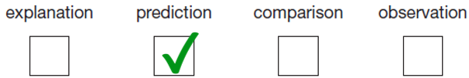
Newbald Primary School Science Progress Assessment
Year 5/6 Science Assessment Cycle 2
Total Marks: /80
Mark Scheme
Living things & their habitats
Award ONE mark for:
Do not give credit if more than one box has been ticked.
2 Award TWO marks for describing that Dr Jenner must have infected James with smallpox and for identifying the evidence he needed to collect to show his statement was true, that James did then not develop smallpox, for example:
he gave James smallpox but James did not get ill
he infected the boy with smallpox and then saw that he did not get the disease
he must have infected James with smallpox but he wouldn’t have caught it
If you are unable to award two marks, award ONE mark for identifying either what Dr Jenner must have done next or the evidence needed to show his statement was true, for example:
he tried to give James smallpox
James didn’t catch smallpox:
TWO marks may be awarded for:
he could have put James close to people with smallpox and if James didn’t get it, he would know he was right
he gave James smallpox but he stayed well [implies infected as then explains did not get ill]
ONE mark may be awarded for:
he could have put James near lots of people with smallpox to see if he got it
he gave James smallpox [assumes means infected]
Do not give credit for an insufficient response that does not indicate smallpox, for example:
he infected him but James didn’t get it
he didn’t get ill

Slide 2
3. Award ONE mark for indicating he needed to do the experiment again to improve the reliability of the results/test/conclusion, for example:
to make his results/test (more) reliable
to check/make sure of his (first set of) results
to get more evidence
to collect more data
to make sure his prediction/conclusion was correct/right
Award ONE mark for indicating that people respond differently:
because people may be different (and have different results)
ONE mark may be awarded for a response indicating the results can be compared or will be more accurate:
to see/make sure if the results were the same
to see if they were similar to his first results
to see if the results followed the same pattern
so he can compare his results
to make sure his results were accurate
to improve the accuracy (of the test)
ONE mark may be awarded for a response indicating an error may have inadvertently been made (rather than there being a fault in the test design), for example:
he might have done something wrong the first time
in case he got an odd result
to make sure his result was not a mistake
Do not give credit for a response that includes incorrect science:
to make the test fair
Do not give credit for an insufficient response implying there is a correct answer/results, for example:
to get the correct/right answer/results
to make sure he has got it right
to see/check if the results/answers are correct/right
Do not give credit for an insufficient response, for example:
to check it
to see if he gets it/the test right
4. Award ONE mark for: 98

Slide 3
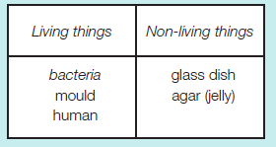
5. Award ONE mark for identifying that there are discrepancies that do not fit the pattern (that younger people were more likely to die)
or that you would need more evidence of ages not given in the table to be sure of the pattern
or that you would need to know how many people were in the total population for each age:
more people died at 20 years than 10 years
you only know what happens at every ten years
the number that died at 70 and 80 may be less because not many people lived that long then
ONE mark may be awarded for:
at 60 years it is higher than at 50
fewer people die at 10 than at 20 years
Do not give credit for an insufficient response, for example:
50 years is too low [no comparison with an older age to demonstrate that it doesn't fit the pattern]
Do not give credit for an insufficient response that just repeats data from the table with no interpretation:
240 people died at 20 years
6. Award ONE mark for:
Accept:
dish
glass
agar
jelly
Do not give credit if one thing has been placed in both columns.
7. Award ONE mark for a life process other than ‘growing’:
reproduction
movement
nutrition
✥ Award ONE mark for a correct response that goes beyond the key stage 2 programme of study:
excretion
respiration
Sensitivity
ONE mark may be awarded for:
reproducing
moving
ONE mark may be awarded for a correct response that goes beyond the key stage 2 programme of study:
excreting
Respiring
Do not give credit for an insufficient response describing a life process, for example:
having babies
eating
getting rid of waste
breathing

Slide 4
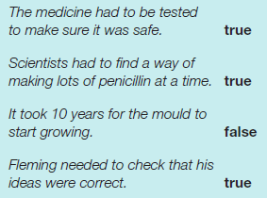
8. Award ONE mark for recognising that there are less bacteria in the second dish when the mould has grown or that the mould must be killing or stopping the bacteria from growing, for example:
the mould has killed the bacteria
the mould has stopped the bacteria growing
the medicine/penicillin kills the bacteria [referring to mould as medicine as indicated later in the question]
fewer groups of bacteria are in the dish with the mould
fewer bacteria on day 6
no bacteria are near the mould on day 6
ONE mark may be awarded for:
there are no bacteria around the mould
fewer bacteria have grown in the dish with mould
ONE mark may be awarded for a response that does not refer to the second dish (day 6) with the mould:
there are less bacteria in the dish
fewer bacteria are growing
Do not give credit for an insufficient response that implies the bacteria has moved away from the mould or that does not make it clear that the mould must be killing/stopping growth of the bacteria in some way, for example:
the bacteria stays away from the mould
the bacteria went away
the mould made the bacteria disappear
the mould took away some bacteria
Do not give credit for a response that includes incorrect science implying the bacteria ate the mould.
9. Award TWO marks for all correctly identified:
If TWO marks cannot be awarded, award ONE mark for any three statements correctly identified as true or false.
10. Give two different ways that these animals could be sorted into two groups:
1 mark each for any two from the following areas:
• Wings/no wings
• Classes based on number of legs
• Insects/not insects
• Come from eggs/not
• Classes based on taxonomy categories
Accept errors in spelling where the intention is clear.
Also accept any reasonable and successful categories for sorting not listed.

Slide 5
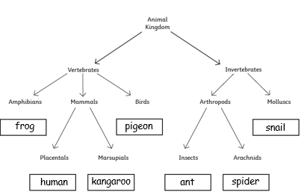
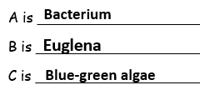

11. Award TWO marks for all correctly identified:
If TWO marks cannot be awarded, award ONE mark for any four animals correctly placed.
12. Award ONE marks for: human
Accept: Placentals or Placental Mammals
13. Award ONE marks for any reasonable and successful question or classification that sorts Human and Fox into 2 groups eg:
Does the animal have 2 legs?
Does the animal have fur over its body?
Does the animal usually wear clothes?
Do not accept similarities that would not separate the animals or incorrect science eg:
Is the animal an omnivore (both)
Is the animal a carnivore (neither)
Does the animal have a pointed nose (both)
14. Award ONE marks for all identified correctly:
15. Award ONE mark for: (Sweet) chestnut
16. Award ONE mark for:
Do not give credit if more than one box has been ticked.

Slide 6
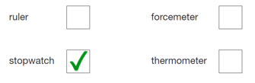

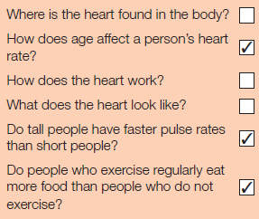
Animals Including Humans
17. Award ONE mark for all three sentences completed correctly:
The heart pumps blood around the body.
The vessels carry blood around the body.
The ribs protect the heart.
18. Award ONE mark for:
Do not give credit if more than one box is ticked.
19. Award ONE mark for all three statements classified correctly:
Different types of exercise can affect pulse rate by different amounts. True
Different people can have different resting pulse rates. True
A high pulse rate means the heart is beating fast. True
20. Award ONE mark for:
Do not give credit if more than one box is ticked.
21. Award ONE mark for both pulse rates within the acceptable ranges:
After running for 10 minutes:
95–190 (inclusive).
After resting for 20 minutes:
90
ONE mark may be awarded for the correct accepted range given in ‘after running for 10 minutes’ and for:
After resting for 20 minutes:
85–95 (inclusive) [95 may not be accepted if given as the 'after running' rate].
Do not give credit for a response that includes incorrect science in which the ‘after resting’ rate given is the same or greater than the ‘after running’ rate.
22. Award TWO marks for the correct three questions ticked:
If you are unable to award two marks, ONE mark may be awarded for any two questions correctly ticked.
(Deduct one mark for each incorrect question ticked.)

Slide 7
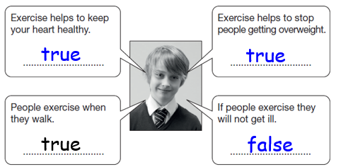
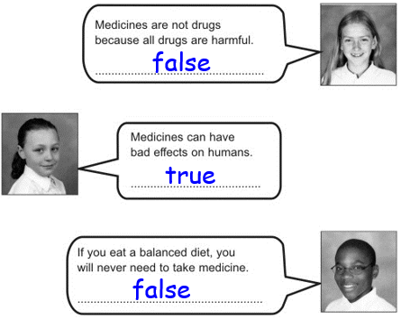
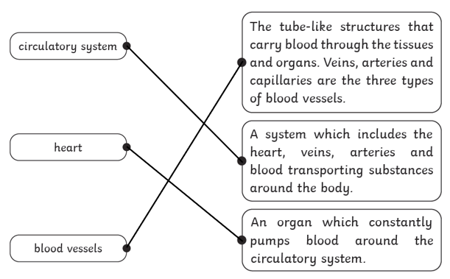
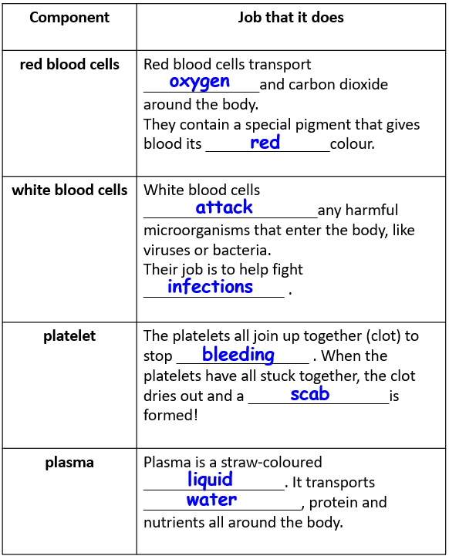
23. Award ONE marks for all three responses correctly identified:
24. Award ONE marks for all three responses correctly identified:
25. Award ONE mark for both responses correct [in either order]:
• B and C.
26. Award ONE mark for all three correctly identified:
27. Award TWO mark for all 4 sections correct and all 8 words correctly placed.
If Two marks cannot be awarded, award ONE mark for 2 or 3 sections correctly identified.

Slide 8
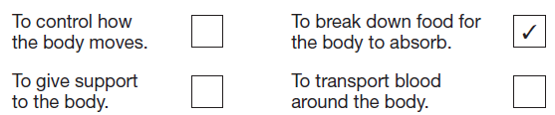
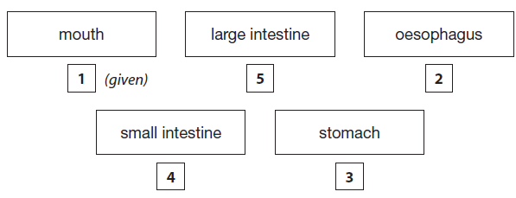
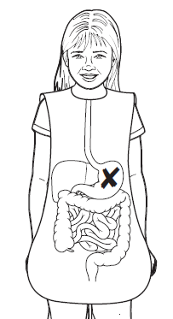
28. Award ONE mark for:
29. Award ONE mark for the correct numbers written in each box to show the correct path through the parts of the digestive system:
30. Award ONE mark for the centre of a cross placed anywhere on the stomach:
ONE mark may be awarded if a cross has not be drawn but the stomach is unambiguously identified.
31. Award ONE mark for responses correctly completing both sentences:
Water and nutrients pass from the small intestine into the blood.
They are then transported around the body by the circulatory system.
ONE mark may be awarded for referring to the circulatory system or the blood system in both sentences:
Water and nutrients pass from the small intestine into the circulatory system.
They are then transported around the body by the circulatory system.
32. Award ONE mark for any two acceptable reasons given for how exercise can help keep our bodies functioning well, eg:
it makes our hearts stronger
it makes our muscles stronger
it can help reduce the risk of heart disease
it can reduce stress/make you feel happier
it can help you lose weight (if you need to)
it can help increase your energy levels
it can help you concentrate better.
Give credit for responses that go beyond key stage 2:
it can reduce the risk of cancer
it can reduce blood pressure (if you suffer from high blood pressure)
it can improve your immune system.
Do not give credit for an insufficient response stating that exercise helps keep you fit but gives no reason why this helps your body.
Do not give credit for a second response that is a repetition or restatement of the first.

Slide 9
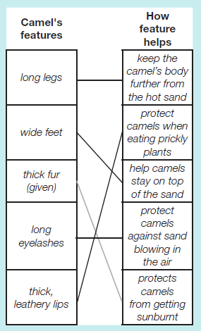
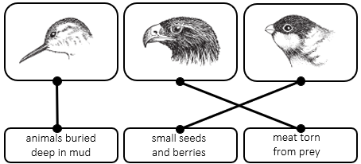
Evolution and Inheritance
33. Award TWO marks for:
If TWO marks cannot be awarded, award ONE mark for any two correct lines drawn.
Do not give credit if more than one line is drawn from each camel’s feature.
34. Award ONE mark for a response identifying a feature and describing how it helps the squirrel to live in a tree, for example:
(bushy) tail; it helps to keep balance
claws/long fingers and toes; to grip onto the branches/climb trees
(sharp) teeth; to eat nuts/seeds/fruits growing on trees
ONE mark may be awarded if the feature is given within the description, for example:
feet; clawing feet grasp the tree for climbing
Do not give credit for an insufficient response indicating hands or feet grip the tree, for example:
hands/feet; grip tree/branches
Do not give credit for an insufficient response, for example:
fur; keeps them warm in winter [this is not specifically needed for tree living]
brown fur; for camouflage
good climber; helps it escape from predators/eat nuts
eat nuts/seeds; these grow in trees
hands/feet; climb/hold nuts
claws; for keeping balance
Do not give credit for identifying a feature without an explanation / insufficient explanation.
35. Award ONE mark for all three correctly identified.

Slide 10
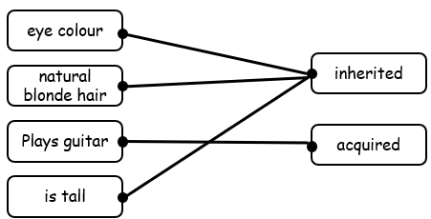
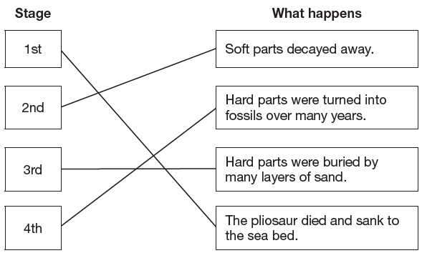
36. Award ONE mark for all three correctly identified.
37. Award ONE mark for correctly naming a material, eg:
minerals
stone/rock (for fossil casts).
Give credit for responses that go beyond key stage 2 naming a sedimentary rock that may contain fossils, eg:
sandstone
mudstone.
Do not give credit for an insufficient response that does not indicate an animal has undergone fossilisation, eg:
bone
teeth.
38. Award ONE mark for correctly matching each stage to what happens during the formation of a fossil of the pliosaur:
39. Award ONE mark for an explanation that identifies that most dead animals will decay before they have a chance to be buried or that many animals do not have skeletons or hard parts that can be fossilised:
lots of animals decay before they are buried (and so cannot become preserved/fossilised)
many animals do not die in places/environments where they could be buried and fossilised (eg in lakes, shallow seas, sandy deserts)
many organisms do not possess hard parts (that are easily fossilised).
ONE mark may be awarded for:
dead animals may not get buried deep enough (to become surrounded in rock).

Slide 11
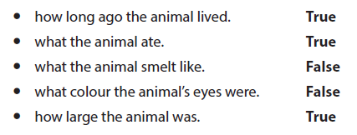
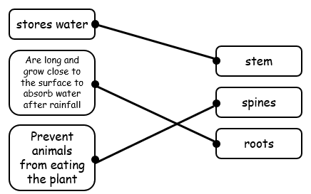
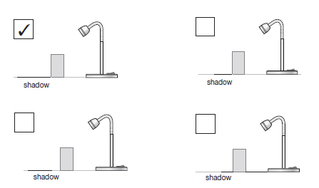
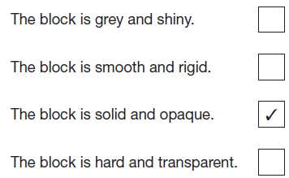
40. Award TWO marks for correctly classifying all five statements:
If you are unable to award two marks, award ONE mark for correctly classifying four of the five statements.
41. Award ONE mark for all three correctly identified:
Light
42. Award ONE mark for:
43. Award ONE mark for:
44. Award ONE mark for a response giving a general comparison describing the relationship between the two variables of distance from the lamp and length of the shadow:
the further the lamp from the block, the longer the shadow
the greater the distance the longer the shadow
the closer the lamp, the shorter the shadow.
ONE mark may be awarded for a response giving two single comparisons:
when the lamp is near, the shadow is short and when it is far, the shadow is longer.
ONE mark may be awarded for:
the further, the longer.
Do not give credit for an incorrect response that changes one or both of the variables:
the further the lamp the bigger the shadow [only looking at the dimension of length of the shadow in the table].

Slide 12
45. Award ONE mark for any credible investigation that could be done to explore shadow size using the same block and torch that clearly identifies the indepent variable, eg:
does the direction the lamp is pointing affect the shadow size?
will the shadow length change if the block is sideways or upright?
will the distance of the block from the table affect the shadow size?
how will shadow size change if I hold the block in front of a wall and move it towards the lamp?
ONE mark may be awarded for an investigation where the dependent variable is not stated [given in question stem] but the independent variable is explicit, eg:
change the angle of the lamp to the block.
Do not give credit for an insufficient response that does not indicate the independent variable, eg:
how can I make the shadow wider? [shadow size is the dependent variable and is given].
Do not give credit for an insufficient response that is ambiguous as could imply it is the distance of the lamp from the block that is being changed as in the original investigation, eg:
change the lamp position and see how big the shadow is.
46. Award ONE mark for an explanation that
jacket B reflects more light than jacket A:
■ jacket B reflects light better than
jacket A
■ jacket A is not such a good reflector
of light as jacket B.
✥ Give credit for a correct response that
goes beyond the key stage 2 programme
of study:
■ jacket A absorbs more light than
jacket B.
ONE mark may be awarded for an
absolute response:
■ jacket B reflects the light
■ it reflects (light)
■ light bounces off jacket B
■ light reflects on jacket B.
Do not give credit for a response that includes
incorrect science:
■ jacket B reflects light but jacket A does not
■ jacket B makes more light.
Do not give credit for an insufficient response:
■ light reflects onto jacket B
■ jacket B is a lighter colour
■ jacket A is darker.

Slide 13
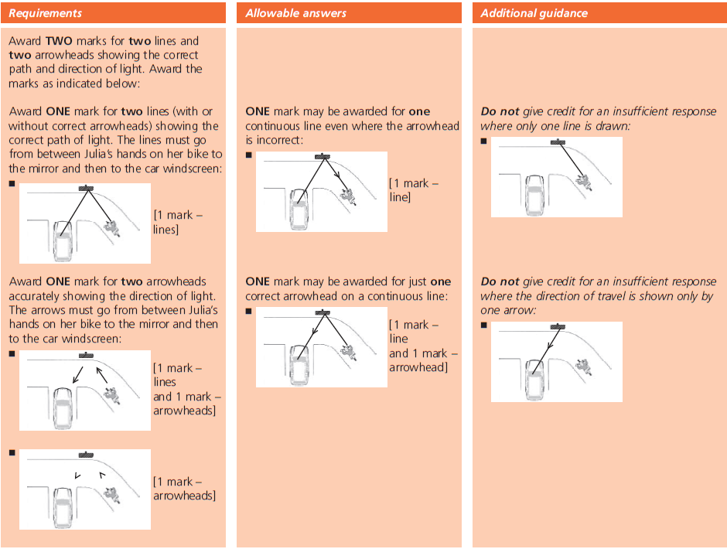
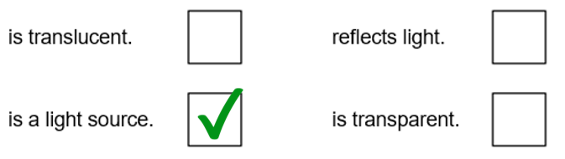
47.
48. Award ONE mark for: television.
Do not give credit for a response that includes incorrect science:
• mirror [will not cause a shadow to form in a dark room].
Do not give credit for an insufficient response naming other light sources not depicted.
49. Award ONE mark for:
50. Award ONE mark for all three sentences completed correctly:
• (i) bottle OR (tracing) paper
AND
• (ii) knife OR bottle
AND
• (iii) cork OR knife.
Do not give credit for:
• name of object used more than once.

Slide 14
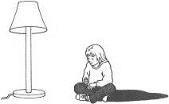
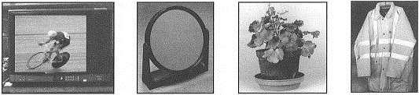
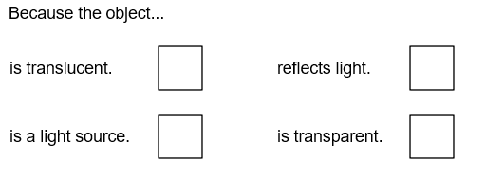
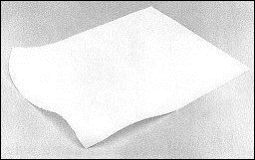
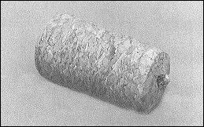
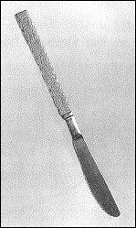
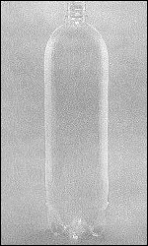
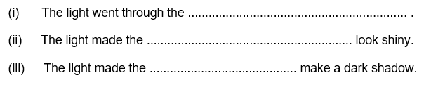
Jenny sits by a lamp. A shadow forms.
She wants to see if any other objects will cause a shadow in a dark room. She turns the lamp off. She sits in front of these objects instead of the lamp:
television
mirror
night safety
jacket
plant
48. Which ONE of these four objects will cause a shadow of Jenny in a dark room?
1 mark
49. Why does a shadow form when Jenny sits in front of this object? Tick ONE box.
1 mark
Ian shines a torch onto some objects to see what happens to the light.
tracing paper
bottle cork
metal knife
50. Write the name of ONE object to complete each of these sentences.
Only use the name of an object once.
clear
plastic bottle
1 mark

Slide 15
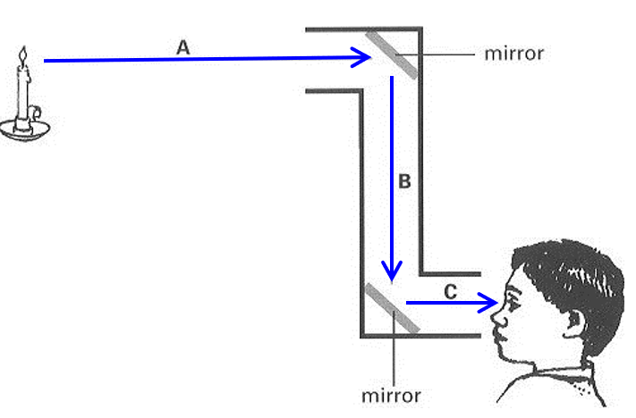
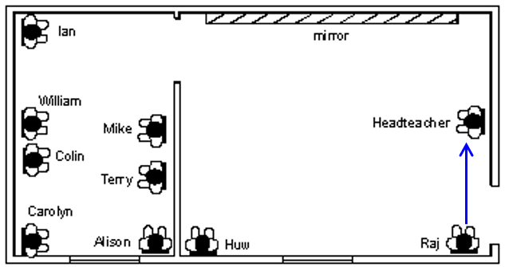
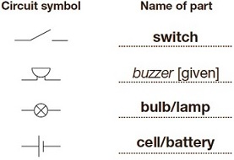
51. Award ONE mark for all three arrows drawn in the correct direction,
ONE from candle to top mirror:
AND one from top mirror to bottom mirror
AND one from bottom mirror to eye:
Allow:
lines with correct arrowheads drawn on diagram by children.
NOTE: Credit can be given if more than one arrowhead is drawn in the
correct direction on each line.
52. Line from Raj to Headteacher must indicate direction in which light travels.
An indication of light source is not required.
53. Award ONE mark for identifying both:
Colin and William
54. Award ONE mark for identifying both:
Raj and Headteacher
Electricity
55. Award TWO marks for all three symbols correctly named:
Do not give credit for any other electrical component named.
Do not give credit for insufficiently naming the bulb:
• light.
Do not give credit for insufficiently naming the switch:
• gate.
or
If you are unable to award two marks, award ONE mark for any two symbols correctly named.

Slide 16
56. Award ONE mark for an indication that the switch must be closed/the circuit is closed, e.g.
• close the switch
• check if the switch is closed
• complete/close the circuit.
ONE mark may be awarded for:
• turn the switch on
• connect the switch.
ONE mark may be awarded for referring to the name given to the switch in part (a) if incorrect/insufficient, e.g.
• close the gate [if the switch symbol was referred to as ‘gate’ in a].
Do not give credit for an insufficient response, e.g.
• check the circuit is joined up/complete [not enough to check]
• connect the circuit.
Do not give credit for an incorrect response where the switch is named incorrectly if this is not the name given to the circuit symbol in part (a), e.g.
• close the gate.
57. Award up to TWO marks for giving any two correct responses as indicated below.
Award ONE mark for a correct response that refers to adding cells/batteries or increasing the number of cells/batteries, e.g.
• add a battery.
ONE mark may be awarded for a reference to decreasing the length of wire in the circuit, e.g.
• use shorter wires.
or
Award ONE mark for a correct response that refers to reducing the number of bulbs/lamps, e.g.
• take away one/both of the lamps/bulbs.
Give credit for a correct response that goes beyond the KS2 programme of study, e.g.
• increase the voltage
• use a higher volt battery.
If you are unable to award two marks, award ONE mark for any one correct response.
Do not give credit for an insufficient response implying they will replace the battery with a bigger one, e.g.
• use a bigger battery.
Do not give credit for an insufficient response that refers to increasing the power, e.g.
• add more power.
Do not give credit for an insufficient response that contradicts the question stem, e.g.
• take away the buzzer.
Do not give credit for an insufficient response, e.g.
• make the circuit smaller.
Do not give credit for a second response that is a repetition or restatement of the first, e.g.
• 1. remove a bulb
2. remove another bulb.

Slide 17
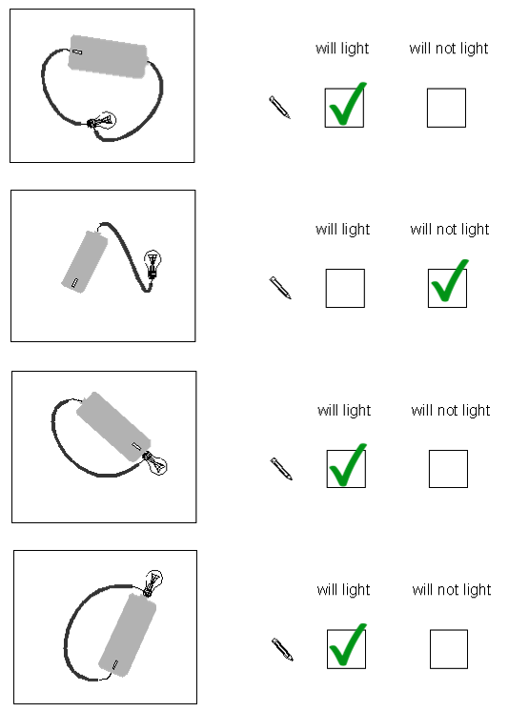

58. Award TWO marks for all four correctly identified. If two marks cannot be given, award ONE mark for three correctly identified.
Do not give credit for a part if both boxes are ticked.
Accept any mark other than a tick provided the child’s intention is clear.
59. Award TWO marks for generalisations (consistent with the data)
about the relationship between the two variables of wire length and bulb
brightness, which use TWO comparatives:
• the longer the wire, the dimmer the light;
• the shorter the wire, the brighter the light.
Allow (for ONE or TWO marks):
• reference to the distance electricity travels (instead of the length of wire);
• reference to a ‘smaller’ wire (instead of shorter).
or
If you are unable to award these TWO marks, use the following requirements
to check if the response should be awarded ONE mark.
Award ONE mark for describing the brightness for only one length of wire:
• when the wire is long, the light is dim;
• when the wire is short, the light is bright.
Do not give credit for:
• reference to electricity being ‘used up’
[energy is always conserved];
• reference to speed of travel.
‘electricity takes longer to go further’;
• reference to ‘power’.
60. Award ONE mark for:

Slide 18
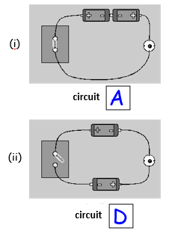
61. Award TWO marks for both correctly identified.
If two marks cannot be awarded, award ONE mark for one circuit correctly identified
62. (i) Award ONE mark for:
• the batteries are not in the circuit correctly
• one of the batteries is the wrong way round
Give credit for:
• use of the word cell in place of battery
• there is no electricity/electric current flowing.
Do not give credit for:
• it is not turned on;
• it is not connected;
• it is not being used;
• the circuit is wrong.
62. (ii) Award ONE mark for:
• the switch is not closed;
• the paper clip is not touching the drawing pin.
Give credit for:
• there is a gap;
• there is a break in the circuit;
• there is no electricity/electric current flowing.
Do not give credit for:
• it is not turned on;
• it is not connected;
• it is not being used;
• the circuit is wrong.
63. Award ONE mark for an awareness of the insulating property
of plastic:
• plastic (it) does not conduct electricity;
• it is an insulator/not a conductor;
• electricity will not pass/go/travel through plastic
Do not give credit for:
• so you do not get a shock [given in question].
64. Award ONE mark for:
• the water might conduct electricity to the body*;
• you might get a shock;
• you could be electrocuted.
Allow:
• there would be a short circuit.
NOTE:
Water is not a good conductor of electricity but it is a better conductor than air.
Do not give credit for:
• Water and electricity do not mix;
• You could die;
• it is dangerous [given in question].

Slide 19
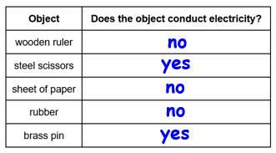



65. Award TWO marks for all correctly identified.
If two marks cannot be awarded, award ONE mark for 4 correctly identified.
66. Award ONE mark for an identification of a fault in the electrical circuit:
• both wires are attached to the + terminal/one side/end/part of the battery;
• it is not a complete circuit.
Allow:
• one wire should be attached to each end (of the battery).
Do not give credit for:
• it is connected wrongly [imprecise].
67. Award ONE mark for a drawn circuit which includes all three symbols as given
in the question (in any order):
Allow:
[non-rectilinear circuits] or [parallel circuits, although this is beyond Key Stage 2]

