Slide 1




Newbald Primary School
Science Progress Assessment
Year 5/6 Science Assessment Cycle 1
Name:
Year Group:
Date:
Living things & their habitats:
Score: /14
Animals, including humans
Score: /5
Properties and Changes of Materials:
Score: /19
Earth and Space:
Score: /15
Forces
Score: /22
Total:
Score: /75

Slide 2
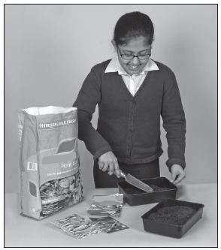
Newbald Primary School Science Progress Assessment
Year 5/6 Science Assessment Cycle 1
Name: Year Group: Date:
Living things & their habitats
Score: /14
Germinating seeds
Mary wants to find out if some types of seed germinate more quickly than others. Mary plants her seeds in seed trays.
1. Name the ONE variable Mary is changing in her investigation.
1 mark
Mugabi needs to make sure her investigation is fair.
2. Name TWO things (constants) Mary should keep the same to make her investigation fair.
i
ii
1 mark

Slide 3
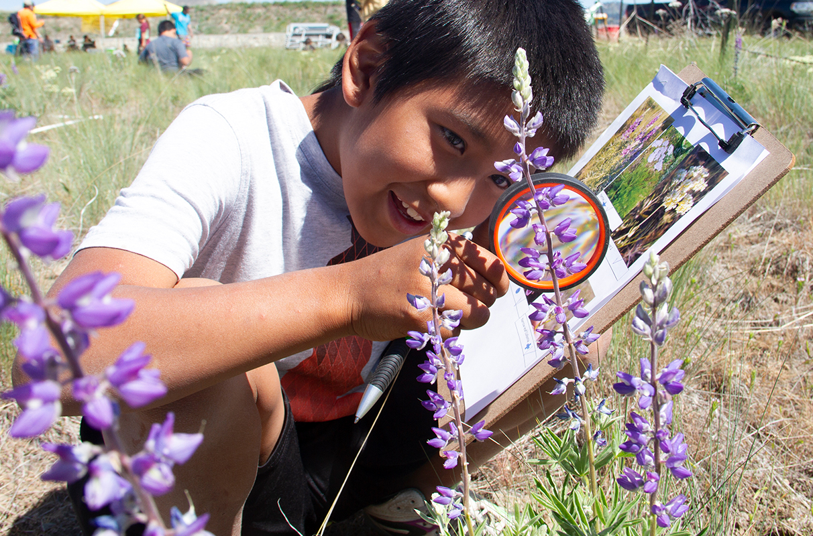
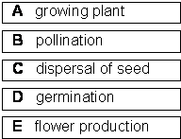
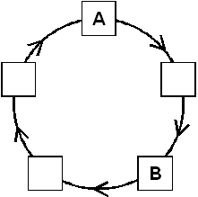
Plant Life Cycle
These stages in the life cycle of a flowering plant are not in the right order.
3. Complete the life cycle in the right order. Put the letter showing each stage in the correct box. Two have been done for you.
1 mark
4. Why are some wild flowers highly scented with brightly coloured petals?
1 mark
5. Some flowering plants are wind pollinated. For these plants, what does the wind carry from one flower to another?
1 mark
6. Explain what these parts do to help plants to grow well.
(i) Roots:
1 mark
(ii) Leaves:
1 mark

Slide 4
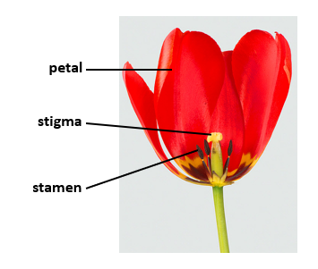
Describe what the parts of the flower do in the life cycle of the plant.
7. The petal
1 mark
8. The stamen
1 mark
9. The stigma
1 mark

Slide 5
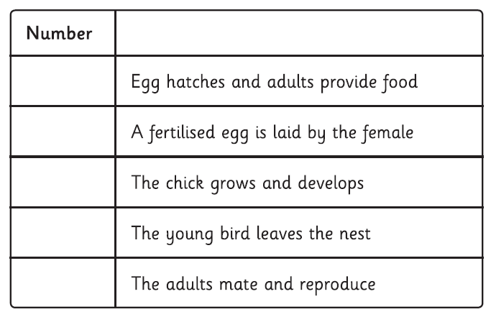
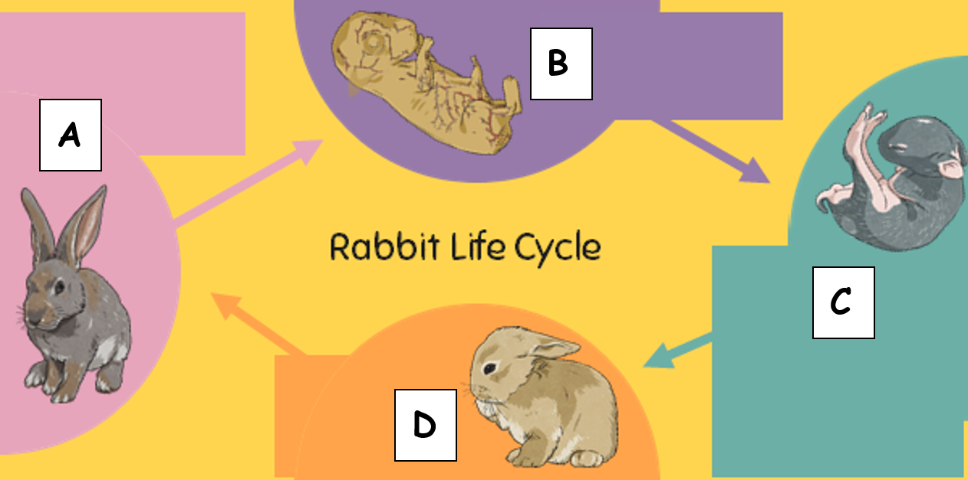
10. Number these stages 1-5 to order a life cycle of a bird. One has been done for you.
1 mark
Here is the life cycle of a rabbit.
11. Write the letters A, B, C and D to match the illustrations of the life cycle of the rabbit with the correct description of each stage.
Adolescent
The young rabbit grows and develops.
Adult
The adult male rabbit will mate with an adult female rabbit and reproduce.
Kitten (baby rabbit)
The kitten drinks milk from the female. As it grows, it develops fur and starts to eat solid food.
Embryo
The embryo grows inside the female rabbit.
1 mark

Slide 6
A rabbit is a mammal. Look again at the life cycles of a bird and a rabbit.
12. Give one similarity between the life cycle of a rabbits and the life cycle of a bird.
1 mark
13. Give one difference between the life cycle of a rabbit and the life cycle of a bird.
1 mark

Slide 7
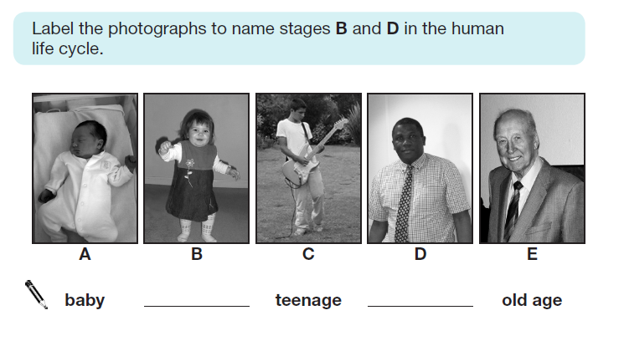
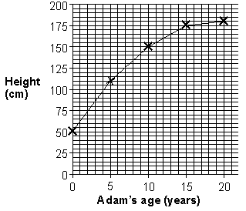
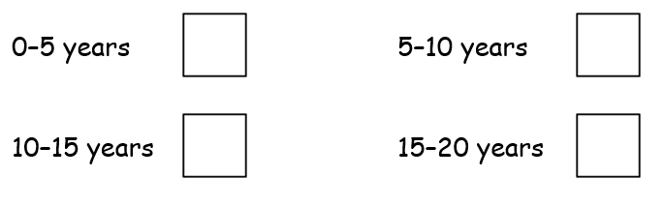
Animals, Including Humans
Score: /5
14. Adam is learning about the human life cycle.
He collects pictures of people of different ages
1 mark
The graph below shows how Adam has grown in height.
15. Look at the graph. How tall was Adam on his fifth birthday?
................................... cm
1 mark
16. Look at the graph. Tick ONE box to show when Adam grew most quickly in height.
1 mark

Slide 8
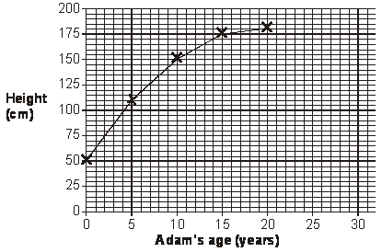
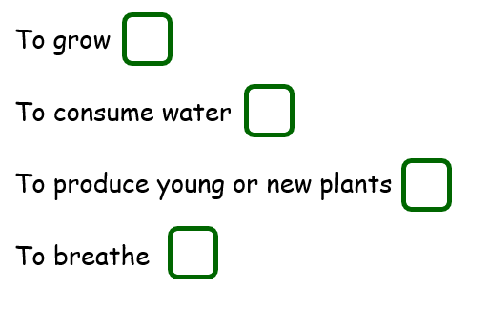
17. Continue the line on the graph below to predict Adam’s height between 20 and 30 years old.
1 mark
18. Animals and plants reproduce.
Tick the most appropriate definition:
1 mark

Slide 9
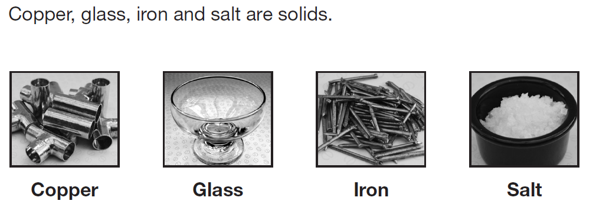
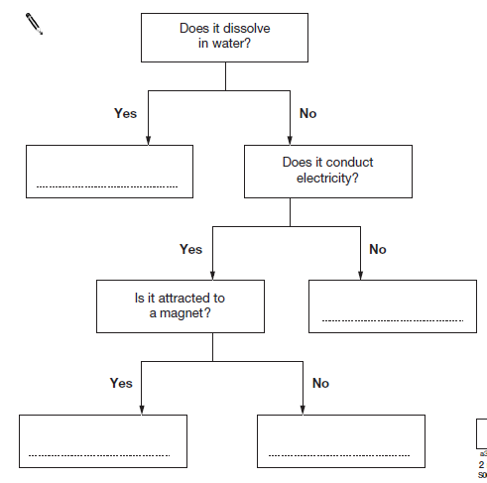
Properties and Changes of Materials
Score: /19
19. Complete the flow chart with the names of these four solids. Write the names on the dotted lines.
2 marks

Slide 10
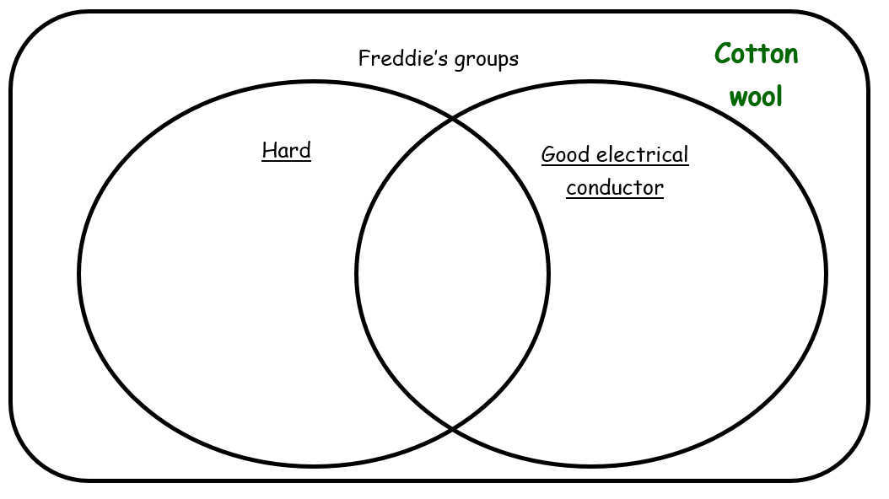
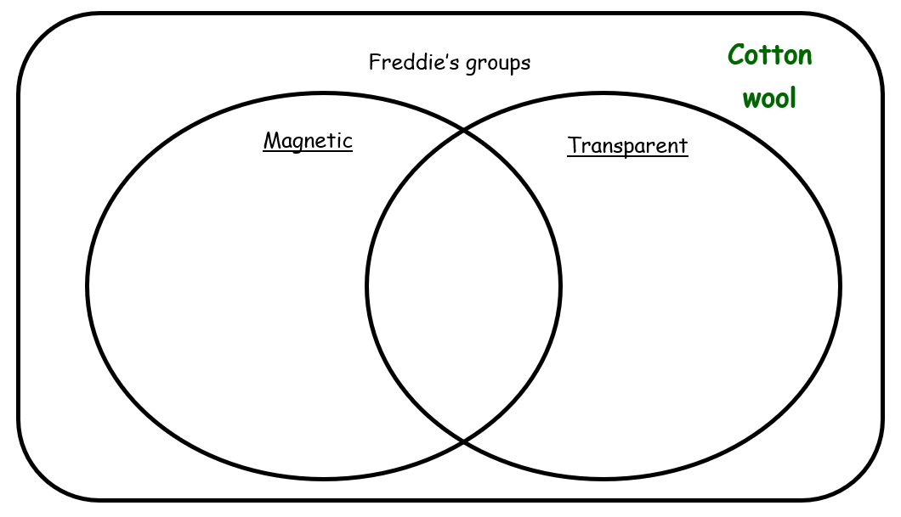
Freddie collects these objects made from different materials.
wooden spoon
cotton wool
leather wallet
steel fork
glass cup
Freddie groups his materials in a diagram to help him sort them by their properties.
20. Write the materials in the correct places on the diagram below. One has been done for you
1 mark
21. He groups them again. Write all the materials in the correct places on the new sorting diagram. One has been done for you
1 mark

Slide 11
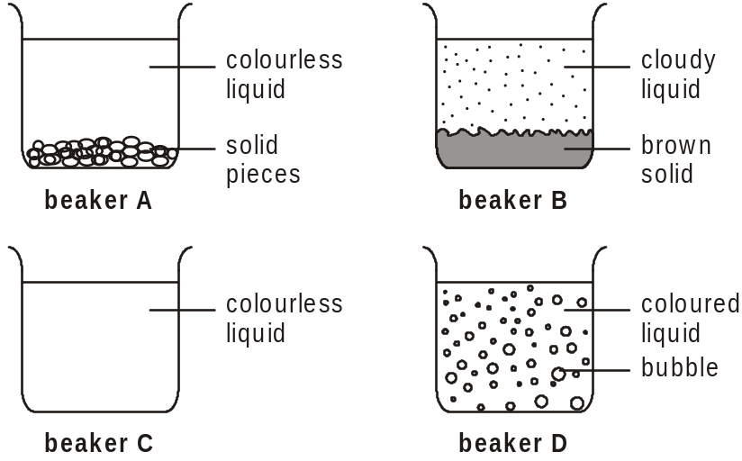
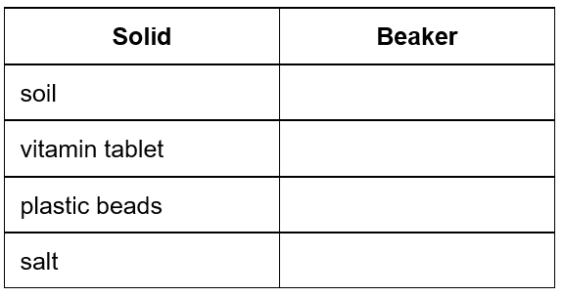
Adding water
Safara wants to find out what happens when solids are mixed with water.
She adds water to four different solids and stirs the mixtures. After 20 minutes she draws pictures of her results.
The table below names the four solids that Safara mixed with water.
Which solid was in each beaker?
22. Write A, B, C or D to complete each row of the table.
1 mark
23. Explain what happened to the solid in beaker C.
1 mark
24. In which beaker was there a non-reversible change?
Beaker
1 mark

Slide 12
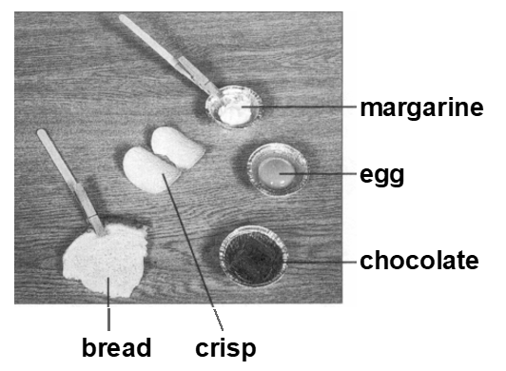
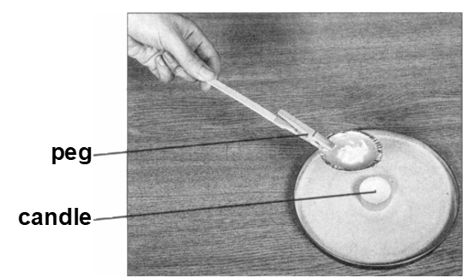
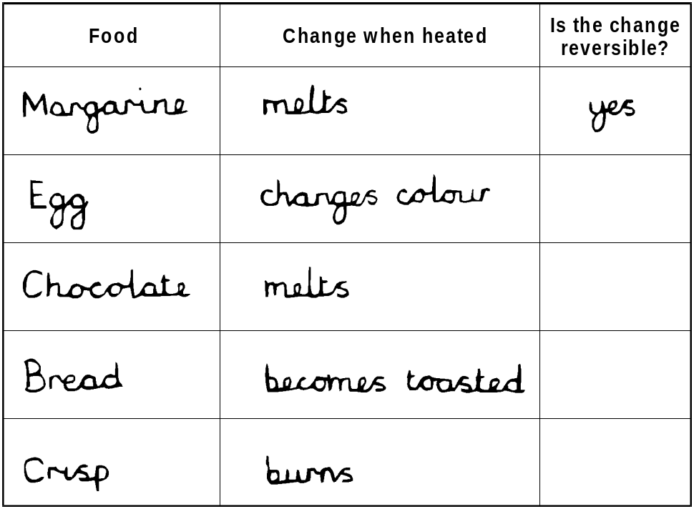
Heating and Cooling
Some children want to see how food changes when it is heated and cooled. They have five different kinds of food.
They use a small candle to heat each kind of food, then leave each to cool.
25. Complete this table. Write yes or no in each box.
2 marks

Slide 13
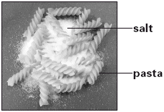
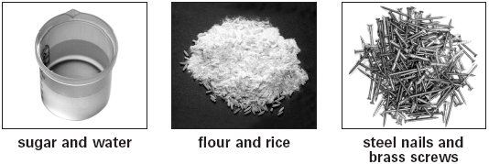
Some children are investigating separating mixtures.
Josh wants to separate a mixture of salt and dry pasta. He decides to use a sieve.
26. What feature of the salt and pasta allows Josh to separate them with a sieve?
1 mark
Josh then wants to separate a mixture of steel nails and brass screws.
Josh wants to separate a mixture of steel nails and brass screws.
27 What item could Josh use to help him separate the steel nails from the brass screws?
1 mark
28. Explain how the item helps in separating the steel nails from the brass screws.
1 mark

Slide 14
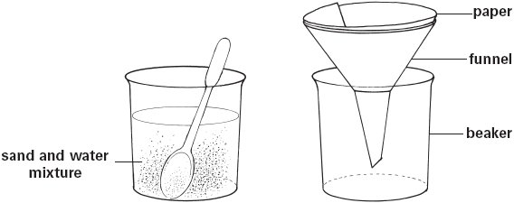
Hannah mixes sand and water together. The mixture can be separated using the equipment below.
29. What name is given to this method of separating?
1 mark
30. Explain why sand can be separated from water using this method.
1 mark
Hannah mixes sugar and water together. The sugar dissolves in the water.
31. Tick ONE box to choose the most suitable word that describes this mixture?
evaporation
solution
condensation
precipitation
32. Explain how Hannah can separate the mixture of the sugar and water.
1 mark

Slide 15

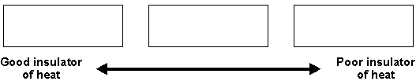
Some children want to find out which material keeps a drink hottest. They fill three cups with hot water.
They measure the temperature of the water. It is the same in each cup.
metal cup
polystyrene cup
plastic cup
33. What equipment do they use to measure the temperature of the water?
1 mark
They leave all the cups in the same place to cool.
34. What else must the children keep the same for their test to be fair?
Tick TWO boxes.
The size of each cup.
The final temperature of the water.
The material used to make the cups.
The volume of hot water in each cup.
1 mark
They measure the temperature again after 20 minutes. In their test, the polystyrene cup keeps the water hottest.
35. Write metal, polystyrene and plastic in the correct order in the boxes below, to show how well each insulates heat.
1 mark
Using a polystyrene container or cup is a good way to help stop heat leaving a drink.
36. Describe another way the children help stop heat leaving their drink to keep it hot for longer.
1 mark

Slide 16
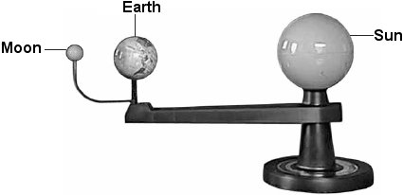
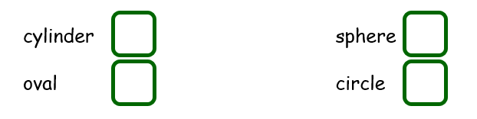
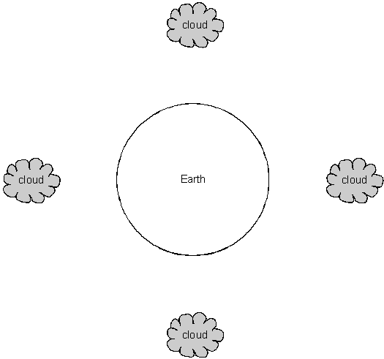
Earth and Space
Score: /15
The picture shows a model of the Earth, Moon and Sun.
37. Tick ONE box to show the shape of the Earth, Moon and Sun in space.
1 mark
38. Complete the sentences below by writing Earth, Moon or Sun.
The ___________________ is a source of light and is a star.
The ___________________ is a celestial body and has an orbit of 28 days.
The ___________________ orbits the sun and takes 24 hours to spin on its axis.
1 mark
39. Draw an arrow from each cloud to show the direction of gravity acting on the rain.
1 mark

Slide 17
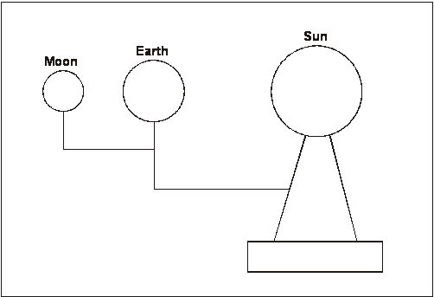
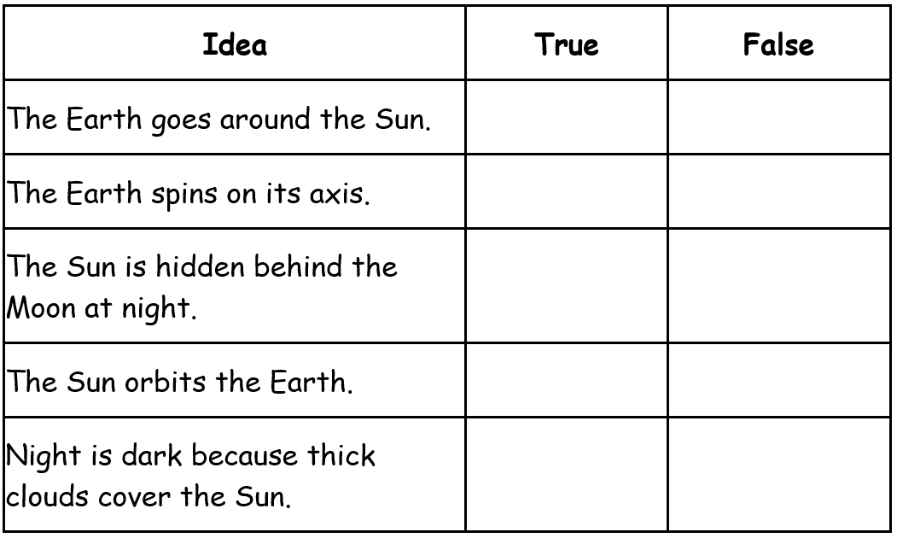
The diagram below shows the model of the Earth, Moon and Sun.
40. On the diagram, shade in the part of the Earth where it is night.
41. Describe how the Earth moves to cause day and night.
1 mark
42. Tick ONE box in each row on the table below to say whether
each idea is true or false.
2 marks

Slide 18
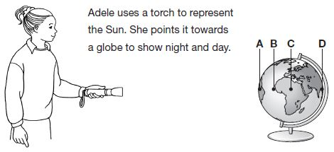
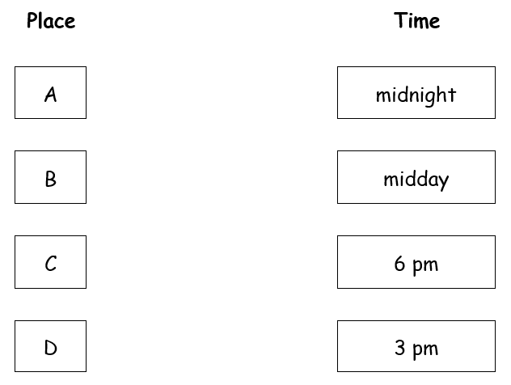
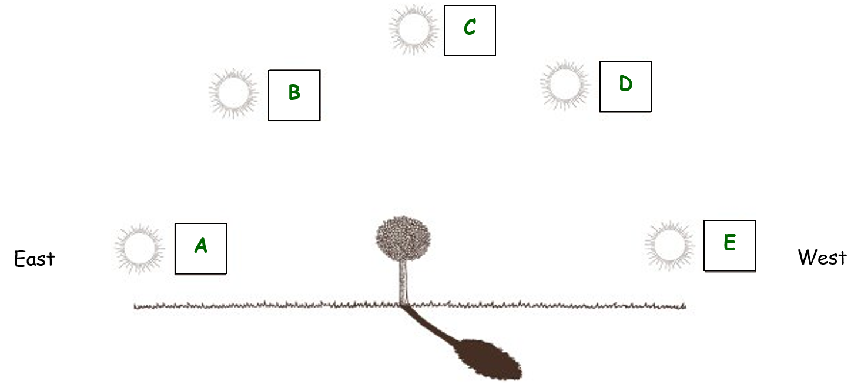
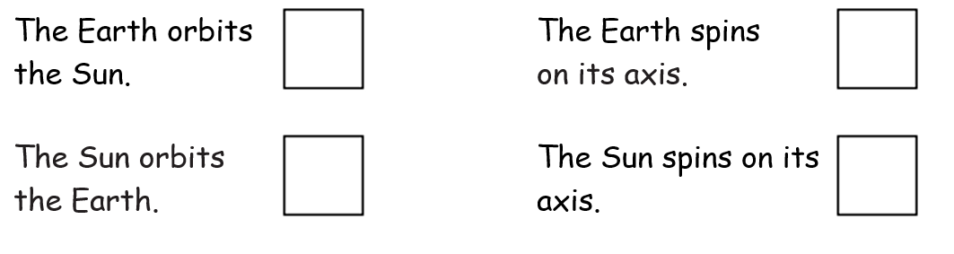
Adele’s class is learning about space.
43. Draw FOUR lines below to show what time it would be at each place on the globe.
1 mark
Adele looks at a tree on a sunny day.
44. Write A, B, C, D or E to best describe the position of the sun for the following situations.
At midday ________________
In the evening ______________
To cast the shadow shown in the diagram
________________
Early morning ________________
1 mark
Adelle looks at the shadow of the tree at different times of the day. He observes that the shadow is in a different position each time. The position of the shadow changes because the Sun appears to move across the sky.
45. Tick One box to explain why the Sun appears to move across the sky each day.
1 mark

Slide 19
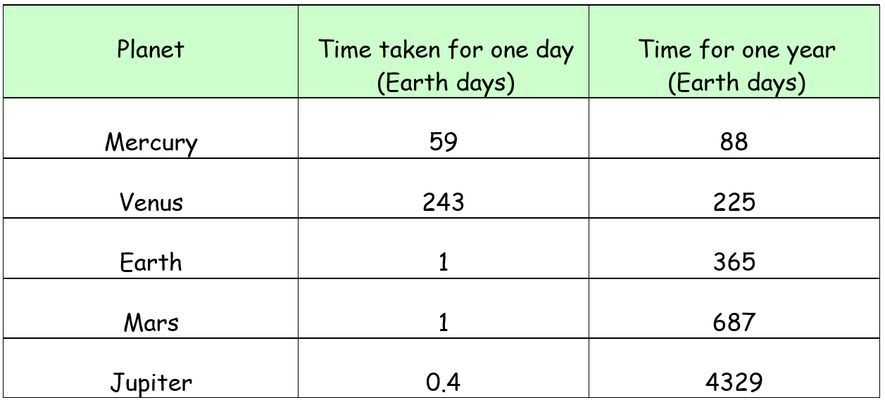
Joe finds out that days and years take different amounts of time on different planets.
46. Look at the table. Which planet has the shortest day?
1 mark
47. Which planet orbits the sun quickest?
1 mark
48. Look again at the table. Do planets with shorter days have shorter years? Use the information in the table to explain your answer.
1 mark
49. Name the force that causes the Earth to orbit the Sun.
1 mark
50. Name the equipment that scientists use to see into space.
1 mark
51. There are 8 planets in the solar system. Name the 3 planets not listed in the table above.
1 mark

Slide 20
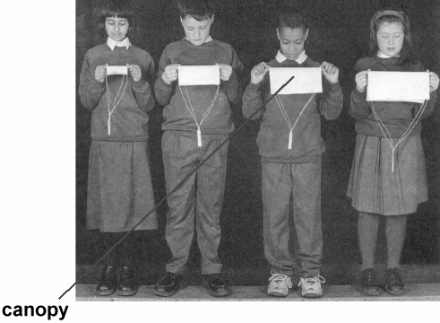
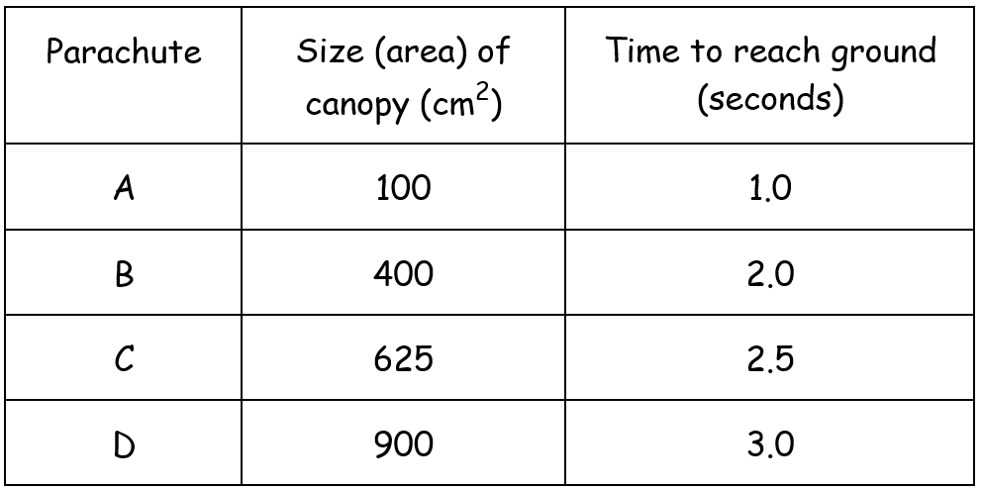
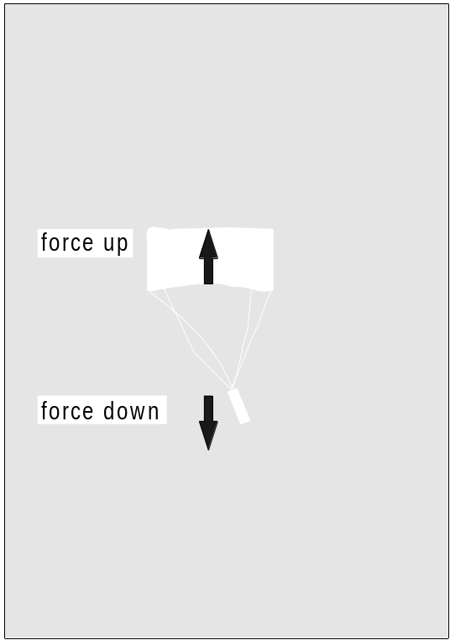
Forces
Score: /22
Parachutes
Some children make four paper parachutes. Each parachute has a different sized canopy.
They drop each parachute from the same height.
They measure how long it takes each parachute to reach the ground.
Here is a table of their results.
52. Which parachute took the longest time to reach the ground?
Parachute
1 mark
The picture, shows two forces acting on a parachute as it falls.
53. Write the name of the force up, on the line below.
1 mark
54. Look at the table of results. Describe how the time taken to reach the ground depends on the area of the canopy.
2 marks

Slide 21
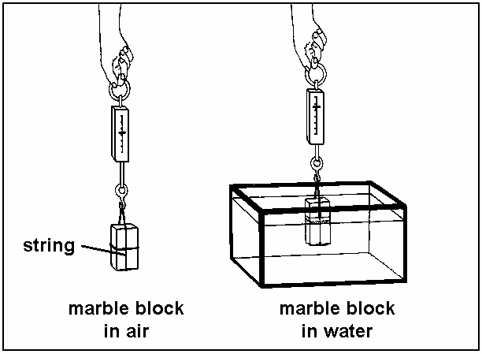
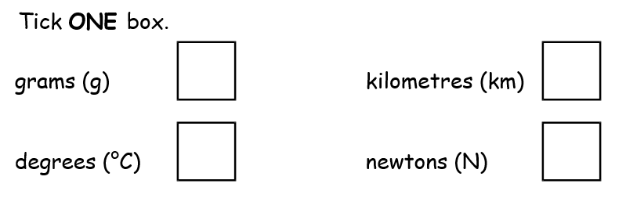
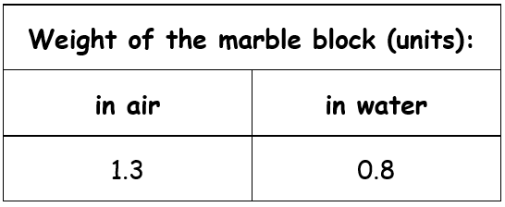
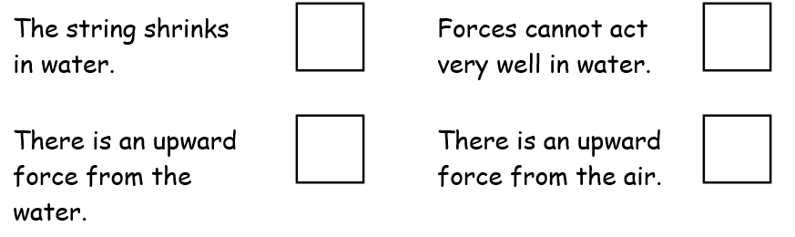
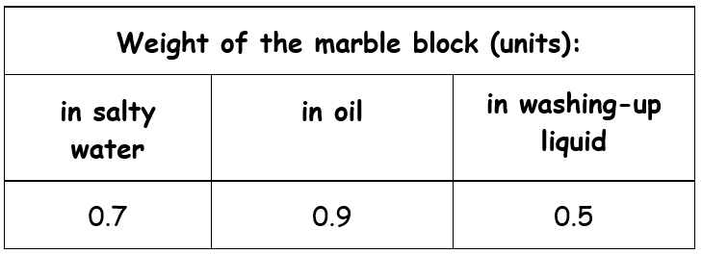
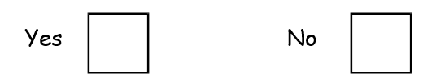
Weighing in liquids
Jerome weighs a marble block in air and in water. Weight is a force.
Look at the picture.
55. Name the equipment that Jerome uses to measure the force of weight on the block.
1 mark
56. What units does this equipment use to measure the force of weight?
1 mark
The marble block weighs less in water than in air.
57. Tick ONE box below to explain why the marble block weighs less in water.
1 mark
Jerome weighs the block in other liquids to see what happens. Here are his results.
Jerome says: ‘I think the marble block will weigh less in any liquid I try than it does in air.’
58. Do Jerome’s results suggest that his prediction is sensible?
Use Jerome’s results to explain your answer.
1 mark

Slide 22
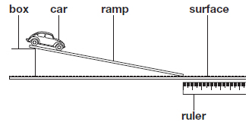
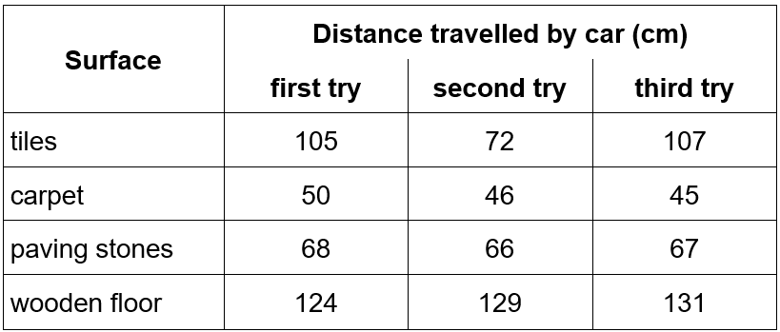
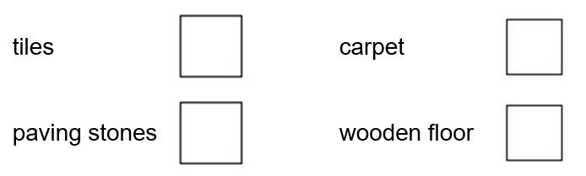
Sue rolls a car down a ramp. She investigates how far the car travels along different surfaces before friction causes the car to stop.
59. Name ONE thing Sue must keep the same (constant) to make her test fair.
1 mark
60. Name ONE thing Sue changes (Variable) in her investigation.
1 mark
Sue draws a table of the results.
Sue looks at the table.
She thinks she should test one of the surfaces again.
61. Which of these surfaces should Sue test again?
1 mark
62. Describe how the evidence in the table shows that Sue should test this surface again.
1 mark
63. Look at the table of results. Tick ONE box to show which surface caused the most friction.
1 mark

Slide 23
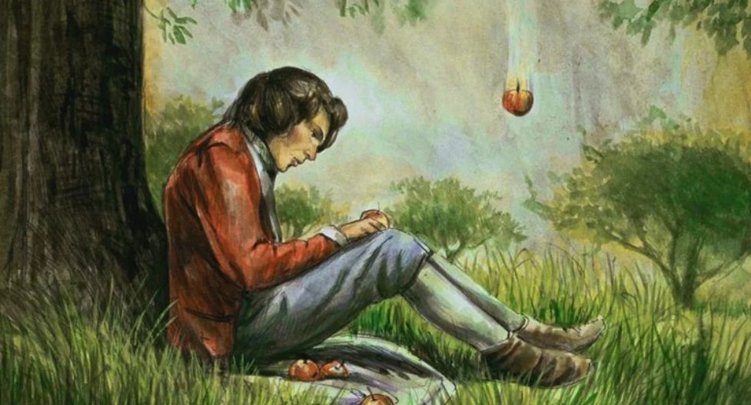
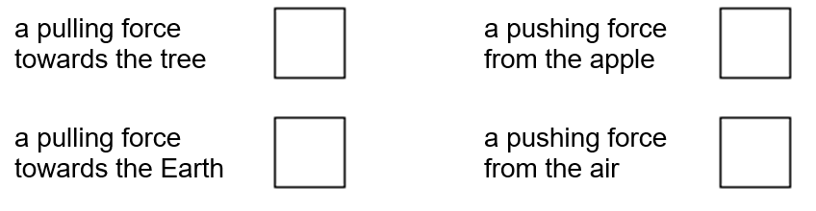
Isaac Newton was a famous scientist who was born in 1642.
There is a famous story about Newton watching an apple fall from a tree.
Newton thought a force must cause the apple to fall.
64. Tick ONE box to show which force on the apple causes it to fall down from the tree.
1 mark
Newton did different investigations to test his ideas.
65. Why was it important for Newton to test his ideas using investigations?
1 mark
66. Name the force that caused the apple to fall from the tree
1 mark

Slide 24
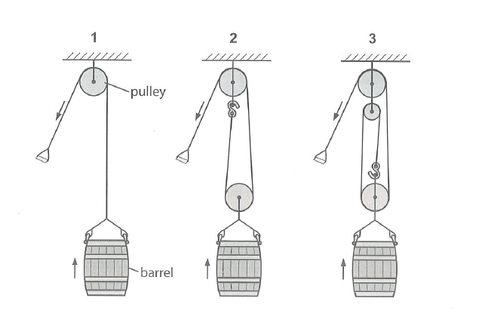


Pulleys
Albert looks at a diagram showing how pulleys can be used to lift barrels.
67. Tick true or false for each statement about pulleys:
2 marks
Friction
Friction is the force which causes moving objects to slow down and stop.
68. Tick THREE boxes to show which activities are only possible because there is a small amount of friction.
1 mark

Slide 25



A
B
C
69. Look at examples of the levers labelled A, B and C above. In which example will the least force be needed to lift the block?
1 mark
70. Look at the picture of some gears. Tick ONE statement below which best describes how turning a small gear will affect the speed of the larger gearwheel
B
Gearwheel B will turn more quickly than gearwheel A
Both gearwheels will turn at the same speed
A
Gearwheel B will turn more slowly than gearwheel A
1 mark
71. Look again at the picture of some gears. Gear wheel A is turned in a clockwise direction. Draw an arrow on gearwheel B to show the direction it will turn.
1 mark

