Slide 1

Newbald Primary School Science Progress Assessment
Year 5/6 Science Assessment Cycle 1
Total Marks: /75
Mark Scheme
Living things & their habitats
1. Award ONE mark for giving the type of seed as the independent variable (IV) /:
• the types of seed
• different seeds.
ONE mark may be awarded for:
• seeds
• (different) plants.
Do not give credit for a response that includes
incorrect science giving a control variable:
• the amount of seeds.
2. Award ONE mark for any two different acceptable control variables (CV):
• type of soil
• amount of soil
• depth seeds planted
• place where the seed trays are put
• size of seed trays
• how often she waters them
• how much water she gives each seed
• amount of light
• put all the seeds in the dark
• number/amount of seeds.
Marks may be awarded for:
• the soil
• temperature
• water
• light
• trays
• time she left them for.
Do not give credit for a response that includes
incorrect science:
• same food
• same seeds [IV]
• time [could be the dependent variable].
Do not give credit for a second CV that is a
restatement or repetition of the first.
Do not give credit for an insufficient response
giving a variable that does not affect the
investigation:
• the same person watering it.

Slide 2
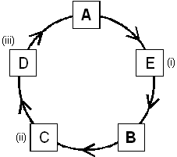
3. Award ONE marks for all identified correctly:
4. Award ONE mark for an awareness that petals are important for
attracting some animals for pollination:
• to attract insects/named insects (for pollination).
Allow:
• help them reproduce/survive;
• attracts some animals/named animals (for pollination).
Do not give credit for an indication that the particular
flower needs this to keep alive.
5. Award ONE mark for:
• pollen.
Do not give credit for:
• seeds;
• pollination.
6(i) Award ONE mark for an understanding of the function(s) of the root:
• anchor the plant;
• take in water/minerals.
Allow:
• holds the plant in place;
• obtain/collect/get/take in/absorb/ soak up moisture or nutrients.
Do not give credit for:
• they take in food;
• to balance the plant;
• support the plant [stem does this];
• produce water/nutrients;
• drink/suck water;
• helps it feed.

Slide 3
6(ii). Award ONE mark for an understanding of the importance of the leaf in
helping the plant to produce food:
• provide/give/make/produce food or sugar;
• take in light.
Allow:
• let water escape;
• take in gas/air/CO²
• store plant’s food;
• respire;
• collect/get energy from Sun/ sunlight;
• photosynthesise;
• produce/keep chlorophyll.
Do not give credit for:
• they get the Sun;
• they make energy;
• helps to feed plant;
• store water,’
• breathe;
• protect plant.
7 Award ONE mark for:
• colour attracts insects, OR
• protects plant's sex organs OR
• provides a 'platform' for insects.
Give credit for.
• it attracts animals.
Do not give credit for:
• it shades seeds from sun;
• it protects it from sun/rain;
• it smells;
• it protects buds.
8. Award ONE mark for:
• makes/contains pollen, OR
• is the male part of the plant.
Give credit for :.
• it gives off pollen.
9. Award ONE mark for:
• receives pollen, OR
• pollen sticks to it to fertilise ovules, OR
• is the female part of the plant.
Give credit for:
• it holds pollen.
Do not give credit for:
• it makes seeds from pollen;
• it holds seeds.

Slide 4
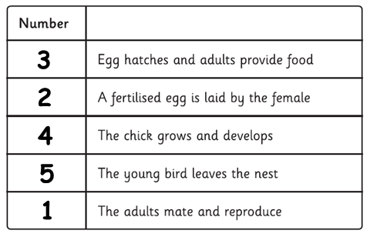
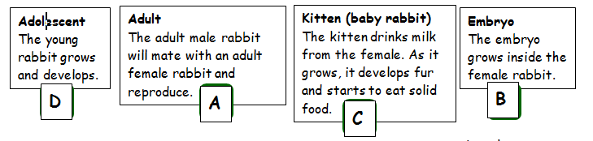
10. Award ONE mark for ALL correctly identified:
11. Award ONE mark for ALL correctly identified:
12. Award ONE mark for correctly identifying ANY similarity between the life cycles eg:
The young animal grows and develops
The adult animals mate
The embryo grows inside something
They both reproduce
Do not accept facts that are not scientifically accurate or not related to the life cycle eg:
They are both animals
They both eat
They both breathe
13. Award ONE mark for correctly identifying ANY difference between the life cycles eg:
The bird lays an egg / the bird hatches from an egg whilst the rabbit give birth to a kitten.
The kitten drinks milk from its mother
The embryo grows inside the female rabbit, but the bird grows inside the egg.
Do not accept facts that are not scientifically accurate or not related to the life cycle eg:
There are 5 stages of a bird’s life cycle and only 4 for a mammal
A bird has feathers
A bird has a beak
A rabbit eats carrots

Slide 5
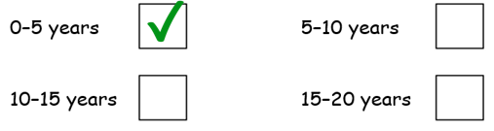
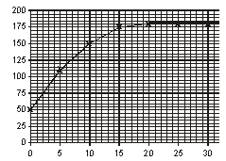
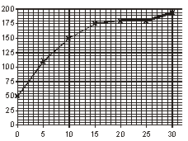
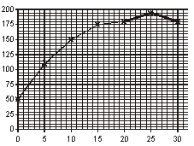
Animals, Including Humans
14. Award ONE mark for:
toddler/infant/child
AND
adult/grown-up
ONE mark may be awarded for:
middle age
grown man
Do not give credit for an insufficient response describing an adult as a parent: e.g.: dad
15. Award ONE mark for:
• 110 cm.
Allow:
• a response within the range 107–113 cm.
16. Award ONE mark for:
17. Award ONE mark for a graph line which levels off to become horizontal (points do not need to be marked on the graph at 25 and 30 years):
Allow: a response which does not decrease below 175 cm.
Do not give credit for an insufficient response where the graph line intentionally increases or decreases after becoming horizontal or forms a peak without becoming horizontal:

Slide 6
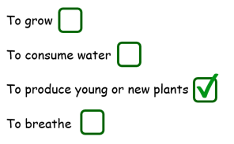
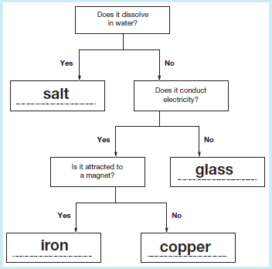
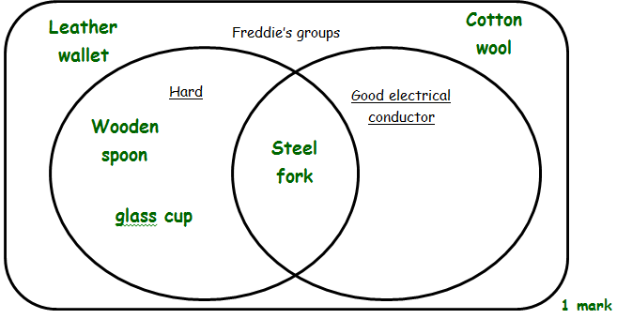
Properties and Changes of Materials
18. Award ONE mark for:
19. Award TWO marks for:
If TWO marks cannot be awarded, award ONE mark for any two materials in their correct places.
Do not give credit if more than one response is given in any one box.
20. Award ONE mark for all correctly placed as follows:
Note: Leather and cotton wool must be placed outside the Venn, but inside the curved rectangle

Slide 7
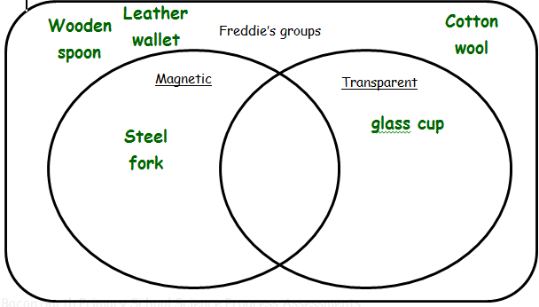
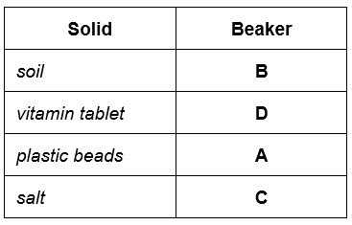
21. Award ONE mark for all correctly placed as follows:
Note: Leather, wooden spoon and cotton wool must be placed outside the Venn, but inside the curved rectangle
22. Award ONE mark for correctly completing all four rows of the table:
23. Award ONE mark for a response indicating the solid dissolved:
· salt/it dissolved;
· it formed a solution.
ONE mark may be awarded for a response stating that the vitamin tablet dissolved if the pupil has identified that the vitamin tablet is in beaker C in part a).
Do not give credit for an insufficient response that does not explain what happened to the solid:
· it disappeared.
Do not give credit for an insufficient response:
· it mixed with the water.

Slide 8
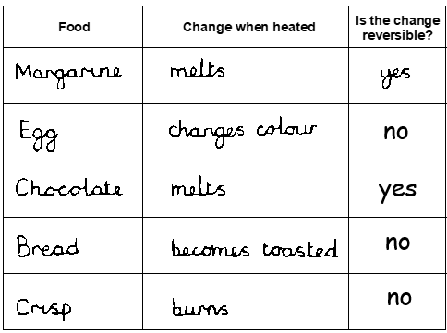
24. Award ONE mark for:
· Beaker D.
ONE mark may be awarded for:
· vitamin tablet.
25. Award TWO marks for identifying all four changes correctly:
If you are unable to award two marks, award ONE mark for any two
changes correctly identified. (not including margarine (given))
26. Award ONE mark for a response indicating that the salt and pasta are
different sizes:
• the salt is smaller than the pasta
• they are not the same size.
ONE mark may be awarded for:
• the salt is small and goes through the sieve but the
pasta does not
• the holes in the sieve are small so the salt can go
through and the pasta cannot.
Do not give credit for an insufficient response which does not compare the size of the solids:
• the salt is small (and goes through the sieve).
Do not give credit for an insufficient response identifying that the size of the material affects the separation without indicating the sizes need to be different:
• size
• the sieve lets small things through.
Do not give credit for an insufficient response:
• the salt goes through the sieve but the pasta cannot
• they are a different shape
• they are different.
27. Award ONE mark for a response identifying appropriate method of separation e.g.:
a magnet
Could be picked out using fingers

Slide 9

28. Award ONE mark for a explanation of method given e.g.
Magnet used –
Steel nails would be attracted to a magnet whilst brass screws would not
Fingers –
Steel nails and brass screws look different / feel different so they could be picked out over time
29. Award ONE mark for:
• filtering;
• filtration.
ONE mark may be awarded for:
• filter.
Do not give credit for an insufficient response:
• evaporation.
30. Award ONE mark for explaining that sand remains in the filter and/or the water passes through:
• the water goes through the filter but the sand cannot because it is too big;
• the holes in the filter paper let the water through, but the sand is too big;
• only the water can go through the filter;
• the sand stays in the filter.
ONE mark may be awarded for a response that recognises that the sand does not dissolve or that the sand has larger particles than the water (and therefore will not go through the filter with the water):
• because it does not dissolve;
• the particles of sand are larger than the particles of water.
ONE mark may be awarded for a response that describes the water evaporating to leave the sand behind.
Do not give credit for an insufficient response:
• the sand can be separated because it has large particles [no comparison with water].
31. Award ONE mark for:

Slide 10
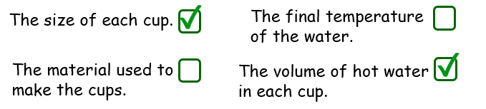


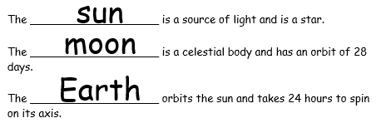
32. Award ONE mark for explaining evaporation process eg:
The water evaporates and the sugar is left in the dish
Allow
The water turns to a gas and the sugar crystals are left behind.
33. Award ONE mark for:
• thermometer.
Allow:
• an appropriate electrical/electronic device for measuring temperature:
• temperature sensor./ data logger
34. Award ONE mark for both identified with no other boxes ticked:
35. Award ONE mark for placing all three materials on the scale in
the correct order:
36. Award ONE mark for a response that increases the amount of
insulation and reduces the heat leaving her drink:
• put a lid on it;
• wrap it in another insulating material/use a mug warmer;
• put the drink in a thicker/more insulating cup;
• put the cup inside another cup;
• wrap it in foil;
• hold the cup in her hands;
• put the drink in a flask.
Earth and Space
37. Award ONE mark for:
38. Award ONE mark for all three sentences correctly completed:

Slide 11
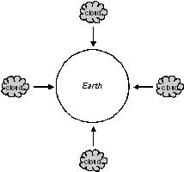


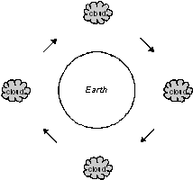
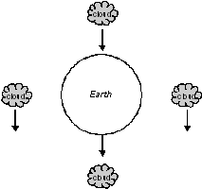

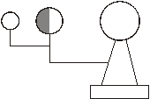
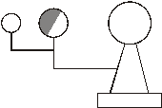
39. Award ONE mark for four arrows drawn from the clouds towards
the center of the Earth:
Allow a response in which the arrows are not drawn horizontally or vertically as long as they point from the clouds towards the Earth:
Do not give credit for a response that includes incorrect science showing any of the arrows drawn at an inappropriate angle [not the direction in which gravity acts]:
40 Award ONE mark for correct shading on the diagram to show where it is night:
Do not give credit for a response that includes incorrect science showing a shadow aligned with the Earth’s axis:
Do not give credit for a response that includes incorrect science showing shading on the Sun.
Do not give credit for an insufficient response showing shading on the Moon.

Slide 12
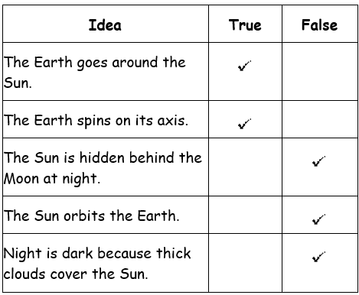
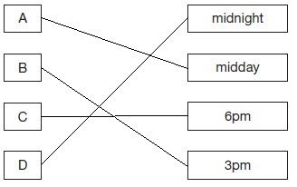

41. Award ONE mark for indicating that day and night are caused
by the spin of the Earth:
• the Earth/it is rotating (on its axis)
• the Earth spinning (on its axis)
• it spins (on its axis)
• it turns/moves on its axis.
ONE mark may be awarded for:
• it revolves.
ONE mark may be awarded for a response correctly indicating night and day are caused by the spin of the Earth, as well as describing the Earth’s orbit around the Sun:
• the Earth spins as it orbits the Sun
• the Earth turns on its axis and moves around the Sun.
Do not give credit for an insufficient response implying night and day are caused by the Earth orbiting the Sun:
• it orbits
• it turns/spins around the Sun.
Do not give credit for an insufficient response:
• it turns (around)
• the rotation [does not indicate what is rotating]
• it moves (round)
• during the day, the Earth is facing the Sun, at night the
Earth is facing away from the Sun/facing the Moon.
42. Award TWO marks for all five ideas correctly classified:
Or
If you are unable to award two marks, award ONE mark for any four
ideas correctly classified.
43. Award ONE mark for all four places matched to the correct times:
44. Award ONE mark for all four correctly identified:
At midday : C
In the evening : E
To cast the shadow shown in the diagram : B
Early morning : A

Slide 13
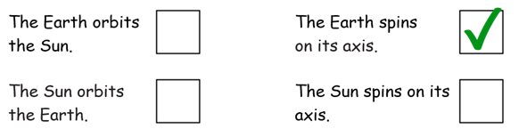
45: Award ONE mark for:
46. Award ONE mark for:
Jupiter
47. Award ONE mark for:
Mercury
48. Award ONE mark for No along with an explanation from the data to back up their theory eg: No as Jupiter has the shortest day, but has the longest year.
or
Jupiter has a day of 0.4 Earth days but a year of 4329 Earth days, whilst Mercury has a longer day of 59 Earth days and its year is much shorter than Jupiter’s as it is 88 Earth days.
Do not award a mark for No alone.
49. Award ONE mark for:
Gravity
50. Award ONE mark for:
Telescope
Also allow item showing accurate scientific knowledge.
51. Award ONE mark for identifying all three planets:
Saturn
Uranus
Neptune
Also allow misspelling
Allow in any order
Do not allow dwarf planets eg Ceres, Pluto, Haumea, Makemake, Eris

Slide 14
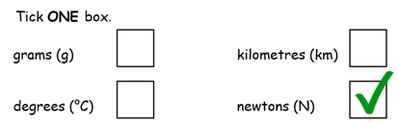
Forces
52. Award ONE mark for an unambiguous reference to the parachute that took three seconds:
parachute D.
53. Award ONE mark for:
· air resistance.
Allow:
· friction;
· drag.
Do not give credit for:
· air pressure;
· upthrust.
54. Award TWO marks for a general comparison describing the relationship
between the two variables of area and time:
· the larger the area, the more time it takes;
· the smaller the area, the less time it takes;
· the bigger the parachute, the slower it goes;
· the smaller the parachute, the faster it goes.
If you are unable to award two marks, award ONE mark for two specific
comparisons describing the relationship:
· the biggest parachute takes longest and the smallest parachute is quickest;
· a small parachute is faster and a big parachute is slower.
Award ONE mark for a single comparison of the variables:
· the biggest parachute took longest;
· a small parachute is faster.
Do not give credit for a response that changes a variable:
· the heavier the canopy, the longer it takes to fall.
55. Award ONE mark for:
· forcemeter;
· Newton meter.
Allow:
· spring balance.
Do not give credit for:
· Newton measurer.
56. Award ONE mark for:

Slide 15
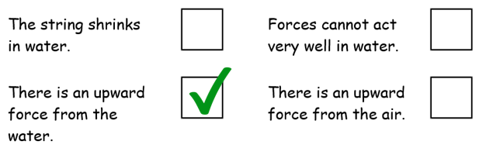
57. Award ONE mark for:
58. Award ONE mark for either of the following types of correct response:
Either: YES
And an explanation that the results achieved in liquids are lower
in comparison to that in air:
because in all the liquids he tried, the block weighed less than in air.
Allow:
if neither box is ticked, but the creditworthy explanation indicates that the pupil believes the prediction is correct, the mark may be awarded.
OR: NO
And an explanation that four liquids is an insufficient number from which to generalise to all liquids:
because he needs to try more than four liquids to be sure of his conclusion;
because he did not try enough different liquids;
because in some liquids they might weigh more than in air.
Give credit for a correct response that goes beyond the key stage 2 programme of study:
Eg: No and the weight of the block will always stay the same [because gravity is constant on Earth].
Allow:
If neither box is ticked, but the creditworthy explanation indicates that the pupil believes the prediction is incorrect, the mark may be awarded.
Do not give credit for a response that includes incorrect science:
there is an upthrust in the liquids but not in air.
Do not give credit for an insufficient response that refers to forces in air/liquids but does not refer to evidence from the investigation:
liquids have more upthrust than air;
there is more upthrust than in air;
liquids will support objects more than air.
Do not give credit for a response where the box ticked is inconsistent with the explanation.

Slide 16
59. Award ONE mark for naming a constant / control variable that makes Sue’s investigation a fair test, e.g.
• the (same) ramp/car
• the height/slope/length of the ramp
• (height/size of) the box
• the position on the ramp the car started at
• how the car was released/let go
• where she measures from.
ONE mark may be awarded for a response suggesting that the same force should be used to push all the cars down the ramp.
Do not give credit for an insufficient response naming measuring equipment on which the calibration will vary very little, e.g.
• ruler.
60. Award ONE mark for naming the independent variable e.g.
• the different surfaces
Allow listing the different surfaces e.g.: tiles, carpet, paving stones, wooden floor
Do not give credit for an insufficient response, incorrect science or insufficient detail e.g.
• material
floor
distance travelled
61. Award ONE mark for identifying the tiles could be retested.
62. Award ONE mark for an explanation, indicating that one of the results for the tiles was a lot lower than the other two results for the tiles or that the tiles’ results are very different to each other, e.g.
• the second result for the tiles was much lower than the others
• 72 cm is much shorter than 105 cm and 107 cm
• two of the results are very similar, but the other result is not
• the results for tiles are too different (to each other)
• the results for tiles have too big a range.
Award ONE mark for a creditworthy explanation that does not refer to the results for the tiles, but the pupil gave ‘tile’ as their response to (c)(i) so it is clear that it is this result they are referring to, e.g.
• the second result is much smaller
• the difference between the second try and the other two tries is very large.
ONE mark may be awarded for a response indicating there is an odd result for tiles, e.g.
• one of the results for the tiles looks wrong.
Do not give credit for an insufficient response, implying that the results for tiles are different to the results of other surfaces or with no indication that the size of difference is too big, e.g.
• the tiles' results are different
• the results (for tiles) are all different
• it only went 72 cm on its second go.

Slide 17
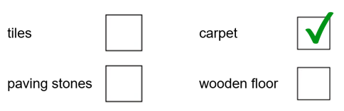
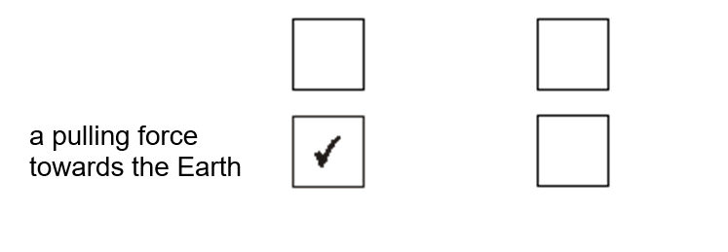
63. Award ONE mark for:
64. Award ONE mark for:
65. Award ONE mark for an indication that Newton needed evidence to
support his ideas or so that he could be more certain of his ideas:
• to gather evidence to support (or reject) his ideas;
• to see if his ideas were supported by his results/investigations;
• to see if his predictions were correct;
• to find out if other things fall from the same force;
• if he said anything without investigating it, other people may find
something different.
ONE mark may be awarded for a response that implies he would know if his ideas were true:
• to see whether his ideas were right/ wrong;
• to see if it/his idea works/is true;
• to check his ideas;
• to know (for sure) which force causes the apple to fall;
• if he just guessed he may be wrong;
• so he could know why the apple fell on his head;
• if he did not test, he would not know what happened.
Do not give credit for an insufficient response:
• to test his ideas [given];
• to make sure;
• to see if his results are true;
• to check his results; [these responses imply an investigation
has already been carried out];
• to see if he had the right/correct answer [implies results
for his ideas have been determined previously];
• to make it a fair test;
• to make it accurate;
• to see if the investigation worked.
66. Award ONE mark for: Gravity

Slide 18
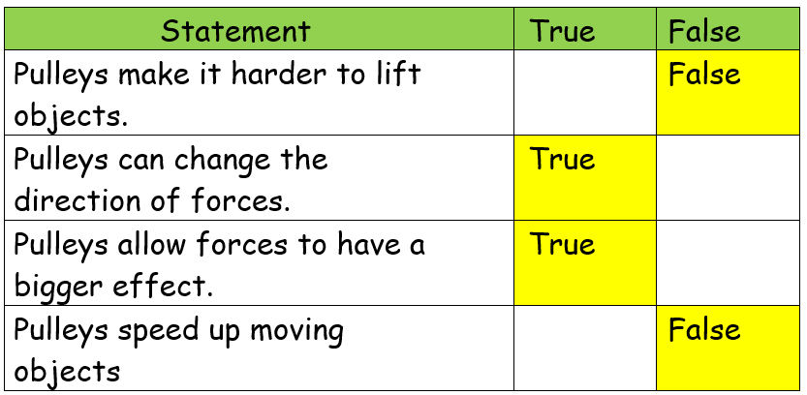
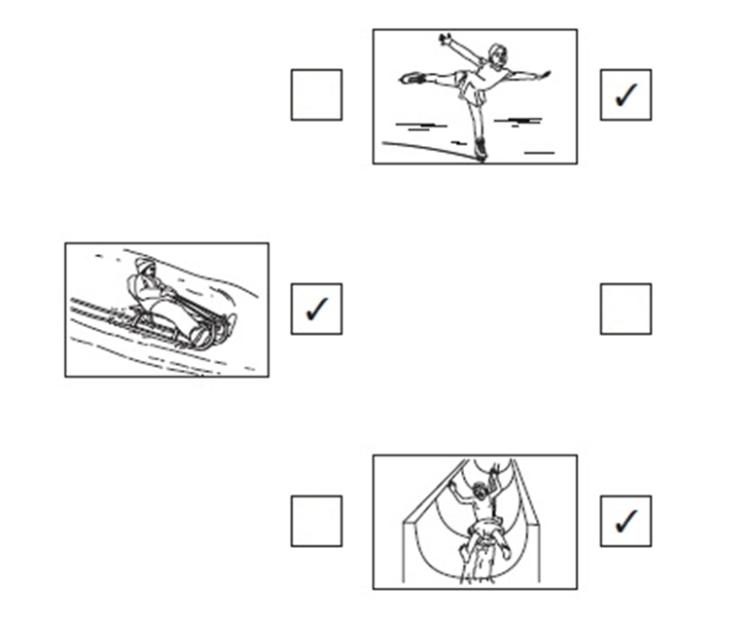
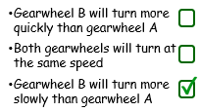
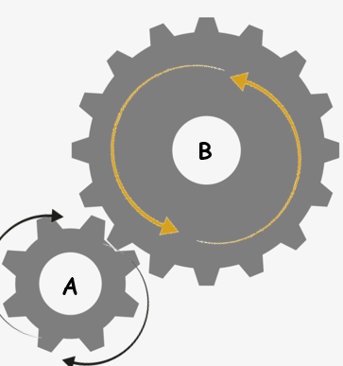
67. Award TWO Marks For all 4 identified correctly.
If two marks cannot be awarded, award ONE mark for two or three correctly identified.
68. Award ONE mark for all three correct boxes ticked:
69. Award ONE mark for:
A
70. Award ONE mark for
71. Award ONE mark for arrow (or arrows) drawn indicating an anticlockwise movement.
Do not allow:
Arrows pointing in contrasting directions
Arrows pointing in clockwise direction
Single straight arrow with no reference to turn

Slide 19
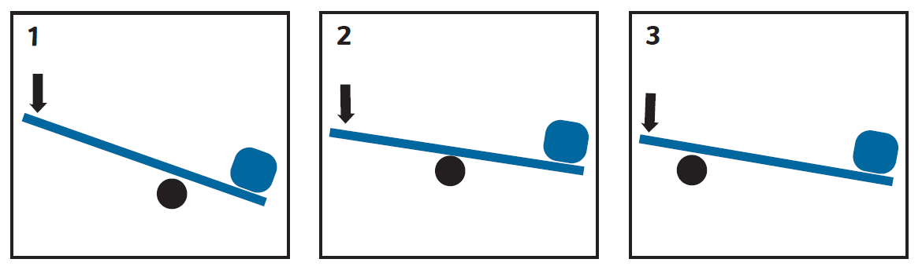

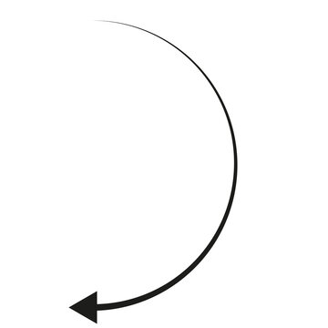

A
B
C
69. Look at examples of the levers labelled A, B and C above. In which example will the least force be needed to lift the block?
1 mark
70. Look at the picture of some gears. Tick ONE statement below which best describes how turning a small gear will affect the speed of the larger gearwheel
B
Gearwheel B will turn more quickly than gearwheel A
Both gearwheels will turn at the same speed
A
Gearwheel B will turn more slowly than gearwheel A
1 mark
71. Look again at the picture of some gears. Gear wheel A is turned in a clockwise direction. Draw an arrow on gearwheel B to show the direction it will turn.
1 mark

