Slide 1




Newbald Primary School
Science Progress Assessment
Year 3/4 Science Assessment Cycle 1
Name:
Year Group:
Date:
Plants
Score: /6
Animals, Including Humans
Score: /15
Rocks (and Soils)
Score: /18
Light
Score: /9
Forces and Magnets
Score: /14
Total:
Score: /62

Slide 2
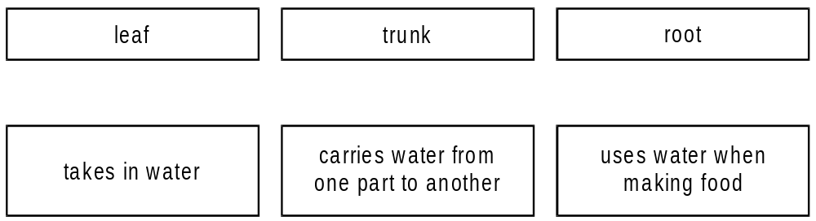
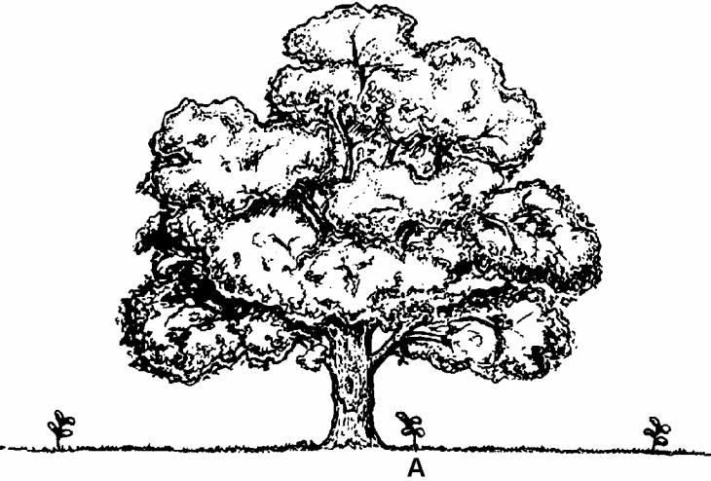
Newbald Primary School Science Progress Assessment
Year 3/4 Science Assessment Cycle 1
Name: Year Group: Date:
Plants
Different parts of a tree have different functions.
Draw THREE lines below to match each part of the tree to its function.
1 mark
Some oak seedlings are growing near a fully grown oak tree.
2. Give one reason why seedling A in the picture may not grow well.
______________________________________________
______________________________________________
______________________________________________
1 mark

Slide 3
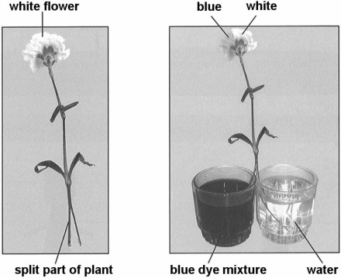
Some children set up an investigation as shown below.
They split part of a plant in half.
They put one half in water and the other half in water mixed with blue dye.
After some time, half of the flower turns blue.
3. What part of the plant did the dye travel through to get to the flower?
______________________________________________
1 mark
4. Predict what would happen if the children put a bunch of white flowers into red dye.
______________________________________________
______________________________________________
______________________________________________
1 mark

Slide 4
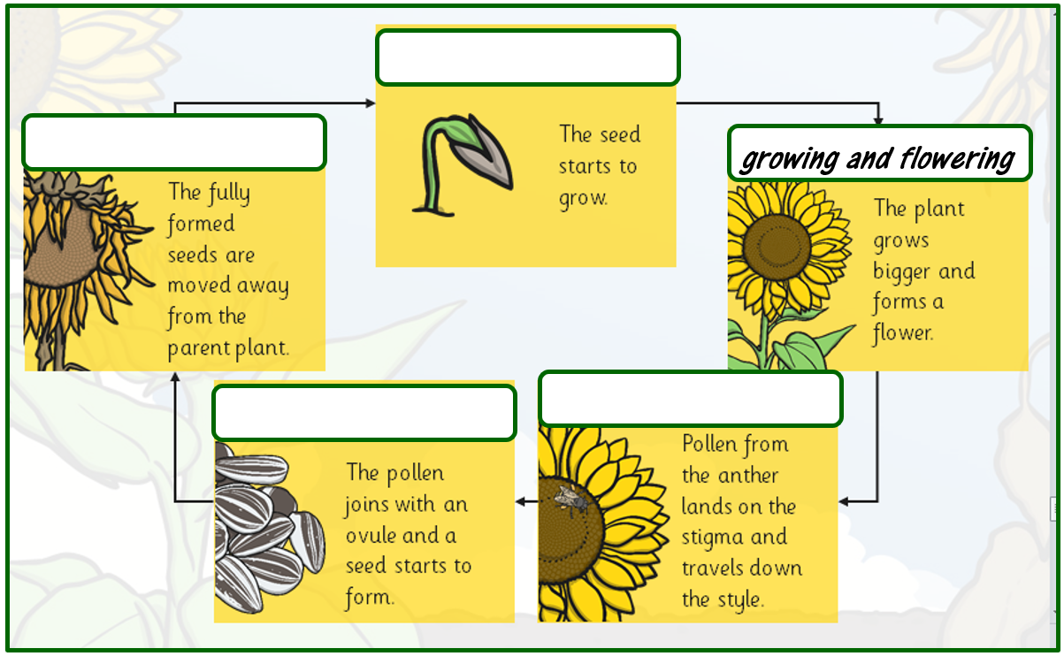
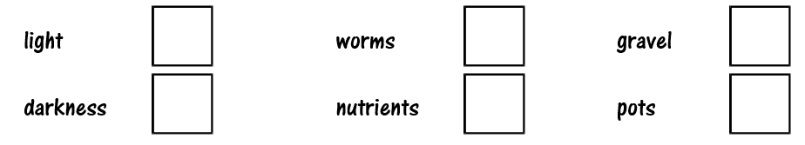
Life Cycle of a Plant
5. Write these labels in the correct place on this diagram to best describe each stage of a plant’s life cycle. One has been completed for you.
fertilisation and seed formation
growing and flowering
pollination
germination
seed dispersal
1 mark
6. What must all plants have to grow well?
Tick TWO boxes.
1 mark

Slide 5
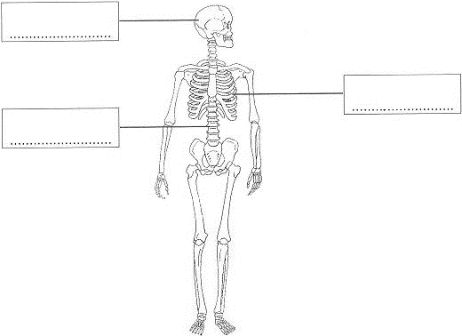
Animals, Including Humans
This is a drawing of a human skeleton. Name the parts of the skeleton.
7. Write ONE word in each box below.
1 mark
8. Describe TWO different ways that the skeleton is important to the human body.
(i) ________________________________________________________________________________________________
(ii) ________________________________________________________________________________________________
1 mark
1 mark

Slide 6
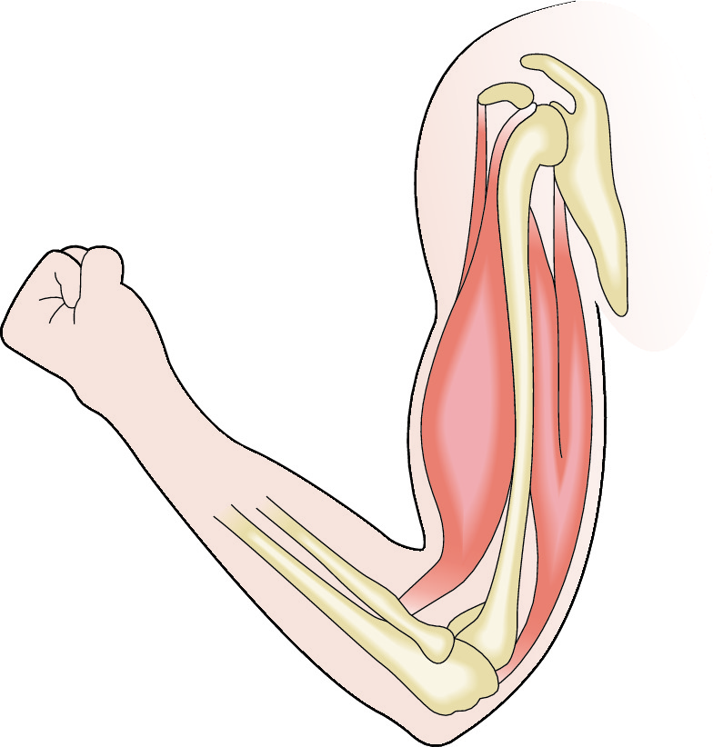
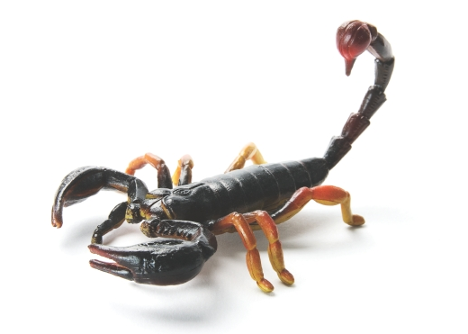
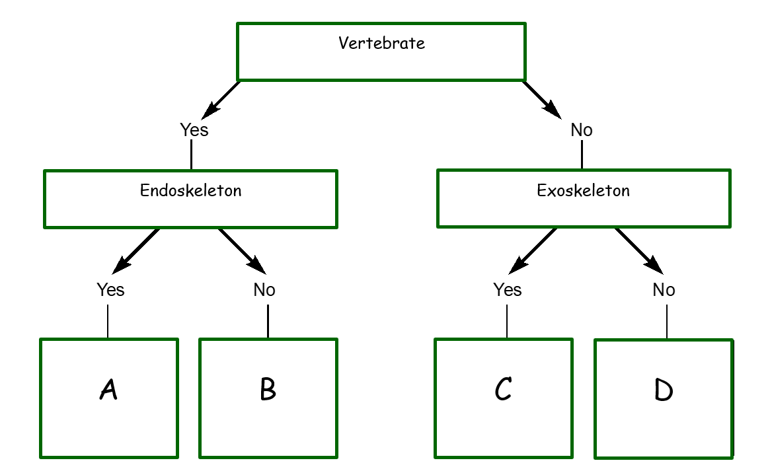
The picture shows the bicep (A) and the tricep (B).
9. Circle the word that describes what each muscle is doing to raise the arm.
A: Contracting / relaxing
A
B: Contracting / relaxing
B
10. Complete the sentence:
1 mark
Muscles act in _________________________
A scorpion does not have a backbone. It has a tough outer layer of chitin to protect and support its body.
1 mark
11. Which letter on the sorting key best describes a scorpion?
____________
12. Which letter on the sorting key best describes a human?
____________
1 mark
1 mark

Slide 7
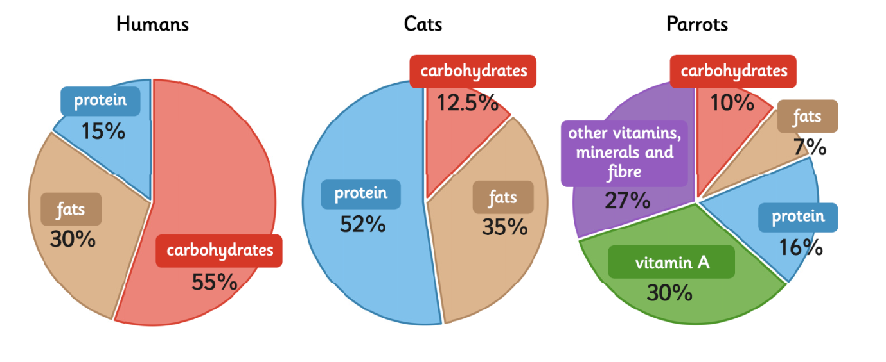
Compare the pie charts below showing the amount of nutrients needed by a human, cat and a parrot.
13. Which animal (listed above) needs 16 percent protein in their diet?
Humans
Cats
Parrots
1 mark
14. Which creature (listed above) needs over half of its diet to be protein?
Humans
Cats
Parrots
1 mark
15. Look at the pie chart for the Cat. Which word would best describe this animal?
Omnivore
Herbivore
Carnivore
1 mark
16. Name another animal (not listed above) that would need significantly more protein than a Human
_________________________________________
1 mark
17. Name another animal (not listed above) that would need significantly less protein than a Human
_________________________________________
1 mark

Slide 8
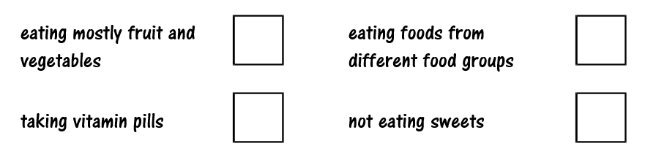
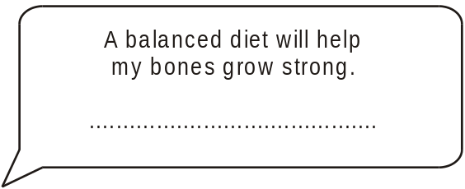
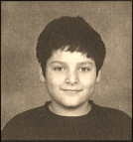
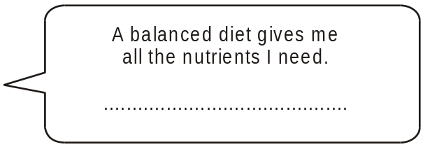
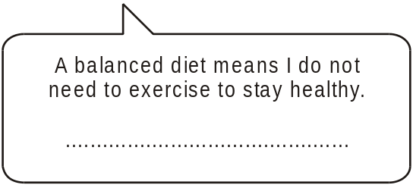
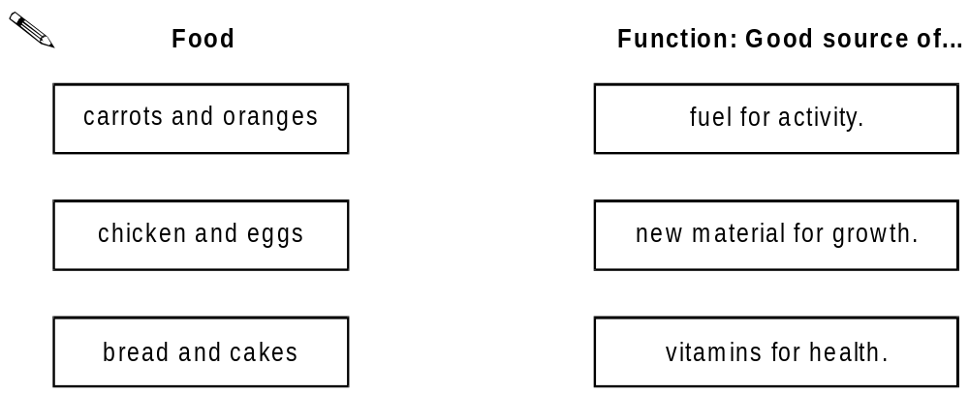
Damon has a balanced diet. It helps him to keep healthy.
18. Which of the following best describes a balanced diet?
Tick ONE box.
1 mark
Damon has some ideas about his balanced diet.
19. Write true or false next to each idea below.
1 mark
In a balanced diet, each food group has a special function in the body. Each food below is a good source of something the body needs.
20. Draw THREE lines below to match each food to its special function.
(Carbohydrate)
(protein)
(vitamins)
1 mark

Slide 9
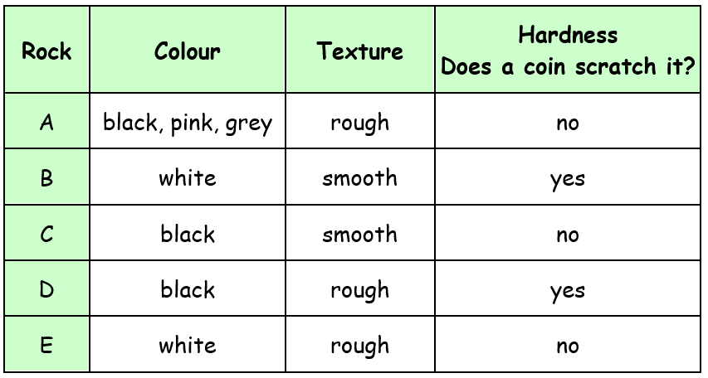
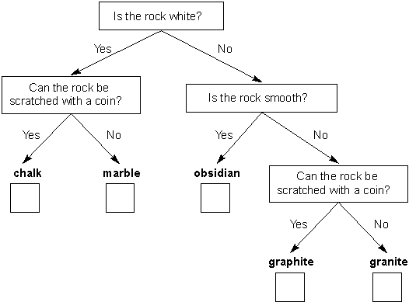
Rocks (and soils)
Tom has five different rocks. He describes their properties in the table below.
21. Write A, B, C, D or E in each box on the sorting diagram below to identify the rocks. One had been done for you.
A
2 marks

Slide 10
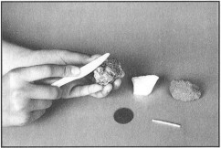
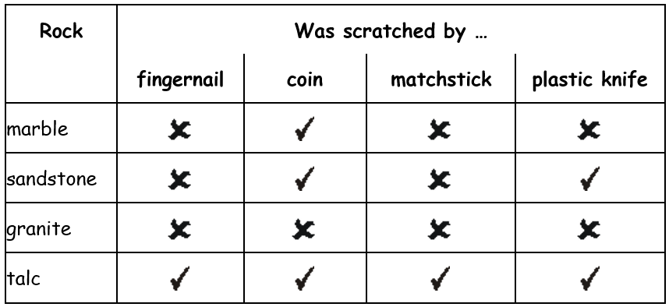
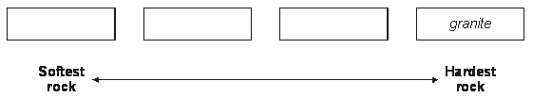
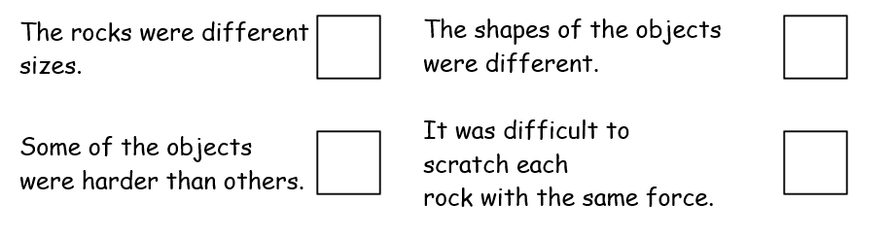
Tom did a scratch test on four different types of rock to see which was the hardest.
He used four different objects to scratch each rock.
This table shows his results:
22. Which rock could Tom’s fingernail scratch?
______________________________________________
1 mark
Tom worked out that granite was the hardest rock he tested.
23. What evidence in the table did Tom use to find out that granite was the hardest rock he tested?
_________________________________________________
_________________________________________________
1 mark
24. Write the name of each rock tested in the boxes below, to show the order of the rocks from softest to hardest.
1 mark
25. As Tom was doing his test, he realised it was hard to keep his test fair. Tick ONE box to show why it was hard for Tom to keep his test fair.
1 mark

Slide 11
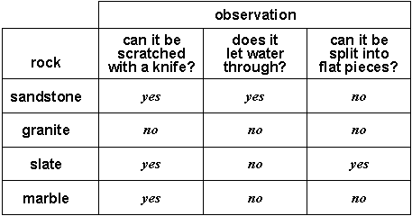
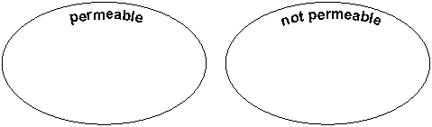
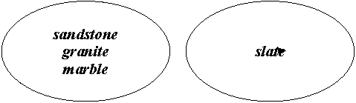
Sally investigated some rocks. She recorded her observations.
26. Look at the table above. Which rock cannot be scratched with a knife?
_____________________________________________
1 mark
27. She sorted all the rocks by permeability. Look at the table. Write the names of the rocks in each group.
Next, she sorted them like this.
1 mark
Group A
Group B
28. Look at the table. Describe why the rocks in group A make a group.
_______________________________________________
1 mark

Slide 12
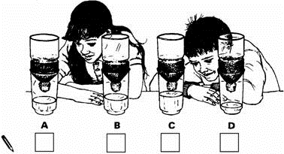
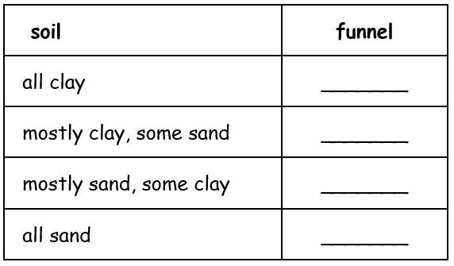
Soils
Children put four different types of soil into funnels. They poured 300 cm³ of water on to each soil. They measured how much water passed through in five minutes. Look at the picture.
29. Which soil allowed the least water to pass through it?
Tick ONE box.
1 mark
30. Say one thing the children needed to do to make it a fair test.
1 mark
Clay has small particles and does not let water through easily.
Sand has larger particles and lets water through easily.
The table shows the four types of soil they tested.
Which type of soil was put in each funnel?
31. Complete the table by writing the letter A, B, C or D for each funnel.
1 mark

Slide 13
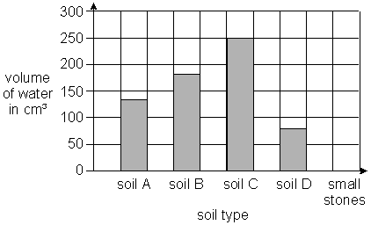
Soils (continued)
The children showed their results on a graph.
The graph shows how much water each type of soil let through in five minutes.
1 mark
32. The children then poured 300 cm³ of water onto small stones in a funnel. Draw a bar on the graph to predict the volume of water which will pass through the small stones in five minutes.
33. The children repeated their test three times. Why?
________________________________________
1 mark

Slide 14
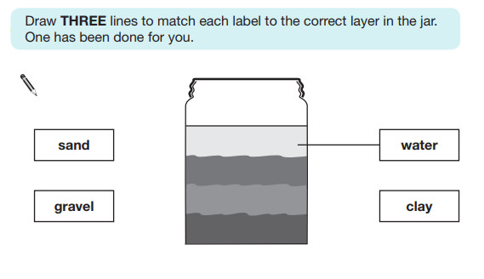
34. Tom puts some soil and water in a jar with a lid.
After a day, the soil in the jar has separated into layers: sand, gravel, and clay
The gravel particles are the heaviest.
The clay particles are the lightest.
1 mark
35. Tom notices something floating on the top of the water. He is told this is humus. Explain what humus is.
_________________________________________
_________________________________________
_________________________________________
1 mark

Slide 15
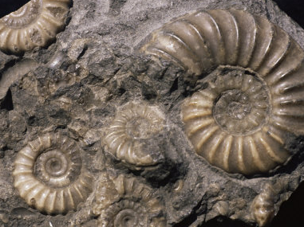
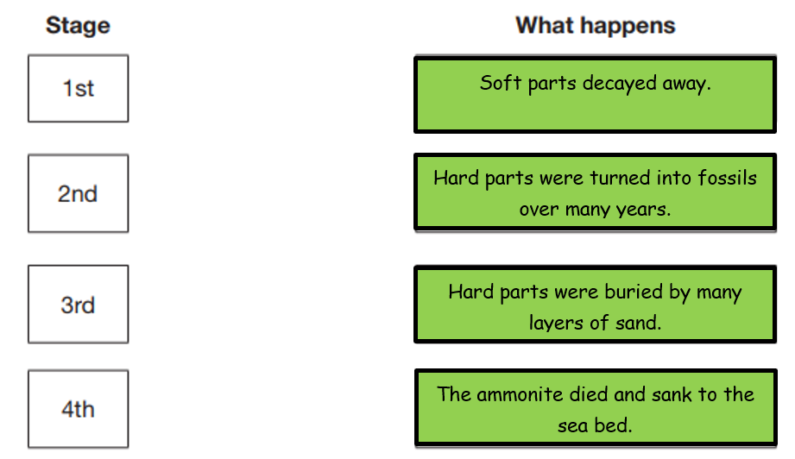
The picture shows a fossil of an ammonite.
These creatures lived in the sea a long time ago.
36. What material are fossils made of?
How did the fossil of the ammonite form? Match each stage to order what happens when a fossil is formed.
1 mark
Fossils can give a lot of information about animals that lived in the past.
37. Write True or False for each statement about fossils.
Fossils could give us information about:
True or False?
how long ago the animal lived.
what size the animal was.
what colour the animal’s eyes were.
1 mark

Slide 16
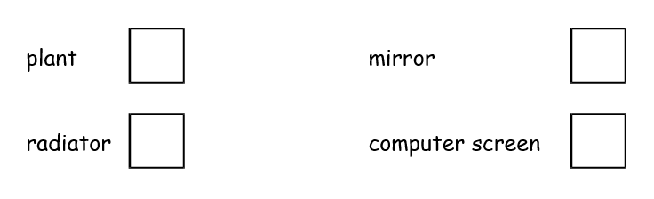

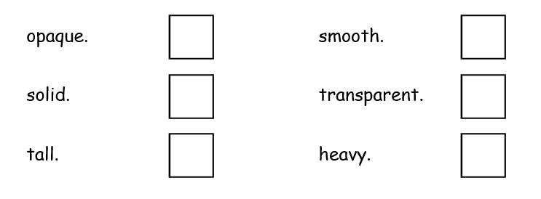
Light
38. Tick ONE box below to show one possible source of light in a classroom.
39. The moon is bright at night, but it is NOT a light source. Explain why it looks bright?
__________________________________________
__________________________________________
1 mark
1 mark
Shadows
One sunny day, some children use a rounders post to make shadows in their playground. When light shines on the rounders post, a shadow forms.
40. The teacher tells the children not to look directly at the sun. Why?
_____________________________________________
1 mark
41. The rounders post makes a dark shadow. Tick ONE box to complete the sentence below.
The rounders post makes a dark shadow because it is...
1 mark

Slide 17
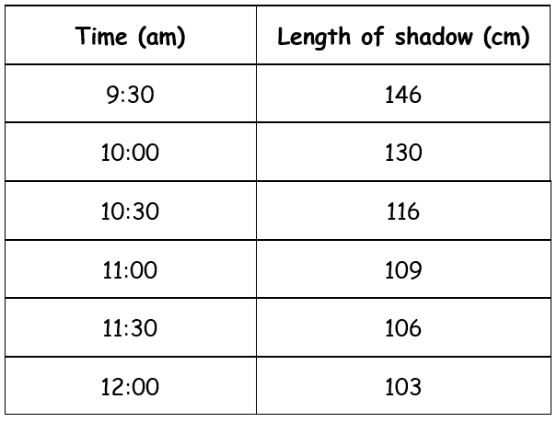
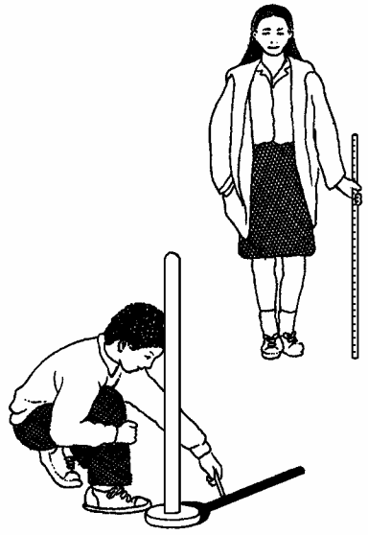
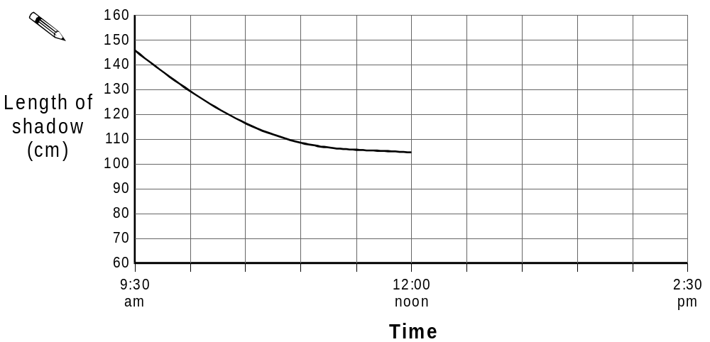
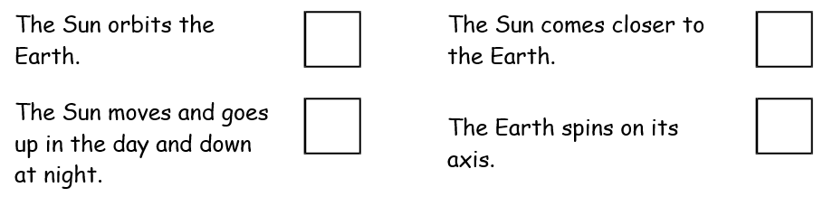
Shadows (continued)
The children draw round the shadow of the rounders post every half hour from 9:30 until 12 noon. They measure the length of each shadow and record their results in this table:
42. What happened to the length of the shadow during the morning?
__________________________________
1 mark
The children make a line graph to show the results from the morning.
43. Continue the line on the graph to show how the length of the shadow would change between 12 noon and 2:30pm.
1 mark
44. Tick ONE box to show why shadows change length during the day.
1 mark

Slide 18
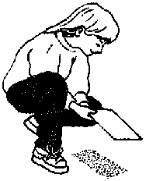
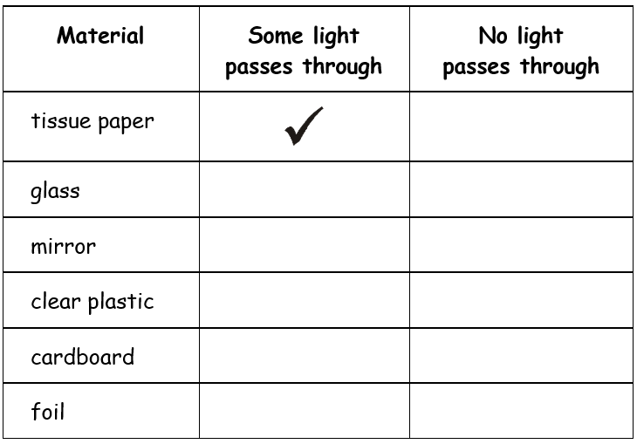
Jenny investigates which materials allow light to pass through. She holds different materials out in the sun.
45. Complete the table below to predict Jenny’s results.
Tick ONE box in each row. One has been done for you.
1 mark
46. Jenny goes into a room that has no windows and closes the door. Jenny cannot see. Explain why Jenny cannot see.
______________________________________________
______________________________________________
______________________________________________
______________________________________________
1 mark

Slide 19
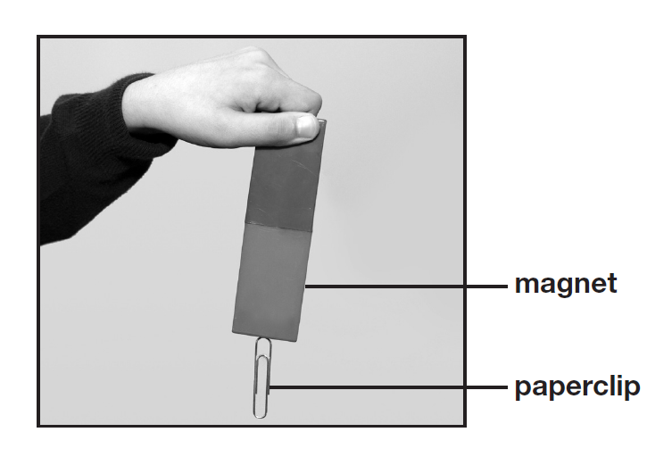
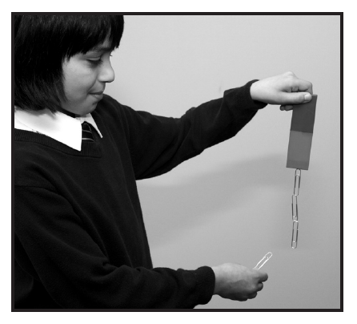
Forces and Magnets
Ali has four different magnets and some paperclips. The paperclips are attracted to the magnets.
47. Draw ONE arrow on the photograph to show the direction of the magnet’s force to the paperclip.
1 mark
48. Name the force that pulls in the opposite direction to the magnet.
____________________________________________
Ali wants to find the strongest magnet. He adds paperclips to a magnet one at a time so they make a chain. He stops when no more paperclips attract. He repeats this with the other three magnets.
1 mark
49. How will Ali know which magnet is the strongest?
___________________________________________
_________________________________________________
1 mark

Slide 20
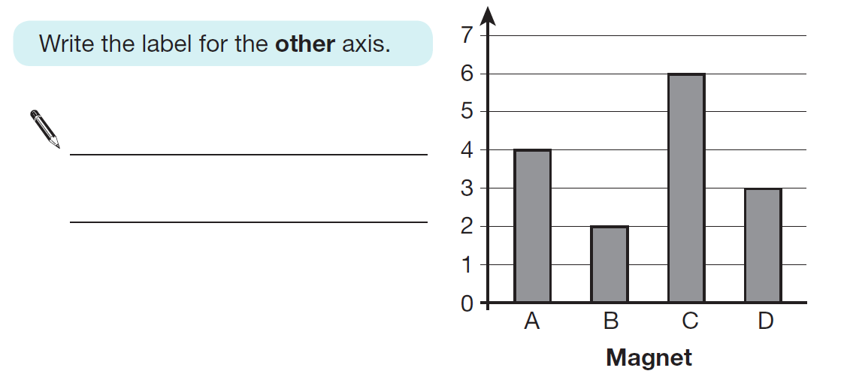
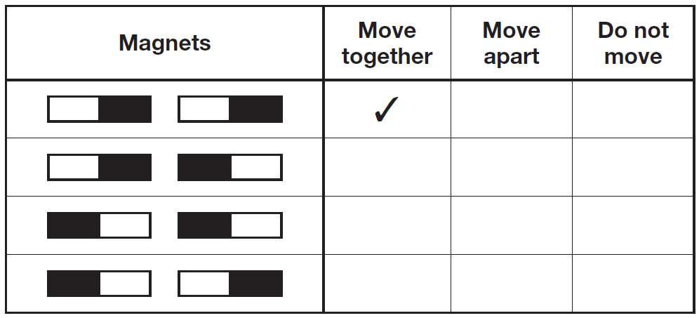
Ali’s magnets continued.
50. The graph below shows Ali’s results. One axis on the graph has been labelled.
1 mark
Ali moves magnet A towards magnet B. Magnet B moves away from magnet A even though Ali does not touch magnet B.
51. Why did magnet B move away from magnet A?
______________________________________________________________________________________
1 mark
Ali tries different ways of putting the magnets together.
52. Tick ONE box on each row of the table to show if the magnets move together, move apart or do not move. The first one has been done for you.
1 mark

Slide 21
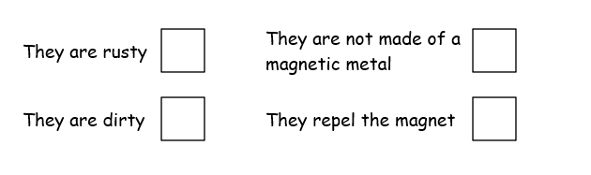
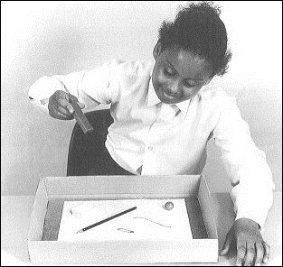
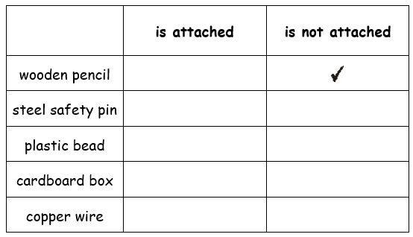
Vicky has some new and old 1p coins.
The new and old coins are made from different metals.
53. Tick ONE box to show why a magnet does not attract the old coins.
1 mark
Vicky has a magnet in her hand. There are some objects in the box. Vicky is going to find out which objects are attracted by her magnet.
54. Compare the table of results by putting ONE tick so show the correct result for each object. One has been done for you.
2 marks

Slide 22
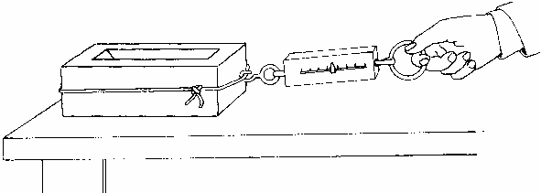
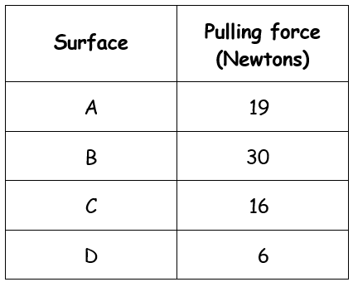
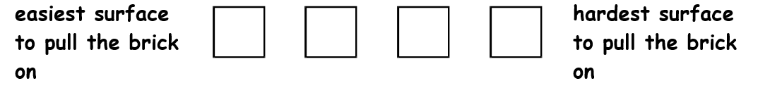
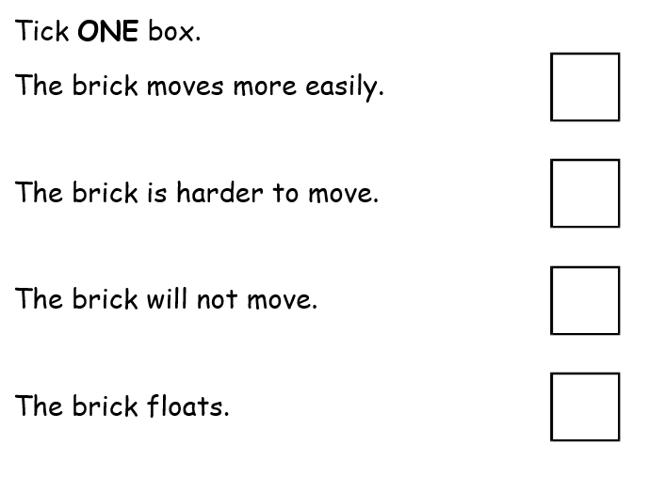
Measuring forces
Lizzie uses a force-meter. She measures the force needed to start a brick moving on different surfaces.
Here are her results:
55. Write A, B, C or D in each box below to put the surfaces in order of force needed to start the brick moving.
1 mark
Lizzie uses the force-meter to pull the brick on a table top.
She spreads a spoonful of oil on the table top.
She puts the brick on the oil.
56. What happens when she tries pulling the brick on the oil?
1 mark

Slide 23



The diagram below shows three forces acting on the brick as it is pulled on each surface.
Force B makes it hard to start the brick moving.
57. Write the name of Force B below.
1 mark
58. Name the equipment that Lizzie uses to measure the force needed to move the brick.
1 mark
59. What units does this equipment use to measure the force?
60. Dave goes over a jump on his skateboard. When he jumps he stays in the air for a short time. What force makes him return to the ground?
1 mark

