Slide 1

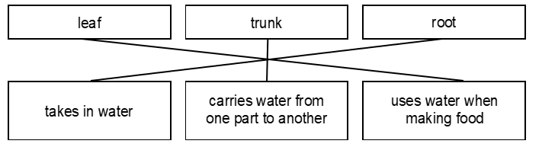
Newbald Primary School Science Progress Assessment
Year 3/4 Science Assessment Cycle 1
Mark Scheme
Plants
Total Marks: 62
1. Award ONE mark for all three correctly matched:
Award ONE mark for each identification of any of the following points
competition for light;
Give credit for:
    shaded by tree/not enough light;
    doesn't get much light;
    fully grown tree blocks out light;
    Sun can't get to it;
    shaded by a big tree.
competition for water;
Give credit for:
    not enough water;
    rain can't get to it;
    all water it is given will be sucked up by roots of tree;
    under foliage of another tree and might not get as much rainwater;
    trees keep rain from coming down.
competition for nutrients
Give credit for:
    not enough nutrients/minerals;
    goodness of soil being taken up by big tree;
    big tree would take up all the nutrients;
    big tree taken all its nutrition;
    too close to the other tree.
Do not give credit for;
not enough food;
not enough room;
roots of the tree are in the way.

Slide 2
3. Award ONE mark for:
stem.
Allow:
stalk.
capillary tubes
Do not give credit for an insufficient response:
roots;
shoot.
4. Award ONE mark for predicting that the flowers would turn red:
the (bunch of) flowers would turn red/pink;
it would turn red/pink.
Allow:
the plant turns red;
the flowers change colour;
the red dye would travel up the stem(s) to the flower(s).
Do not give credit for an insufficient response indicating that the flowers themselves have been dipped in dye:
there would be drops of dye on the flowers.
Do not give credit for an insufficient response:
half the flower(s) changed colour;
the flowers turned blue.

Slide 3
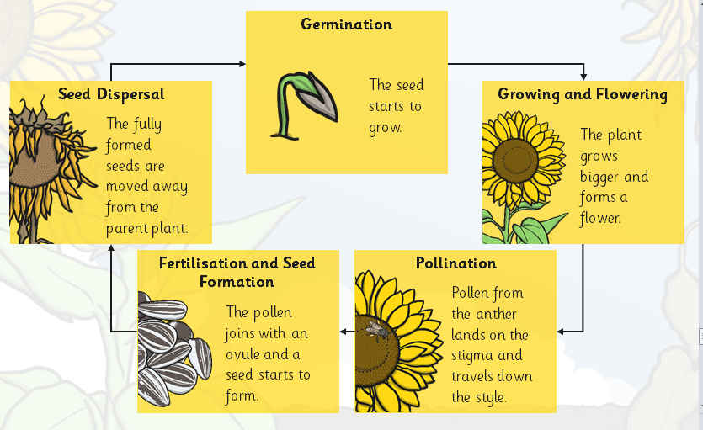
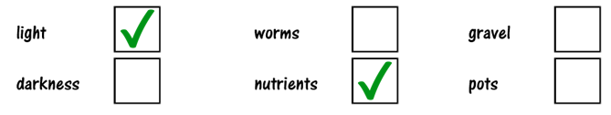
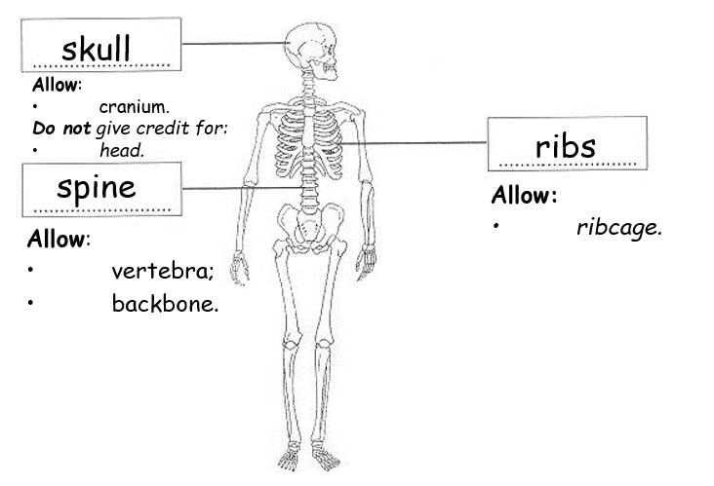
5. Award ONE mark for all correctly identified as follows:
6. Award ONE mark for both correctly identified:
Animals, Including Humans
7. Award ONE marks for correct identification of all three:

Slide 4
8. (i & ii) Award up to TWO marks for descriptions of the function of the
skeleton in any of the following categories:
NOTE: only one scoring response can be credited from each category.
Movement
• it is needed to move;
• it helps you move/run/other specific movement;
• it has joints in it so that you can move.
Allow:
• you can’t walk/stand up without a skeleton;
• muscles are joined to it/for muscles to pull on.
Support
• stand/upright/straight;
• it gives you shape;
• prevents collapse.
Allow:
• for muscles to be attached/pull on;
• stops you being floppy.
Protection
Give credit for a correct response that goes beyond the key stage 2 programme of study:
• it protects your organs;
• the ribs protect your heart;
• the skull prevents damage to the brain.
Importance to blood cells
Give credit for a correct response that goes beyond the key stage 2
programme of study:
• it makes red blood (cells).
Do not give credit for an insufficient ‘support’ response that does not recognise the substance of the other parts of the body:
• without it, you would be (like) a puddle;
• it stops you being (like) jelly;
• it stops you wobbling;
• it holds your body/organs together.

Slide 5


9 Award ONE mark for identifying both:
A: contracting
B: Relaxing
10. Award ONE mark for an unambiguous answer that identifies that muscles work in pairs.
Muscles act in PAIRS
Also accept in twos
Do not accept: together or at the same time
11. Award ONE mark for C
12. Award ONE mark for A
13. Award ONE mark for:
14. Award ONE mark for:
15. Award ONE mark for:
16. Award ONE mark for identifying an example of a carnivore:
E.g.: lion, tiger, shark, bird of prey, polar bear, anteater, penguin, etc
Do not allow an example of an omnivore e.g.: dog, bear (brown bear), hedgehog, pig, fox etc
Do not allow description e.g. carnivore.
Do not allow Cat (mentioned in the question)
Do not allow non-specific ambiguous generalisations e.g. bird
17. Award ONE mark for identifying an example of a herbivore:
E.g.: rabbit, sheep, cow, Giant panda, horse, giraffe, koala, etc
Do not allow an example of an omnivore e.g.: dog, bear (brown bear), hedgehog, pig, fox etc
Do not allow description e.g. herbivore.
Do not allow parrots (mentioned in the question)
Do not allow non-specific ambiguous generalisations e.g. bird

Slide 6
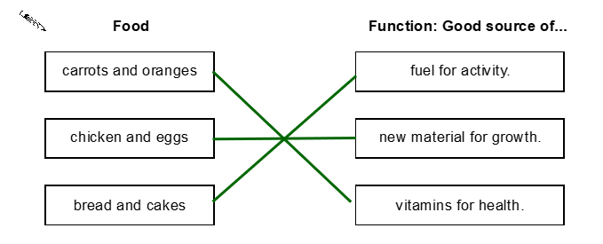
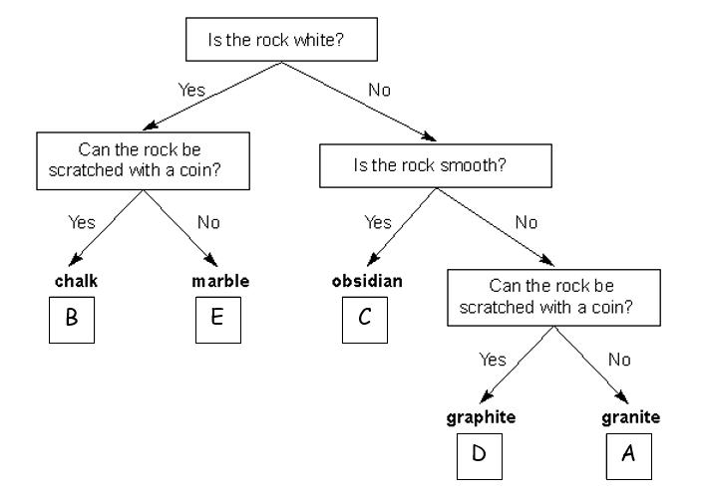
18. Award ONE mark for:
Eating foods from different food groups
19. Award ONE mark for all three correct responses
A balanced diet will help my bones grow strong (True)
A balanced diet gives me all the nutrients I need (True)
A balanced diet means I do not need to exercise to stay healthy (False)
20. Award ONE mark for all three correctly identified as follows:
Rocks (and soils)
21. Award TWO marks for correctly identifying all five rocks:
Or if you are unable to award two marks, award ONE mark for any three or four
rocks correctly identified.
22. Award ONE mark for:
• talc

Slide 7
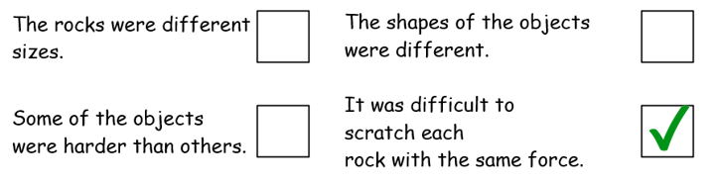
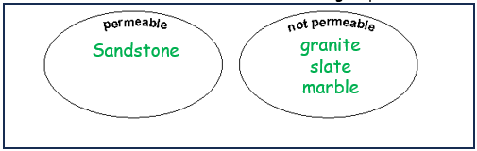
23. Award ONE mark for a response indicating that granite was the only rock not to be scratched by the objects:
• none of the objects were able to scratch granite, but some could scratch the other rocks;
• all the other rocks were scratched by at least one object;
• fewer objects/tools could scratch granite than the others.
Allow: an absolute response that does not describe whether the other rocks were
scratched:
• no object could scratch granite;
• it could not be scratched.
Do not give credit for an insufficient response that does not interpret the table:
• it only has crosses, where the other rocks have at least one tick.
24. Award ONE mark for all the rocks written in the correct place:
25. Award ONE mark for:
26. Award ONE mark for correctly identifying one rock which cannot be
scratched with a knife:
• granite.
27. Award ONE mark for correctly identifying all four rocks according to permeability:

Slide 8

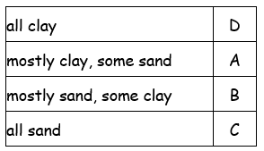
28. Award ONE mark for correctly identifying how the rocks in group A
are different from the rocks in group B:
• they cannot be split into flat pieces.
Allow:
• slate can be split into flat pieces.
Do not give credit for:
• they are all rocks [given];
• by looking at the table.
29. Award ONE mark for: D
30. Award ONE mark for identifying any constant in the investigation e.g.:
Same amount of soil in each test
Same amount of water poured onto the soil
Same size funnel (upturned bottle)
Same time allowed for each water sample to pass through each soil sample
Do not allow non-specific responses, variables or incorrect scientific answers e.g.:
The amount of water
The time
Different soil
Soil
Bottle
Room
Same stopwatch
31. Award ONE mark for:
32. Award ONE mark for a bar (or bar line) drawn for small stones
which is more than 250cm³ and less than or equal to 300cm³
33. Award ONE mark for: To check their results.

Slide 9
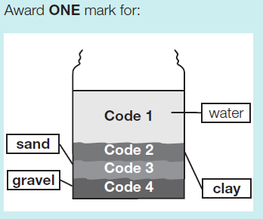
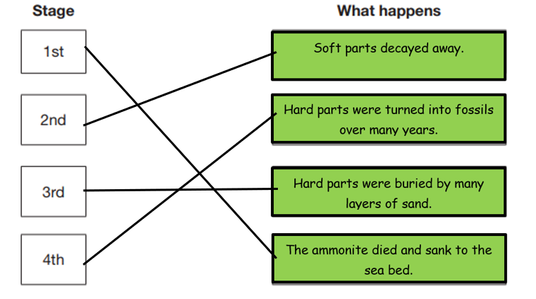
34. Award ONE mark for all correctly identified as follows:
35. Award ONE mark for identifying that humus is the organic component of soil, formed by the decomposition of leaves and other plant material by soil microorganisms.
Allow
dead/ decaying plants
Allow
dead plants and/ or animals
Do not allow references to other non contextualised items referred to as humus e.g.
A chick-pea dip
36. Award ONE mark for correctly identifying:
37. Award ONE mark for all 3 correctly identified:
how long ago the animal lived TRUE
what size the animal was. TRUE
what colour the animal’s eyes were. FALSE

Slide 10
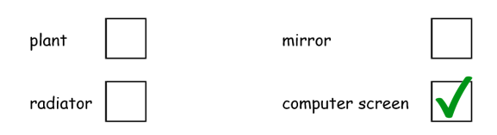
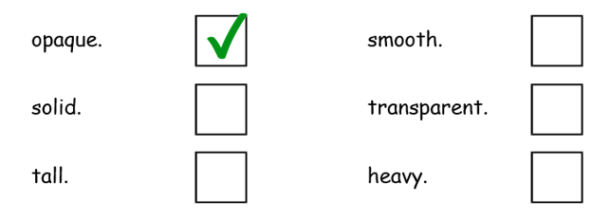
Light
38: Award ONE mark for:
39. Award ONE mark for an awareness that light reflects off the moon’s surface:
· the moon reflects the light from the sun;
· light bounces on/off the moon
· the moon (it) acts like a mirror.
Allow:
· light reflects on/off the moon
· it reflects/is a reflection;
· the light is scattering off the moon
Do not give credit for an insufficient response:
· because the moon is shiny;
· because the light is shining on it
[restatement of the stem – no acknowledgement of reflection];
· the light reflects on to the moon
[implies light is reflected from another surface on to the moon but not off it again].
40. Award 1 mark for: It could damage your eyes. Also accept it is dangerous / it can hurt your eyes.
41: Award ONE mark for:
(no other boxes ticked)
42. Award ONE mark for an indication that the shadow became shorter:
· the shadow kept getting shorter;
· it got shorter.
Allow:
· it was less long at lunchtime;
· it was longer at first.

Slide 11
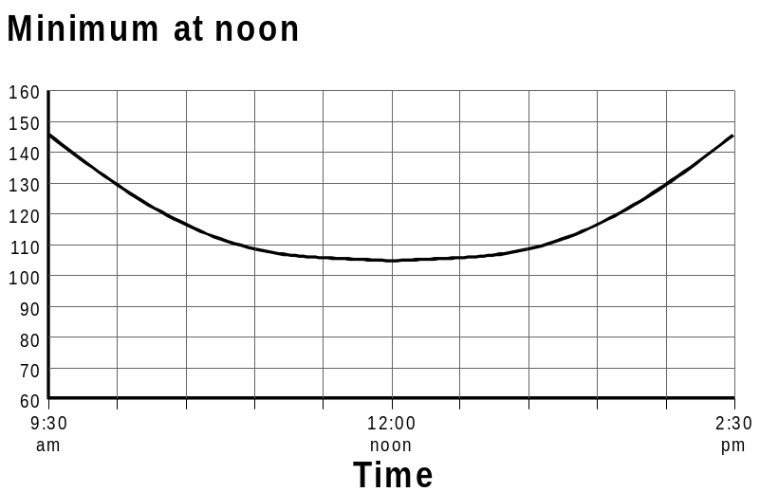
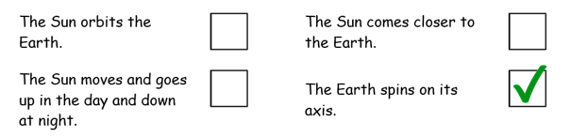
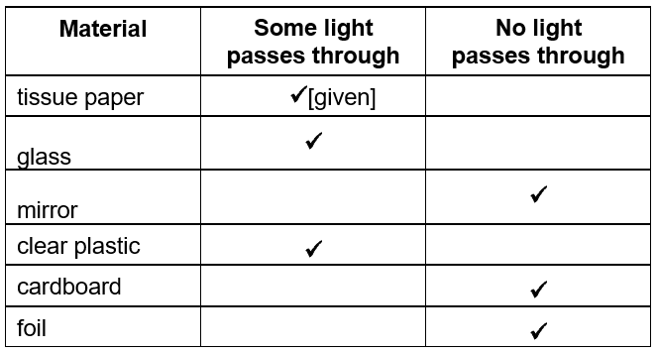
43. Award ONE mark for a graph with a minimum point of no lower than 95cm, occurring between noon and 1pm. Following the minimum point, the graph should go upwards to a maximum point of no more than 160cm and
no less than 105cm.
Do not give credit for an insufficient response where the line remains level or gets lower at any time after 1pm.
44: Award ONE mark for:
45. Award TWO marks for correct classification of all five:
or
If you are unable to award two marks, award ONE mark
for any three or four correctly classified.
46. Award ONE mark for acknowledgement that humans need light in order to see
No, as there is no light
Jenny needs light to see
Do not allow poorly or un-explained answers or incorrect science eg:
No (with no explanation)
Yes (incorrect science)
It will be dark
She will find it hard to see
She can see a bit
Do not allow answers which change the context of the question, despite scientific accuracy e.g.:
If the door is made of glass and the sun is shining through it than yes.

Slide 12
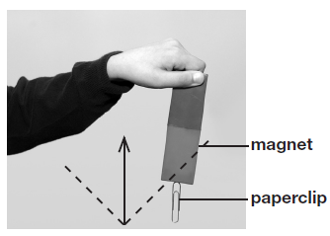
Forces and Magnets
47. Award ONE mark for an arrow pointing upwards that is less than 45° either side of the vertical.
Do not give credit for a response that includes incorrect science showing an arrow pointing downwards.
Do not give credit for an insufficient response where a line, rather than an arrow, is drawn.
48. Award ONE mark for:
Gravity
or
Weight
ONE mark may be awarded for:
the pull of the Earth
gravitational attraction
Do not give credit for an insufficient response that does not recognise the force is due to the Earth, for example:
a pulling force towards the Earth
downwards pull
Do not give credit for an insufficient response that may refer to the magnet’s force, for example:
attraction
49. Award ONE mark for an indication that the strongest magnet will hold the largest number of paperclips, for example:
it has more paperclips
the best magnet holds the most paperclips
ONE mark may be awarded for:
the magnet/it holds the most
Do not give credit for an insufficient response in which no comparison is given:
by the amount of paperclips it holds
magnet C holds 6 clips
Do not give credit for an insufficient response referring to the results on the graph:
it is the biggest bar on the graph

Slide 13
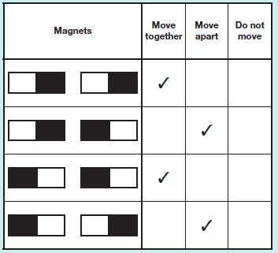
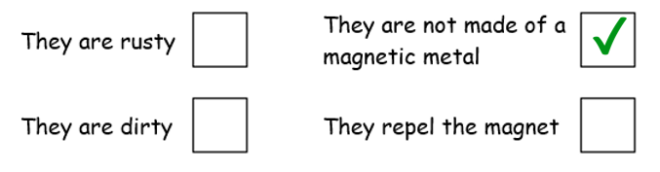
50. Award ONE mark for correctly labelling the axis to indicate the number of paperclips.
ONE mark may be awarded for:
paperclips
51. Award ONE mark for an indication that the magnets are repelling each other or that like poles are together, for example:
they repel each other
they are repelling
the same poles are facing each other
two North/N poles/ends are facing
two South/S poles/ends are facing
ONE mark may be awarded for:
the same ends are facing each other
Do not give credit for a response that includes incorrect science that uses incorrect terminology:
negative and positive are facing
Do not give credit for an insufficient response that implies each magnet is the same pole:
they are both North
they are the same poles
Do not give credit for an insufficient response:
the poles are the same [does not imply the facing poles]
the same sides are facing
52. Award ONE mark for all identified correctly:
Do not give credit if more than one box has been ticked in a row.
Do not give credit if no ticks are given in a row.
53. Award ONE mark for:
They are not made of a magnetic metal

Slide 14
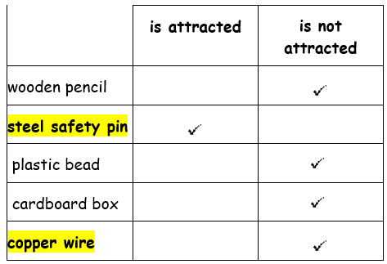


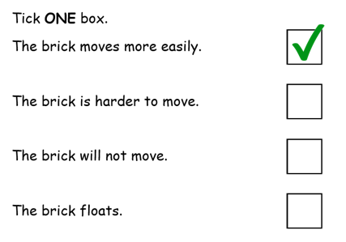
54. Award TWO marks for correctly attributing properties of all FOUR of the materials.
If Two marks cannot be awarded award ONE mark for identifying the TWO metal objects:
• steel and copper both correct.
55. Award ONE mark for:
Do not give credit for a response that orders the force, not the surface:
56. Award ONE mark for:

Slide 15
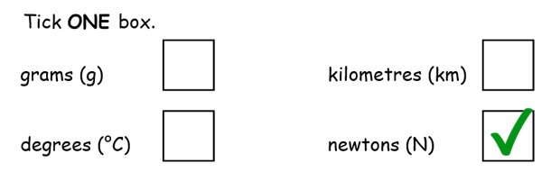
57. Award ONE mark for:
· friction.
Do not give credit for a response that includes incorrect science:
air resistance [applies once an object is moving; force B makes it hard to start the brick moving];
drag [synonym for air resistance].
58. Award ONE mark for:
forcemeter;
Newton meter.
Allow:
spring balance.
Do not give credit for:
Newton measurer.
59. Award ONE mark for:
60. Award ONE mark for:
· weight.
or:
· gravity.

Slide 16
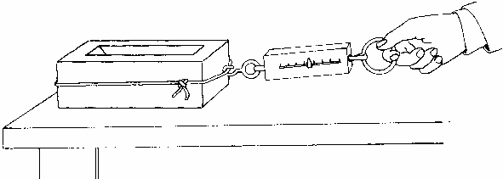
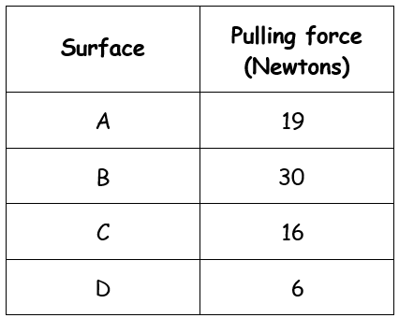
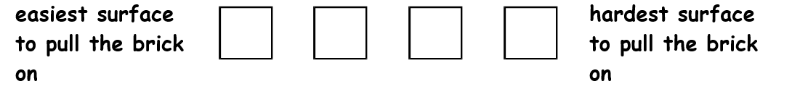
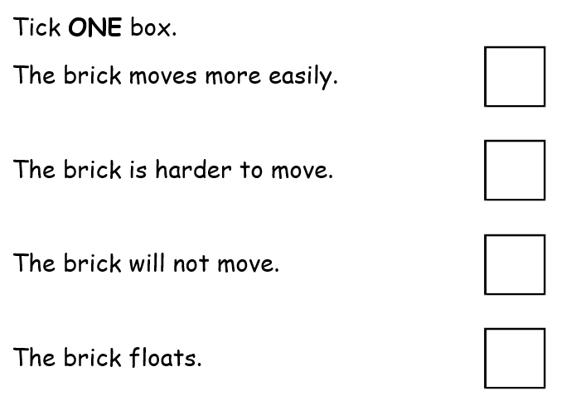

Measuring forces
Lizzie uses a force-meter. She measures the force needed to start a brick moving on different surfaces.
Here are her results:
55. Write A, B, C or D in each box below to put the surfaces in order of force needed to start the brick moving.
1 mark
Lizzie uses the force-meter to pull the brick on a table top.
She spreads a spoonful of oil on the table top.
She puts the brick on the oil.
56. What happens when she tries pulling the brick on the oil?
1 mark

Slide 17
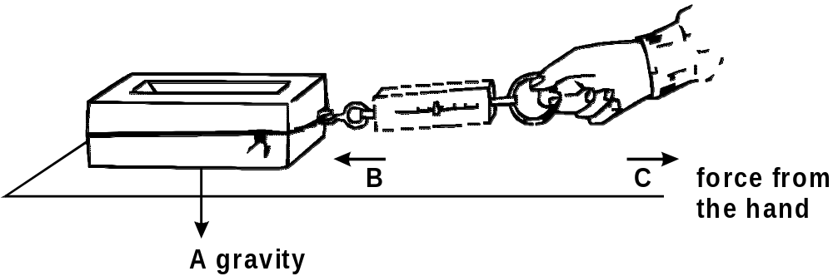
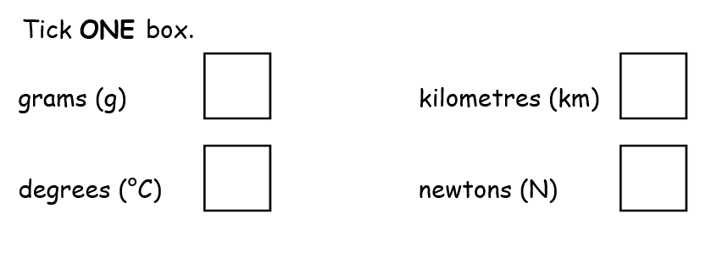
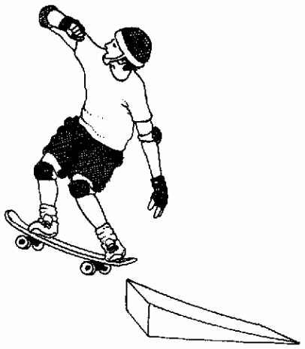
The diagram below shows three forces acting on the brick as it is pulled on each surface.
Force B makes it hard to start the brick moving.
57. Write the name of Force B below.
1 mark
58. Name the equipment that Lizzie uses to measure the force needed to move the brick.
1 mark
59. What units does this equipment use to measure the force?
60. Dave goes over a jump on his skateboard. When he jumps he stays in the air for a short time. What force makes him return to the ground?
1 mark

