Slide 1


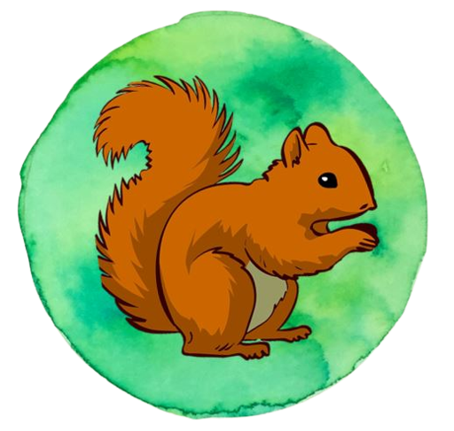

Newbald Primary School
Science Progress Assessment
Year 1 Science Assessment
Name:
Year Group:
Date:
Plants
Score: /4
Seasonal Changes
Score: /4
Animals, Including Humans
Score: /8
Everyday Materials
Score: /9
Total:
Score: /25

Slide 2
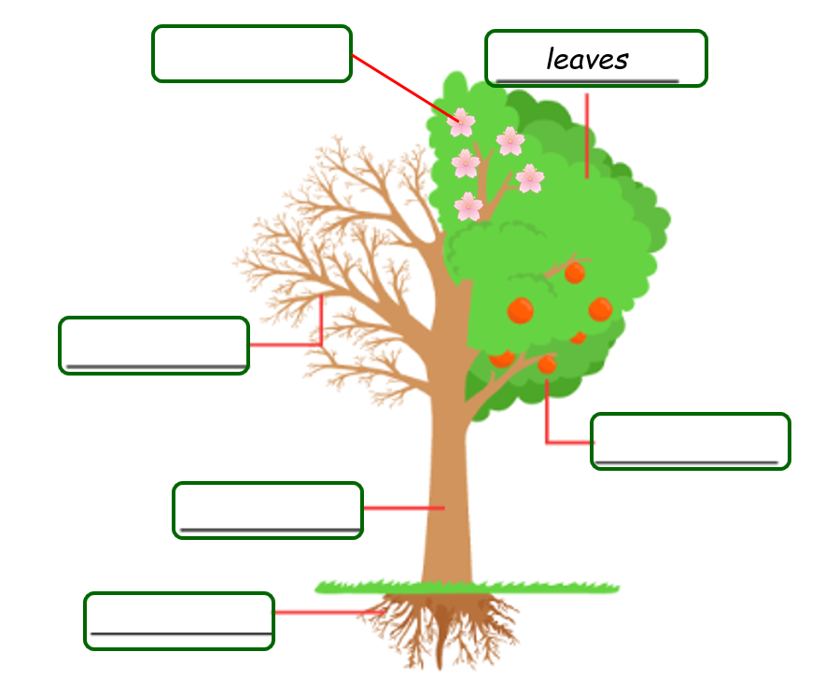
Newbald Primary School Science Progress Assessment
Score: /25
Year 1 Science Assessment
Name: Year Group: Date:
Plants
Score: /4
Parts of plants and trees
1. Here is a diagram of a tree. Please use the words to help you label the tree correctly. One has been done for you.
leaves
branches
trunk
roots
fruit
Blossom / flowers
2 marks

Slide 3
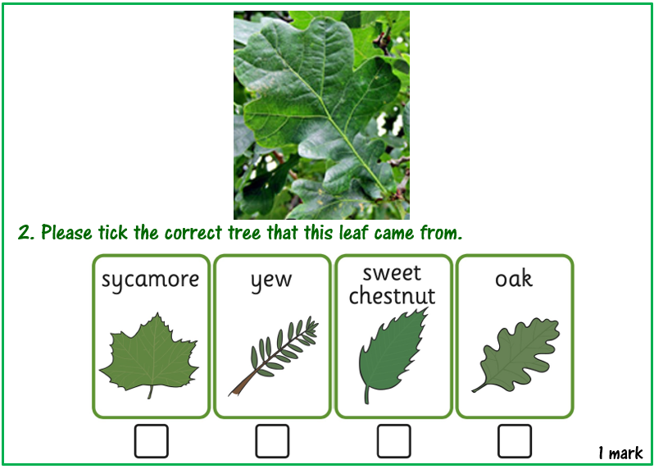
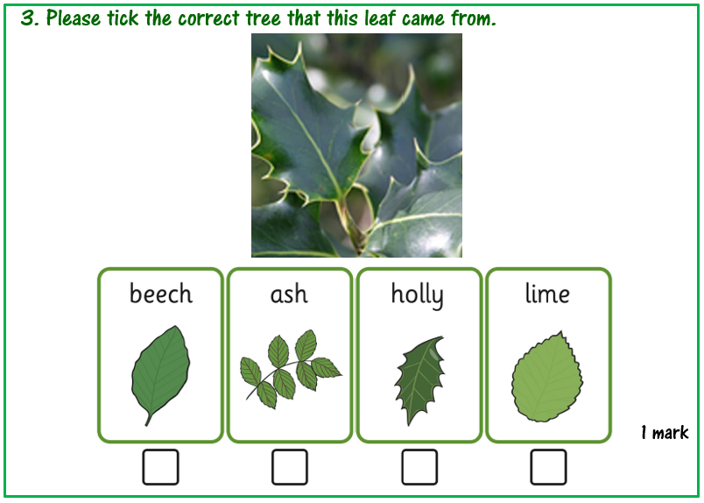
Tree identification
These leaves were found on some trees near the school. Can you use the identification charts to identify which tree they came from?
1 mark
1 mark

Slide 4
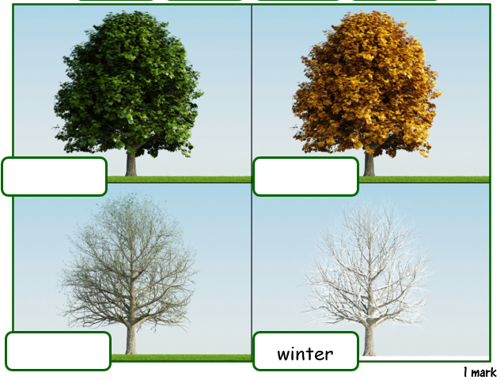
Seasonal Changes
Score: /4
4. These four pictures are of the same tree. Label each picture with the time of year that the picture was taken.
Use the words given to you to help. One has been done for you.
winter
spring
autumn
summer
1 mark

Slide 5
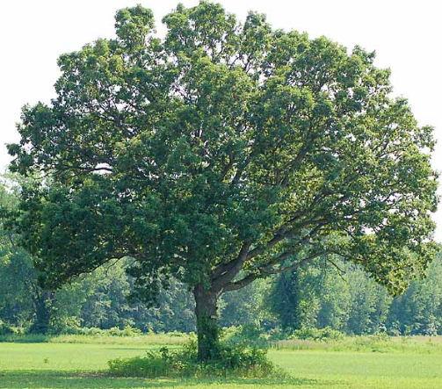

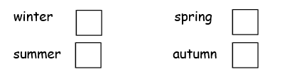
5. Look at this tree. It is a deciduous tree. The picture was taken during the summer months. What will happen to its leaves in autumn?
1 mark
Bill records the amount of time between sunrise and sunset each day through the year.
6. In which season would you expect the most daylight? (the longest days)
1 mark
7. In which season would you expect the least daylight? (the shortest days)
1 mark

Slide 6
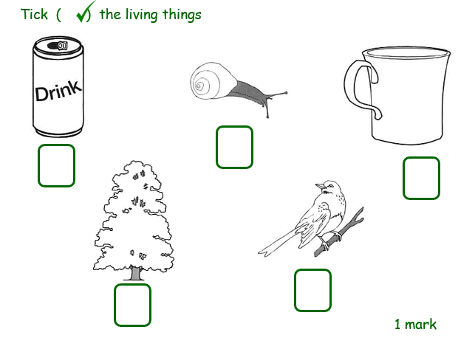
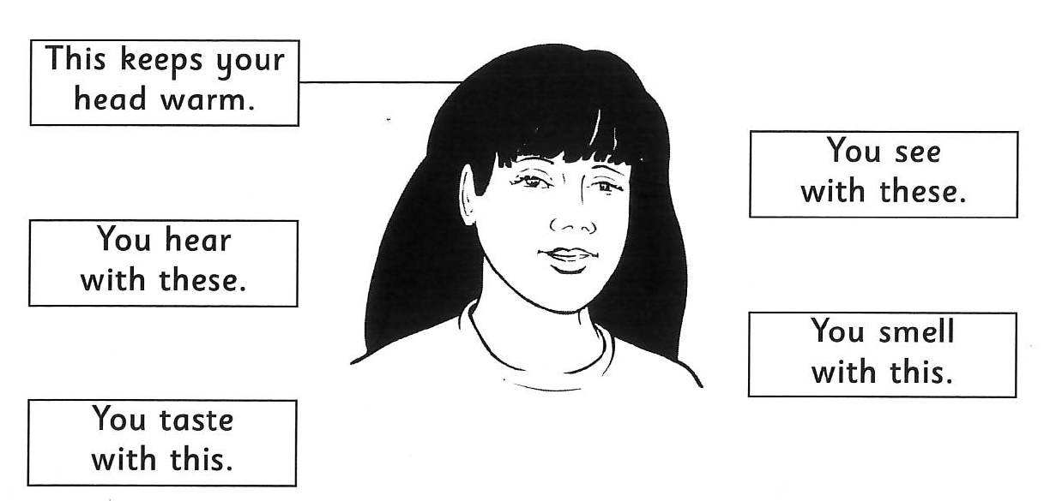
Animals, Including Humans
Score: /8
8.
1 mark
9.
Connect the label to the correct part of the body. One has been done for you.
1 mark

Slide 7
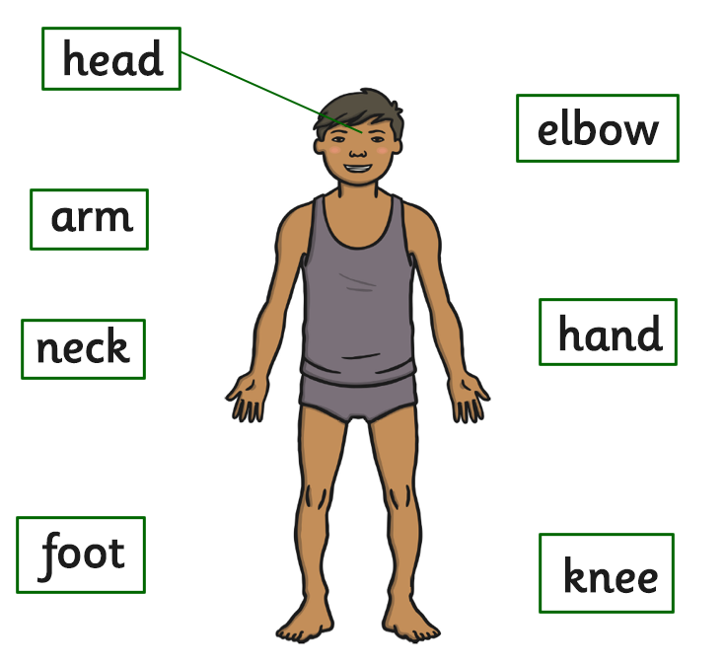
10. Draw a line to label the body parts accurately. One has been done for you.
2 marks

Slide 8
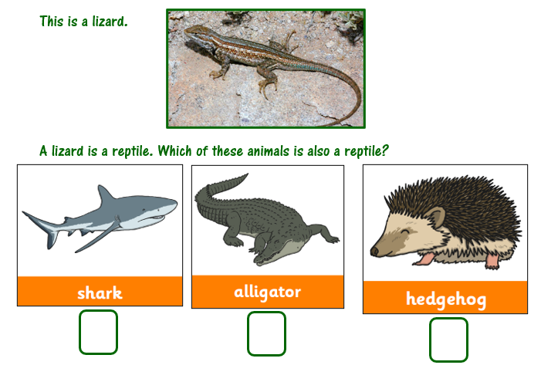
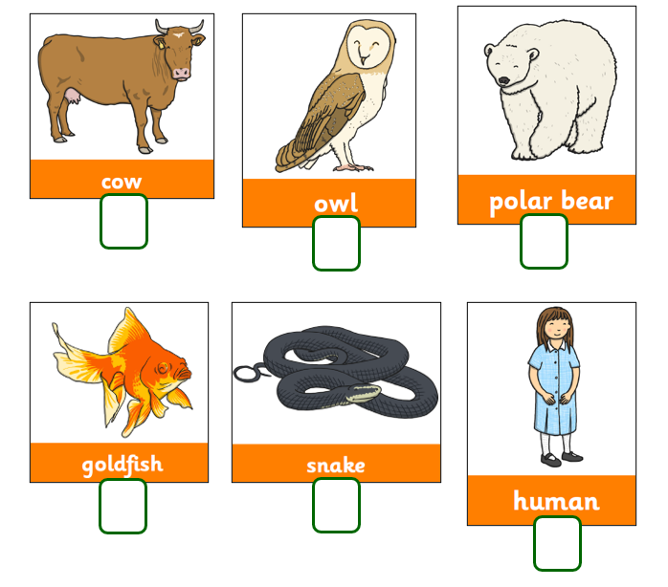
11.
1 mark
12.
Look at these animals. Tick the animals that are mammals.
1 mark

Slide 9
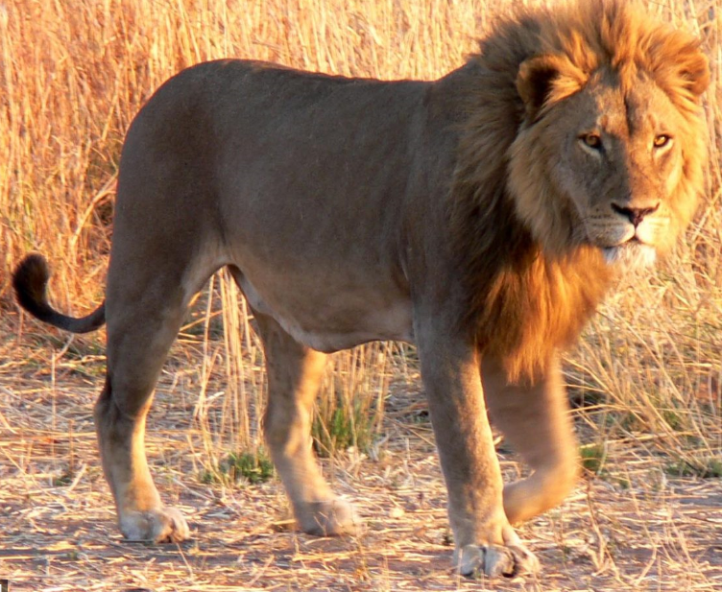
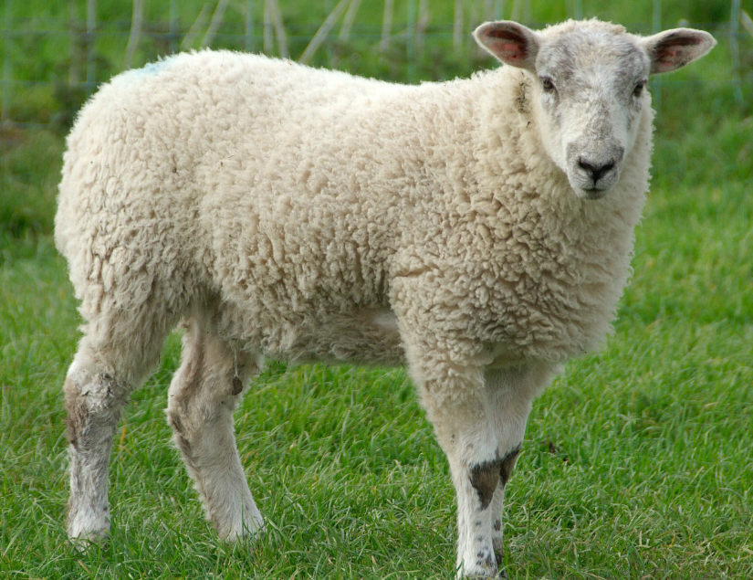

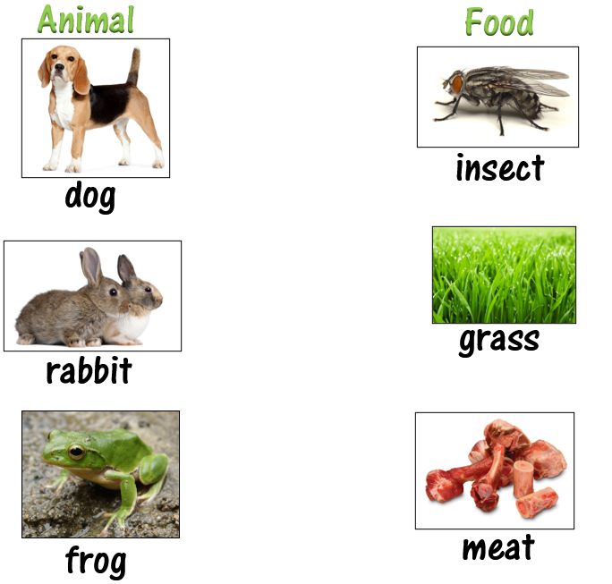
13. Draw a line to match the animal to the correct description.
herbivore
carnivore
omnivore
1 mark
14. Draw a line from the animal to a food that it would most likely eat
1 mark

Slide 10
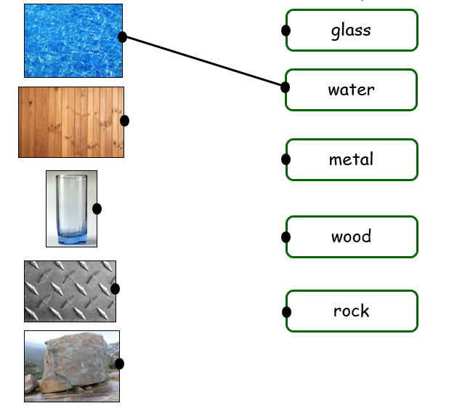
Everyday Materials
Score: /9
Materials
15. Please draw a line connecting the pictures of these materials with their name. One has been done for you.
1 mark

Slide 11
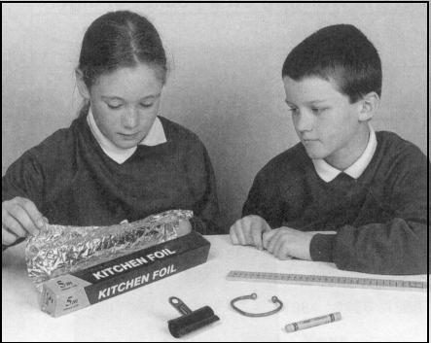
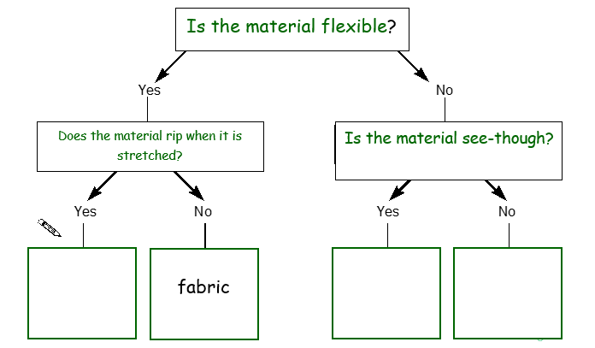
Sarah and Rob are investigating the properties of materials.
They compare wood, metal, paper and glass
They use a key to sort the materials.
16. Complete the key by writing wood, fabric, paper and glass in the correct answer boxes at the bottom of the key.
Use each word once. You may put one word in each answer box. One has been done for you.
2 marks

Slide 12
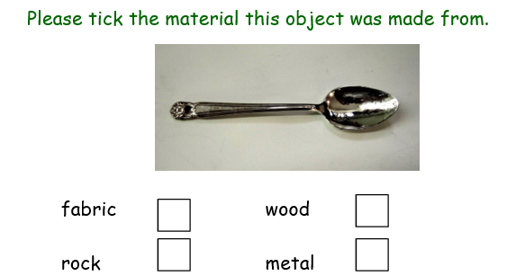
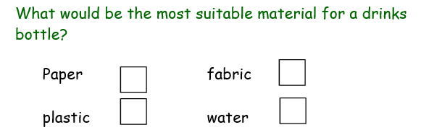
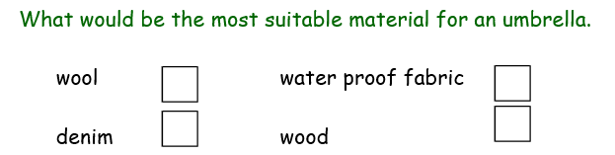
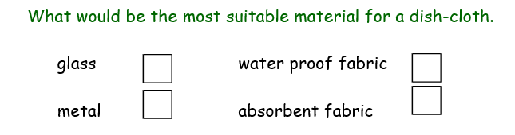
17.
1 mark
18.
1 mark
19.
1 mark
20.
1 mark

Slide 13
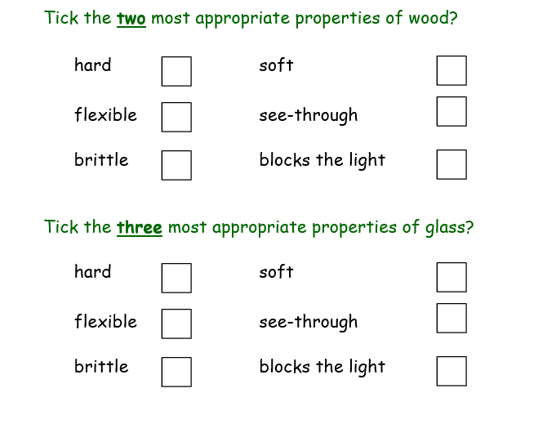
21.
1 mark
22.
1 mark

