Slide 1
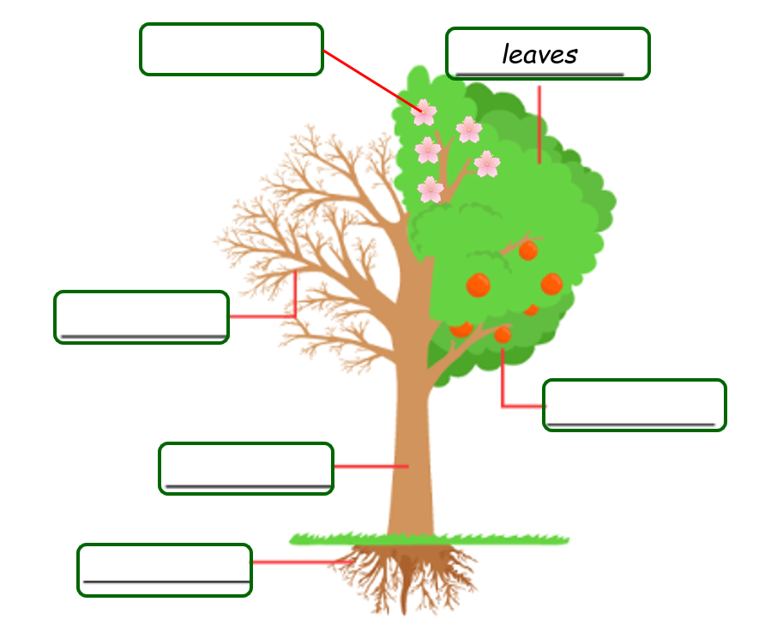
Newbald Primary School Science Progress Assessment
Year 1 Science Assessment
Mark Scheme
Total Marks: 25
1. Award TWO marks for correctly identifying five parts of the tree: If two marks cannot be awarded, award ONE mark for three parts correctly labelled.
Blossom / flowers
branches
fruit
trunk
roots
2 marks

Slide 2
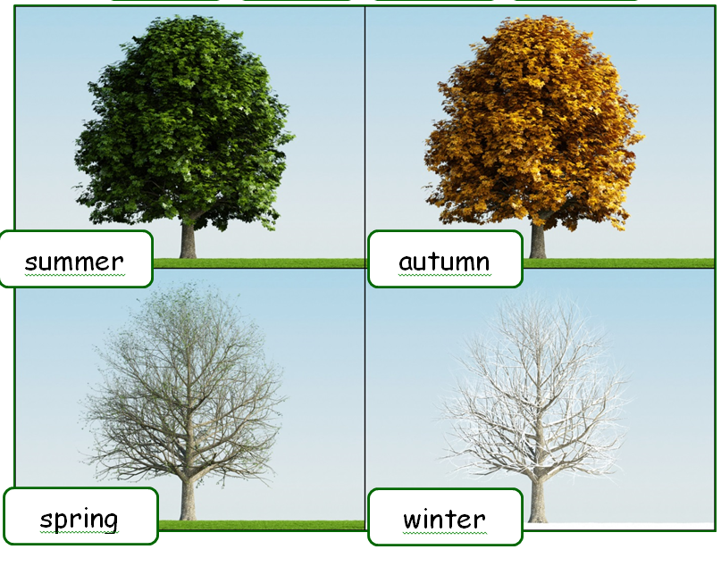
2. Award ONE mark for:
oak
3. Award ONE mark for:
Holly
4. Award ONE mark for all three seasons correctly identified.
5. Award ONE mark for identifying that the tree will lose its leaves.
Accept that the leaves will change colour.
Do not accept any reference to the tree being an evergreen.
6. Award ONE mark for:
Summer (Do not award the mark for any other boxes ticked.)
7. Award ONE mark for:
Winter (Do not award the mark for any other boxes ticked.)

Slide 3
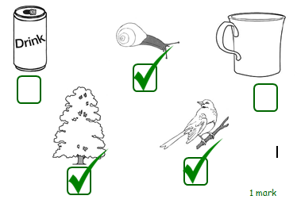
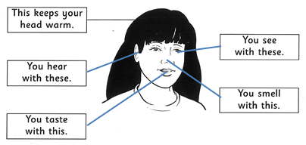
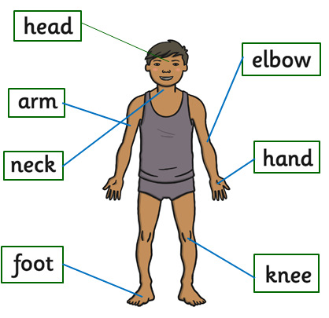
8. Award 1 mark for all three correctly identified with no errors as follows:
9. Award 1 mark for all 4 correctly labelled as follows.
10. Award 2 marks for all correctly identified. Award 1 mark for 4 or 5 correctly identified.
Do not accept ambiguous labelling to areas of the body that are near the correct part but continue the line or end in an incorrect place.

Slide 4
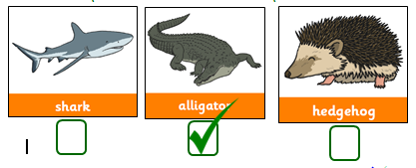
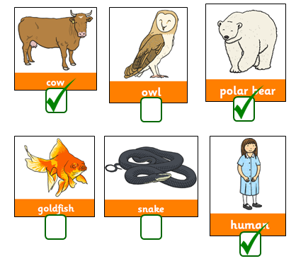
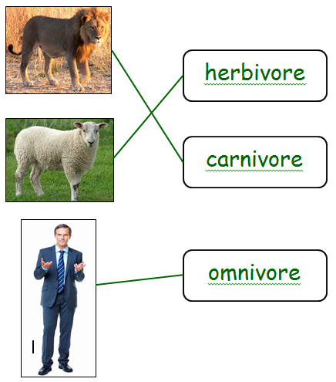
11. Award 1 mark for:
12. Award 1 mark for all three correctly identified with no errors.
13. Award 1 mark for all three correctly identified with no errors.

Slide 5
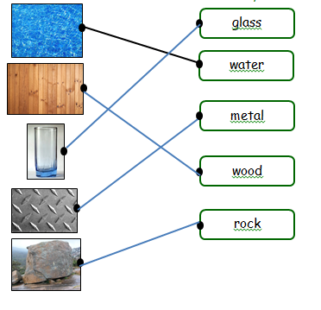
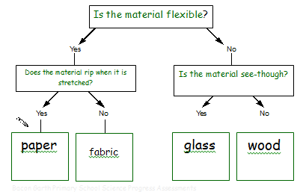
14. Award 1 mark for all three correctly identified as follows.
dog – meat
rabbit – grass
frog – insect
15. Award 1 mark for all correctly identified.
16. Award 2 mark for all three correctly placed with no errors. Do not award 1 mark for 1 or 2 correct.

Slide 6
17. Award 1 mark for: Metal
18. Award 1 mark for: plastic
19. Award 1 mark for: waterproof fabric
20. Award 1 mark for: absorbent fabric
21. Award 1 mark for two properties identified:
Hard
Blocks the light
(With no mistakes or other properties ticked)
22. Award 1 mark for three properties identified:
Hard
See-through
brittle
(With no mistakes or other properties ticked)

