Slide 1


Newbald Primary School
ART
Summer 2 - Framework

Slide 2



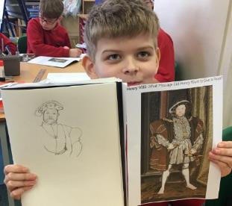
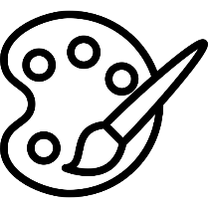
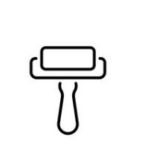

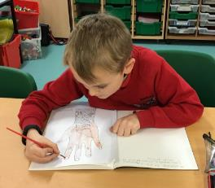

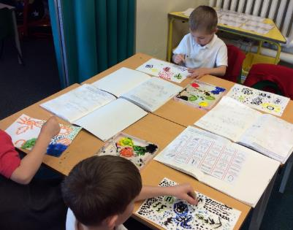


Core Concepts
Key Core Concept Areas
Drawing
Painting
Sculpture
Printing
Textile/Collage
Plus:
Famous Artists
Developing Ideas

Slide 3

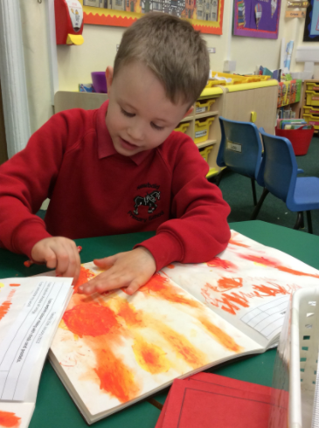
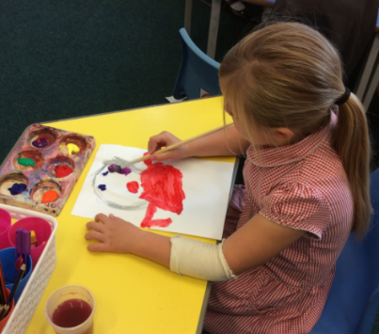
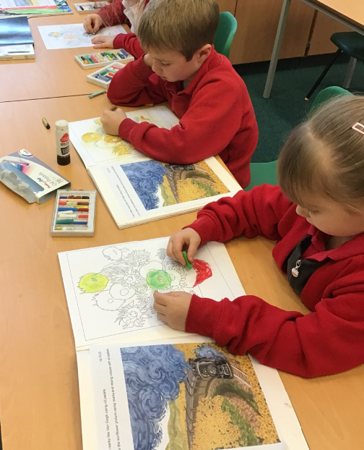
Long Term Plan Coverage – Cycle A
 | Autumn 1 | Autumn 2 | Spring 1 | Spring 2 | Summer 1 | Summer 2
Year N & R | People who help us Drawing Focus | The World Painting Focus | Dinosaurs Collage Focus | Traditional Tales Sculpture Focus | Growing & Lifecycles Printmaking Focus | Houses & Homes Painting Focus
Year 1 & 2 | Painting Aboriginal Art Emily Kame Kngwarreye | Painting Aboriginal Art | Weather and Climate Collage | Explorers printing | Local Artist: Yorkshire Sculpture Artists Henry Moore & Barbra Hepworth etc | Sketching Light & Shade Real Life Drawings Drawing: still life inventions
Year 3 & 4 | Victorian Britain: Victorian Artist focus: Beatrix Potter Drawing & painting - Watercolour |  | India & Asia printing Carbon Paper Print Art | English Artist Greats: Painting Landscapes L. S. Lowry, John Constable | Coasts Drawing: Light, shade & sea birds | Vikings Viking Long-ship Collage
Year 5 & 6 | Ancient Egyptian Art Watercolour silhouette landscapes (Painting) Canopic Jars (sculpture & clay work) | European Artists Study Monet Vincent Van Gogh Seurat Painting | Hans Holbein Tudor Portraits Drawing & Painting Tudor Roses collage | Mountain Landscapes Albert Bierstadt (artist) Use of depth / perspective Drawing & painting | Pop Art Study Andy Warhol (Printing) Roy Lichtenstein (Ben Day Dots) Richard Hamilton (Collage)
Key Core Concept Areas & Coverage
Drawing
Painting
Sculpture
Printing
Textile/Collage
Within the above Concept Areas
Famous Artists
Developing Ideas

Slide 4
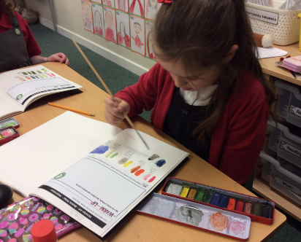
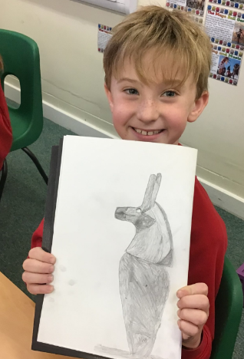
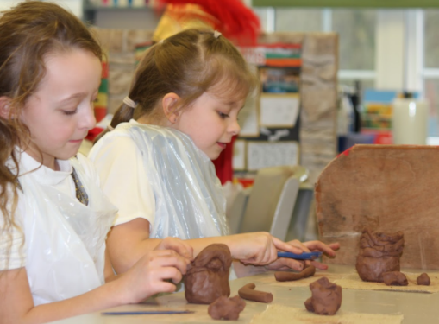
Long Term Plan Coverage – Cycle B
 | Autumn 1 | Autumn 2 | Spring 1 | Spring 2 | Summer 1 | Summer 2
Year N & R | All About Me Drawing Focus | Space Painting Focus | Julia Donaldson Collage Focus | Newbald Sculpture Focus | Minibeasts Printmaking Focus | Beside the Seaside Painting Focus
Year 1 & 2 | Transport Drawings Hot air Balloon Art Drawing, Painting & Collage Artist: Vincent Van Gogh | Polar Regions Landscapes & Animals | Great Fire of London(buildings) Printing & Drawing | Pirates and the oceans Collage / Painting -sea scape Artist: Turner /Terry Frost/Henri Matisse. Collage & Painting | An Island Home Textiles -weaving tartan Textile / Collage | Kings and Queens Sculpture -Clay tiles palaces and Castles Sculpture
Year 3 & 4 | Blitz Scenes & World War 2 Art & Propaganda Drawing & Painting | Famous American Artists, Jasper Johns, Jackson Pollock & Edward Hopper Famous Artists, Painting & Collage | The Romans Sculpture Coil pots and mosaics Sculpture & Collage |  | Forests Drawing : pastels Rainforest animals Drawing & Painting | Middle Ages Bayeux Tapestry Printing Printing
Year 5 & 6 | Propaganda Art & Paul Nash Drawing focus | Brazilian Artist Study Romero Britto Famous Artists | Ancient Greece Sculpture Masks Sculpture | Human Rights Make my voice heard Guernica –Picasso Drawing & painting | The Mayan Civilisation Printmaking : block printing & Digital Print design -string /lino printing Printing | Maps and Rivers Drawing/sketching Flora and Fauna Lilian Snelling & Drawing
Key Core Concept Areas & Coverage
Drawing
Painting
Sculpture
Printing
Textile/Collage
Within the above Concept Areas
Famous Artists
Developing Ideas

Slide 5
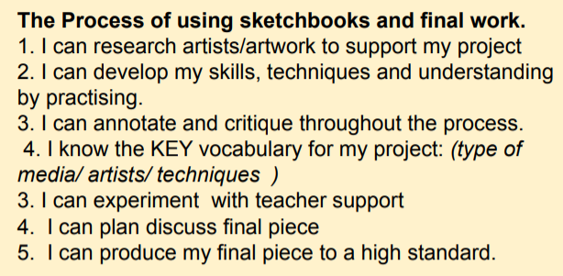

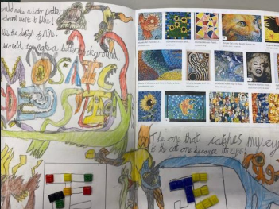
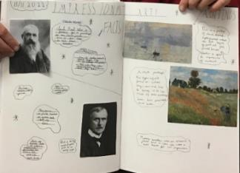
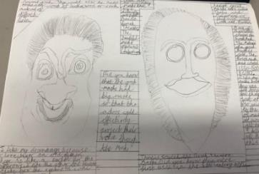
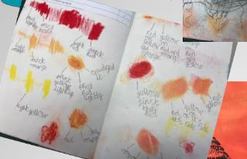
Sketchbooks
Need to show progression of the project with research /experimentation
All work needs to have short date and learning objective
Aim to have a double page allocated to a project showing aspects of the learning journey -children can take pride in this and learn how to add interesting titles/lettering and neat annotations. Of course, extra pages may be needed.

Slide 6
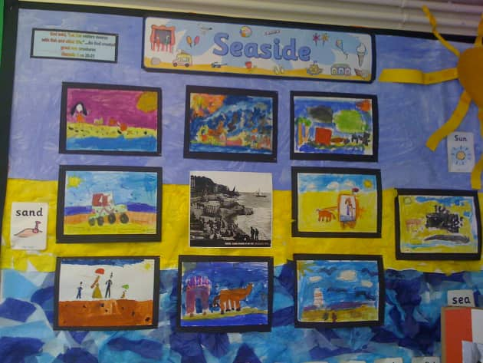
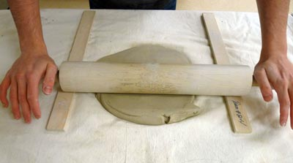
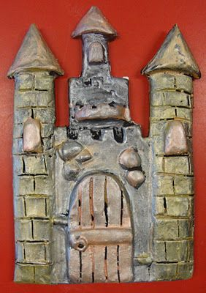
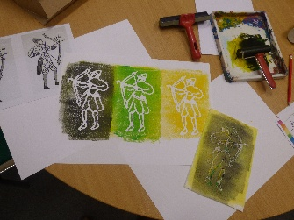
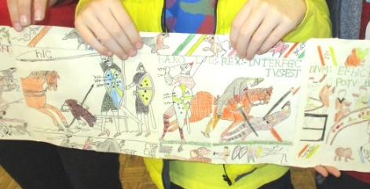
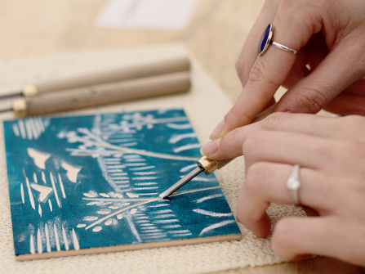
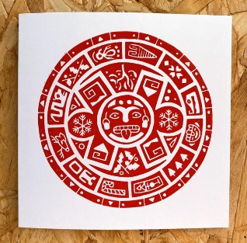
Newbald Primary School : Summer 2 - Art
Newbald Primary School : Nursery & Reception Art
Term: Summer 2 – Beside the Seaside
Project: Various activities linked to the development matters learning goals
Newbald Primary School : Year 1 & 2 Art
Term: Summer 2 – Kings & Queens
Art Focus: Sculpture
Project: 3D Clay tiles (Palaces and Castles)
Newbald Primary School : Year 3 & 4 Art
Term: Summer 2 – Middle Ages
Art Focus: Drawing & Printing
Project: Bayeux Tapestry Drawing & Printing
Newbald Primary School : Year 5 & 6 Art
Term: Summer 1&2 – Mayan Civilisation & Maps & Rivers
Art Focus: Printing
Project: String / Lino Printing

Slide 7


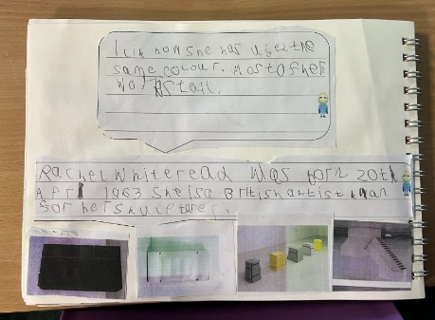
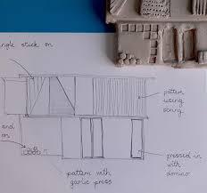
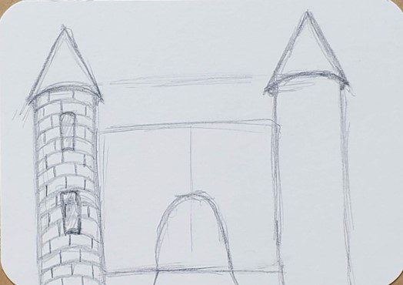
Newbald Primary School : Year 1 & 2 Art
Term: Summer 2 – Kings & Queens
Art Focus: Sculpture
Project: 3D Clay tiles (Palaces and Castles)
Year 1 – Sculpture Key Objectives
Investigate clay using pinching, rolling, twisting, stretching and coiling
Experiment with constructing and joining (clay)
To know two or more methods for manipulating clay (e.g.: pinch, roll, twist, stretch, coil)
Year 1 – Famous Artists Key Objectives
Describe the work of famous, notable artists and designers
Express an opinion on the work of famous, notable artists;
Use inspiration from famous, notable artists to create their own work and compare.
Year 2 – Sculpture Key Objectives
To know how to and be able to use tools details and textures to clay using
tools safely
Experiment with constructing and joining natural materials (clay)
Look at sculptures by known artists and objects (castles & palaces) as starting points for own work
Year 2 – Famous Artists Key Objectives
Describe the work of famous, notable artists and designers
Express an opinion on the work of famous, notable artists;
Use inspiration from famous, notable artists to create their own work and compare.

Slide 8
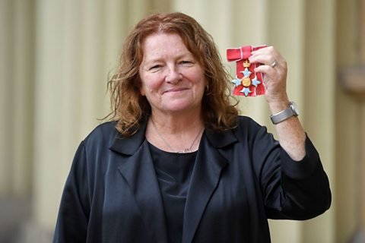
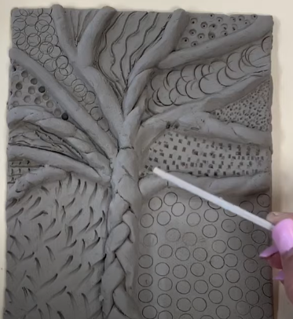
Kings & Queens
Palace & Castle Sculpture Tiles
I can comment on work by Artist (and sculptor) Rachel Whiteread
I can explore clay and use a variety of clay tools to create texture
I can research palaces and castles of Kings and queens to influence my design
I can design a 3D clay tile of a palace or castle
I can make a 3D clay tile from my drawn design
I complete and evaluate my 3D clay tile

Slide 9
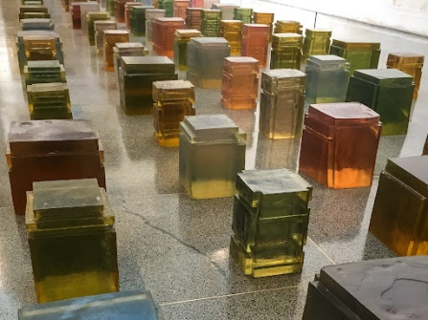
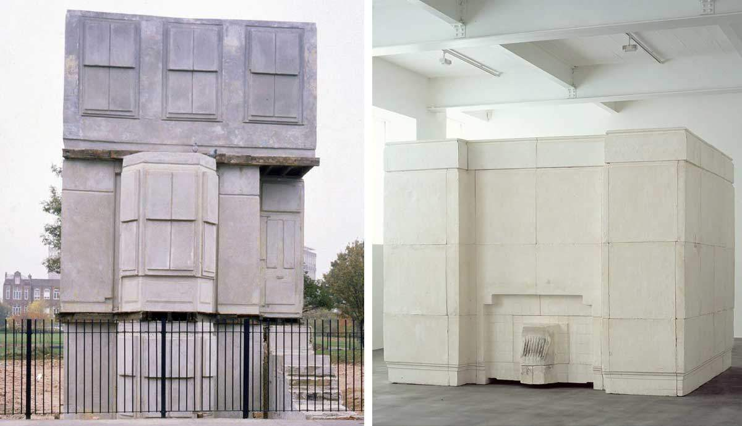
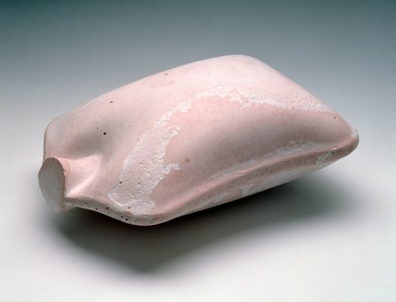

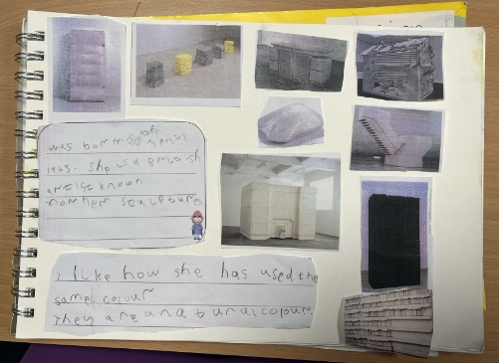
1. I can comment on work by Artist (and sculptor) Rachel Whiteread
Look at the artist and sculptor Rachel Whiteread. Explain that she is famous for her sculptures and plaster cast work. Explain that she recognises and champions negative spaces that some people might not even see.
Rachel was the first woman to win the Turner Prize in 199. She was awarded a CBE in 2006 and a Damehood in 2019. Her work is all about celebrating the invisible negative space. Look at some information about Dame Rachel Whiteread and look at some examples of her work. Some useful websites are below.
https://www.bbc.co.uk/bitesize/articles/z4wjxg8#z9jq6rd
https://youtu.be/h3BqweEOGm4?si=69yjHndARjNihJfh
https://www.tate.org.uk/kids/explore/who-is/who-rachel-whiteread
https://kids.kiddle.co/Rachel_Whiteread
Look at some examples of her artwork and encourage the children to create a sketchbook profile. This should include Describing the work of the famous artist, giving opinions about her work and thinking about using her work as inspiration for their own clay tiles that they will be making in the forthcoming sessions.
Children could make some sketches of Whiteread’s work and write sentences giving their opinion about her work.

Slide 10
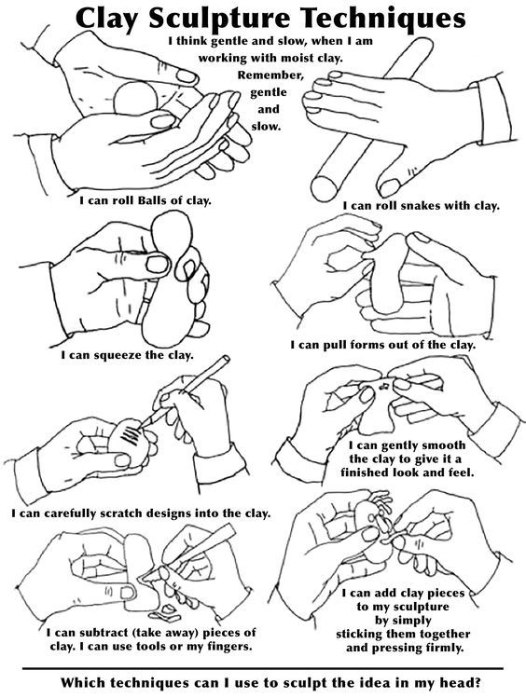
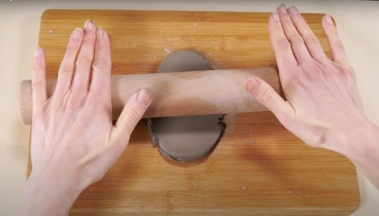
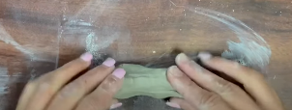
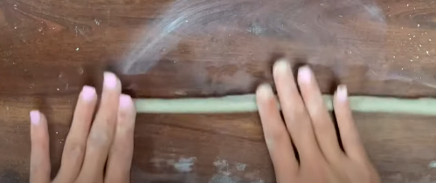
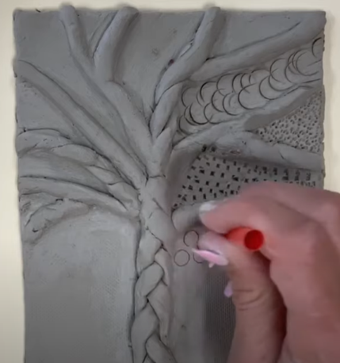
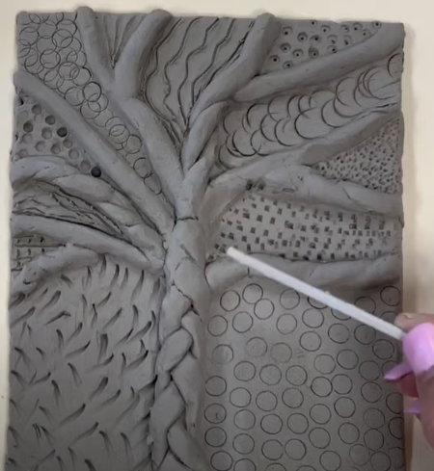
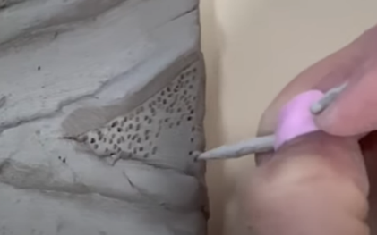
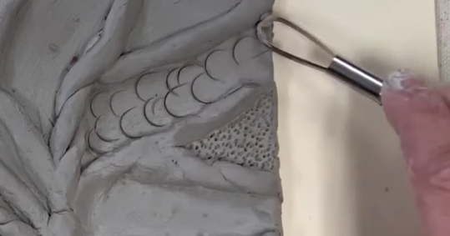
2. I can explore clay and use a variety of clay tools to create texture
Remind the pupils about the artist Dame Rachel Whiteread and her sculptures.
What can the pupils remember about her? Can they remember anything about her artwork? What does negative space mean? How did she use texture in her work?
Explain that in this unit the pupils will be experimenting with clay in this session and they will be developing skills that they will be using to create a clay tile.
In this session allow the children to experiment with clay and techniques that they may need when creating their tile later on in the unit.
Children should experiment with:
How to smooth and flatten clay.
How to roll clay into a cylinder or ball.
How to make different surface marks in clay.
How to pinch clay
How to mix clay slip using clay and water.
How to join two clay pieces using slip.
How to make a relief clay sculpture.
How to use hands in different ways as a tool to manipulate clay.
How to use a variety of clay tools to score clay and create texture.
Explain that the use of texture will be crucial to a successful tile and the pupils should think about the different elements that might be on their tile design and how they can use a variety of tools and objects to create interesting textures.
The video below is useful to show the process of making a clay tile and experimenting with tools and textures.
https://youtu.be/o2ammJpSiaY?si=G_vwsy0JY2cCgRKr

Slide 11
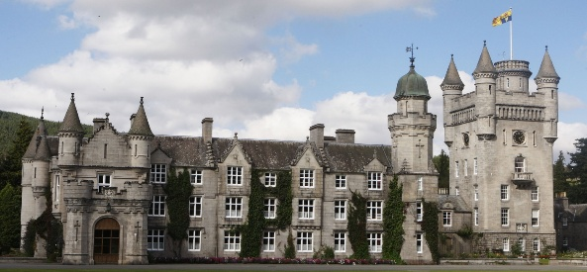
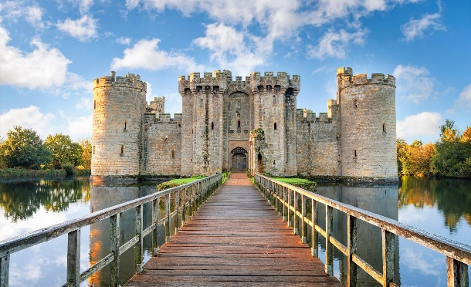
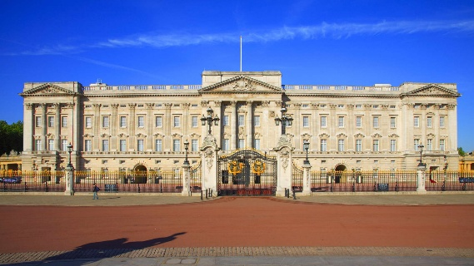
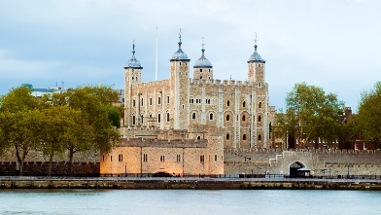
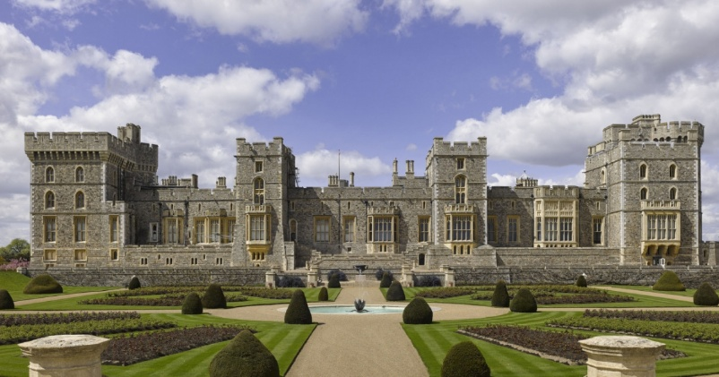
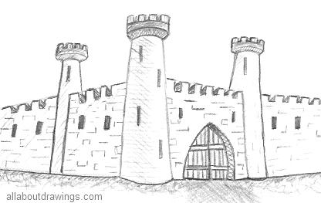
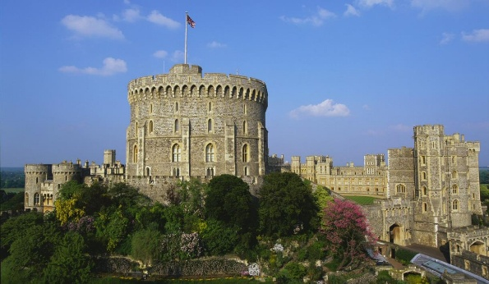
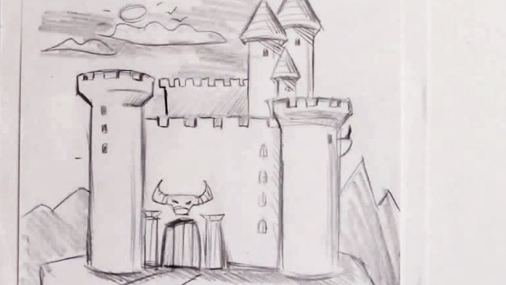
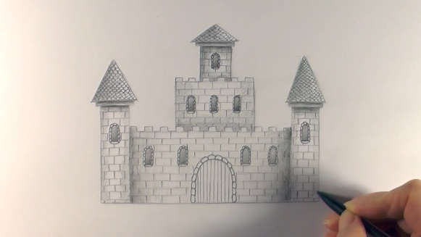
3 I can research palaces and castles of Kings and queens to influence my design
Recap the last session and remind the children about experimenting with clay and texture.
Remind the pupils that their task is to create a 3D clay tile of a palace or castle belonging to a king or queen.
Explain that the pupils can also be influenced by the work of Dame Rachel Whiteread and they can also consider the use of negative space if they wish to as well as ensuring the tile incorporates texture.
In this session allow the pupils to research palaces of kings and queens. The pupils could record some sketches of their favourite palaces, castles and buildings that once were homes or places of interest related to the kings and queens of England.

Slide 12
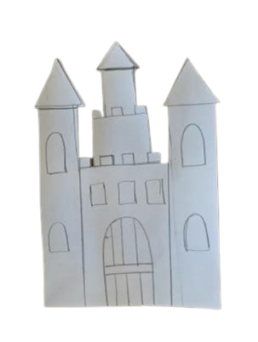




4 I can design a 3D clay tile of a palace or castle
Recap the sessions in this unit so far.
Remind the pupils that their task is to create a 3D clay tile of a palace or castle belonging to a king or queen.
Explain that the pupils can also be influenced by the work of Dame Rachel Whiteread and they can also consider the use of negative space if they wish to as well as ensuring the tile incorporates texture.
In this session ask the pupils to design their tile. They should draw their designs in their sketch books and label any interesting features or textures. The children could label which tools they would use to create certain textures and they could label where they would use a score and slip technique to ensure any added detail does not fall off.

Slide 13







5. I can make a 3D clay tile from my drawn design
6. I complete and evaluate my 3D clay tile
Remind the children about the art unit and their task to create a 3D tile of a castle or palace (linked to a king or queen)
Use more than one session for the children to create their tile and ask the children to consider the finishing touches and apply any textures with care
The children will need to draw on some techniques that they explored in session 2. Some key techniques that the children would benefit from being shown again include: How to roll out a slab to create a tile, using a score and slip technique and creation of texture using clay tools.
Ask the pupils to work from their designs to create and complete their 3D tiles. Consider how the tiles will be displayed. If necessary, ensure pupils put holes in the tiles so that ribbons can be added to hang etc.
There is no intention to paint, yet when the clay is dry a glaze like substitute could be used to enhance the tiles.
After the tiles are complete and dry, take pictures of the tiles to include in their art sketch books. The pupils should write some evaluation sentences saying what they liked best and what could be improved.

Slide 14



Slide 15






Newbald Primary School : Year 3 & 4 Art
Term: Summer 2 – Middle Ages
Art Focus: Drawing & Printing
Project: Bayeux Tapestry Drawing & Printing
Year 4 - Drawing Key Objectives
Draw for a sustained period of time at an appropriate level.
Demonstrate experience in different grades of pencil and other implements to draw different forms and shapes.
To be able to indicate facial expressions in drawings and show body language in drawing
To use a range of implements to draw different forms and shapes.
To understand how to use a variety of hard and soft drawing pencils to create
different effects
To use shading to show light and shadow effects.
To show an awareness of space when drawing
Begin to understand, perspective and proportion including foreground, middle-ground and background
Year 4 Printing Key Objectives
Print pictures using different printing techniques e.g. mono printing,
block printing, relief or impressed method with increased precision
To create a template and print multiple copies of a design
To use more than one colour to layer in a print
To use printing methods to make repeated patterns with precision.
Year 3 – Drawing Key Objectives
Develop intricate patterns/ marks with a variety of media.
Experiment with marks and lines with a wide range of implements e.g. charcoal/graphite, chalk, pencil, crayon/pastel, pens
Begin to indicate facial expressions in drawings
To begin to understand how to use a variety of hard and soft drawing pencils to create different effects
Begin to use shading to show light and shadow effects.
Begin to show an awareness of space when drawing
Begin to understand how proportion can be related foreground, and background
Year 3 Printing Key Objectives
Print simple pictures using different printing techniques e.g. mono printing,
block printing, relief or impressed method
To know how to create a template to print multiple copies of the design
To begin to use more than one colour to layer in a print
To use printing methods to make repeated patterns

Slide 16





Bayeux Tapestry Drawing & Printing
I can research the Bayeux Tapestry
I can experiment with printing a repeated pattern of part of the Bayeux Tapestry
I can complete my Bayeux Tapestry repeat pattern print and I can evaluate it.
I can make detailed observational drawings to create a class reproduction of the Bayeux Tapestry
I can make detailed observational drawings to create a class reproduction of the Bayeux Tapestry
I can evaluate my Bayeux Tapestry inspired artwork

Slide 17





1. I can research the Bayeux Tapestry
Explain that in this unit the children are going to research and complete art tasks about the Bayeux Tapestry. Discuss the Bayeux Tapestry together and discuss questions such as, what is it? What does it show? How was it made? Who made it?
Research the tapestry together as a class. The children may be aware of what the Bayeux Tapestry is through their History lessons if not share information about it using this PowerPoint. https://www.twinkl.co.uk/resource/ks2-all-about-the-bayeux-tapestry-powerpoint-t2-h-5773
And this video which shows the tapestry:
https://youtu.be/F8OPQ_28mdo?si=an2BRtQvPumGGDLi
Give the children copies of the information and quiz questions on the next two pages. Ask the pupils to read through the information and answer the questions carefully and neatly. Answers to the quiz questions are also included. Go through these with the children and invite them to correct their work if they have made any mistakes.
Evaluating the artwork.
Ask the children to consider the Bayeux tapestry as a piece of art. Do they like it? Why? How is the artwork successful? Would it be as effective if it wasn’t 70 meters long? Consider the drawn figures. Are they accurate representations of humans? Why have they been simplified? Explain that this is more of a medieval cartoon strip than a piece of traditional fine art, yet it is recognised as a historical masterpiece.
Look at different sections of the tapestry, which sections do the pupils like? Why do they like these scenes? If time allows the children could make quick sketches of a favourite scene and write why they like the artwork.

Slide 18


Slide 19


Slide 20


Slide 21








2. I can experiment with printing a repeated pattern of part of the Bayeux Tapestry
3. I can complete my Bayeux Tapestry repeat pattern print and I can evaluate it.
Begin by reminding pupils about the Bayeux Tapestry and explaining that they will complete two short art mini projects inspired by it. The first mini project will take approximately two sessions and will extend pupils’ understanding of printing techniques.
Recap printing methods the children have previously explored, such as polystyrene printing, carbon paper transfers and wax rubbings. Explain that pupils will select a figure from the Bayeux Tapestry and create a repeated pattern print based on that figure.
Pupils may use one of the outline figures provided on the following pages or choose another figure from the tapestry. Before beginning the printing process, pupils should make a quick observational sketch of their chosen figure in their sketchbooks. This will help them simplify the image and prepare for the printing activity.
The final print will be created on A3 paper and will contain three repeated prints of the same figure. Each individual print should therefore be approximately A5 in size (around 20 cm × 13 cm) to allow space for the repeated pattern.
To create the printing block, pupils will use a polystyrene printing sheet, building on the technique used in their Great Fire of London printing project. Using a pencil, pupils should draw a simplified version of their chosen Bayeux Tapestry figure onto the polystyrene surface. Encourage pupils to focus on clear outlines and key features, as very detailed drawings are less effective when printed.
Tracing techniques may be used if helpful, although it is often easier to draw directly onto the polystyrene. Teachers should also remind pupils that prints will appear reversed. If correct orientation is important, a reversed image may need to be prepared beforehand.
Printing ink (or paint) should be rolled evenly onto the polystyrene surface using a printing roller. The block can then be placed onto the A3 paper, leaving enough space for two additional prints. A clean, dry roller should be used to gently press the polystyrene onto the paper before carefully lifting it away to reveal the print.
Pupils should produce three repeated prints using different colours. They should begin with a light colour, followed by a mid tone and finally a darker colour. This sequence will create contrast across the repeated pattern.
Once the prints are complete, a photograph of the finished work should be taken and added to pupils’ sketchbooks.
When the prints are dry, they may be cropped and either mounted for display or added directly into sketchbooks. If the work is displayed, a photograph of the display should be included in the sketchbooks.
To conclude the activity, pupils should write several evaluative sentences reflecting on their work and the printing process. They should consider what went well, what they might improve next time and the overall effect of the repeated prints. Pupils should also comment on their artistic choices, including colour selection and composition.
Note: In this session, the children can soak tea bags to then stain many pieces of A4 paper in preparation for their future art sessions. This will allow the paper to dry. Please see the next lesson for more details.

Slide 22


Slide 23


Slide 24


Slide 25


Slide 26


Slide 27





Slide 28





Slide 29




4. I can make detailed observational drawings to create a class reproduction of the Bayeux Tapestry
5. I can make detailed observational drawings to create a class reproduction of the Bayeux Tapestry
6. I can evaluate my Bayeux Tapestry inspired artwork
Remind the children what they have learnt about the Bayeux tapestry and about the printing work they have completed. Explain that they will now collaborate to produce a replica of the Bayeux tapestry. The original is approximately 70 metres long, so a section may be chosen for the pupils to recreate.
Explain that the pupils will individually recreate a section of the tapestry and then these can be pieced together to create a collaborative piece of art. The website below shows the entire tapestry in HD. https://www.bayeuxmuseum.com/en/the-bayeux-tapestry/discover-the-bayeux-tapestry/explore-online/ This website describes what is happening in each scene. Children could choose different scenes of interest. https://historylearning.com/medieval-england/bayeux-tapestry/bayeux-tapestry-scene-by-scene/
When creating their section or scene, the children should be encouraged to use a similar scale and the children should be encouraged to draw for a sustained period of time and ensure high standards by carefully reproducing detail in the tapestry.
Before the session, the children could use tea-bags soaked in water to stain pieces of paper to make them look aged. This will also give a consistent colour for all the pieces of art. Children can use pencils and pencil crayons for their artwork. The pupils should consider scale and work collaboratively to ensure that borders are a consistent width so that it looks pleasing when pieced together. Children should be challenged to consider scale of the figures drawn and this should be in keeping with the original.
When complete the pupils can collate their art to create one long Bayeux Tapestry reproduction. Photographs / colour photocopies of both an entire piece and the individual artwork can be included in sketchbooks. The pupils could write an evaluation about how they created their reproductions: Pupils to include: How they took care to draw each figure. What they found difficult and why. What they think was successful and why. Some examples are on the following pages.

Slide 31





Slide 32





Slide 33





Slide 34






Newbald Primary School : Year 5 & 6 Art
Term: Summer 1&2 – Mayan Civilisation
Art Focus: Printing
Project: Mayan Lino Reduction Printing
Year 5 – Printing Key Objectives
Design and create printing blocks / tiles
Develop techniques in mono, block and relief printing
Create and arrange accurate patterns
Begin to experiment with over printing motifs and colours
Begin to replicate (or be influenced by) pieces by famous printers (Picasso)
Year 5 – Famous Artists Key Objectives
Begin to give detailed observations about notable artists’, artisans’ and designers’ work;
Begin to offer facts about notable artists’, artisans’ and designers’ lives;
Year 6 – Printing Key Objectives
Demonstrate experience in a range of printmaking techniques.
Describe techniques and processes. Adapt their work according to their views and describe how they might develop it further.
Show understanding of the techniques used by famous printers (Picasso)
Experiment with over printing motifs and colours
Replicate (or be influenced by) pieces by famous printers (Picasso)
Year 6 – Famous Artists Key Objectives
Give detailed observations about notable artists’, artisans’ and designers’ work;
Offer facts about notable artists’, artisans’ and designers’ lives;

Slide 35







Mayan Reduction Lino Printing
I can research Mayan art & Printing techniques used by artist Pablo Picasso
I can sketch plans and designs for a relief printing tile thinking about how a Reduction Linocut Print technique might be used for a tri colour print
I can create a printing tile
I can create a repeat pattern print
I can use a Reduction Linocut Print technique to add to my repeat pattern print
I can complete my repeat pattern print using 3 colours reduction and evaluate my artwork

Slide 36







1. I can research Mayan art & Printing techniques used by artist Pablo Picasso
2. I can sketch plans and designs for a relief printing tile thinking about how a Reduction Linocut Print technique might be used for a tri colour print
Explain to the children that in this art unit the pupils will be creating a linocut print piece of art. Explain that the design of which will be inspired by the Mayan Civilisation. Ask the pupils to research some Mayan artwork, glyphs and typical patterns. The pupils will need to create a sketch study of some of their favourite examples that will influence their Mayan linocut printing artwork
Introduce the pupils to what a lino-cut printing technique is by watching a video. This will influence designs as the children will need to The pupils should collect some examples of Myan artwork that they think would work well with a simple printing technique.
Remind the pupils about the Artist Pablo Picasso and ask the pupils to look back at work they have completed by this artist in their previous art unit. Research artist Pablo Picasso’s use of lino cut printing techniques using this video. Explain that the pupils will be looking at using a two or three colour print as well as considering the colour of the background. https://youtu.be/bg6FowI4h8o?si=576ooOBQMv0YFo0v
Ask the pupils to comment on Picasso’s work and ask them to consider how his printed piece of art: ‘Jacqueline with Glossy Hair’ could influence their Mayan print designs.
Another video looks at a repeat pattern. Explain that the pupils will need to repeat the pattern at least 4 or more times.
https://youtu.be/LHWq7r_V720?si=Kr2vQxJDg3y1ke2B (Watch this video from 2 minutes in to see over printing technique)
Ask the pupils to make multiple designs for their lino print. They should annotate and consider the background colour and how two or three colours could be applied at stages to create the final design. Ask the pupils to consider the order the colours will be applied. A good technique can be to start with the lightest colour e.g. yellow and build to the darkest e.g. blue / black etc. Children may like to consider that prints will be ‘back to front’ and should avoid lettering etc.

Slide 37







2. I can create a printing tile
3. I can create a repeat pattern print
Remind the pupils about their art unit and their study of lino cut printing and Mayan art. Ask the pupils to look back at their designs for a Mayan style lino print using two or three colours. Firstly, the children should consider the background colour and how this will be created. This could be by choosing coloured paper or by creating a watercolour wash etc. This should be done and left to dry so that it is ready for the printing process.
IMPORTANT: Ensure that safety has been considered when asking the children to do lino cutting. CLEAPS should be accessed and risk should be assessed before asking the children to use tools for the reduction process of the lino tile. Remind the children of some key safety tips such as: Always carve away from yourself; Keep both hands behind the sharp end of your carving tool; Use a non-slip safety mat or protective surface to protect the tables; Carve short, small pieces at a time etc.
Ask pupils to consider the first colour of their print and to remove areas where the colour would not be printed. Some useful slides to help with this are included
This video reminds the children about multi colour reductive prints: https://youtu.be/enYSeVtcp_w?si=__fv6k07b7rhM1CR
This video is a beginner's guide to lino printing (parts of this video may be useful to illustrate particular skills in the process):
https://youtu.be/2PtUWMojapo?si=UCiGanpGuHcW5Fdx
Ask the pupils to carve their lino print and than use printing ink (or paint if no ink is available) to print a repeat pattern of the first colour.
Children should consider neatness and regularity of the repeat pattern. They should also consider rotating the repeat prints. Patterns should be repeated at least 4 times or more. It is important that ink fully dries on paper, but also the children will need to clean the lino tile and let it fully dry before the children continue with the process for a second (or third colour)

Slide 38






5. I can use a Reduction Linocut Print technique to add to my repeat pattern print
6. I can complete my repeat pattern print using 3 colours reduction and evaluate my artwork
Remind the pupils about what they have done so far in this unit. Look at the repeated print that the pupils have created so far and explain that they will need to reduce the surface area on their tile to print a second colour. (Note: For pupils doing a third colour, they will need to repeat this process)
Remind the pupils again about the reduction process and how the removed areas from the lino will not print the next colour. Pupils should consult their designs and carefully think about what needs to be removed using the carving tools. It is important that CLEAPS is consulted and risk is considered when asking pupils to use carving tools. Remind the pupils about safety when using the carving tools.
Pupils to carve their lino time and use ink (if possible) to print second (and then third) colours to their design until completion.
Photographs of the final piece should be included in sketchbooks and pupils should be asked to evaluate their artwork commenting on what they think worked well, what could be improved or changed if they did the process again. Pupils could compare their print to that of Picasso’s Jaqueline with glossy hair. The lino tiles do not need to be stuck into sketch books, but a picture of these could be taken and included. If time allows, pupils could write a ‘how to’ guide for making a reduction lino print.

