Slide 1


Newbald Primary School
ART
Spring 2- Framework

Slide 2




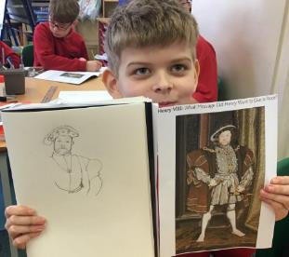



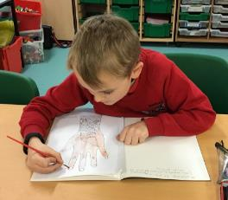

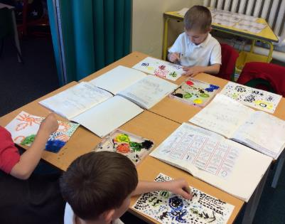


Core Concepts
Key Core Concept Areas
Drawing
Painting
Sculpture
Printing
Textile/Collage
Plus:
Famous Artists
Developing Ideas

Slide 3

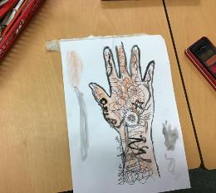
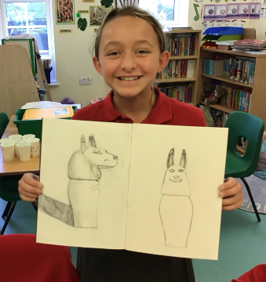
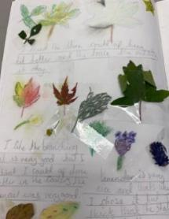
Long Term Plan Coverage – Cycle A
 | Autumn 1 | Autumn 2 | Spring 1 | Spring 2 | Summer 1 | Summer 2
Year N & R | People who help us Drawing Focus | The World Painting Focus | Dinosaurs Collage Focus | Traditional Tales Sculpture Focus | Growing & Lifecycles Printmaking Focus | Houses & Homes Painting Focus
Year 1 & 2 | Painting Aboriginal Art Emily Kame Kngwarreye | Painting Aboriginal Art | Weather and Climate Collage | Explorers printing | Local Artist: Yorkshire Sculpture Artists Henry Moore & Barbra Hepworth etc | Sketching Light & Shade Real Life Drawings Drawing: still life inventions
Year 3 & 4 | Victorian Britain: Victorian Artist focus: Beatrix Potter Drawing & painting - Watercolour |  | India & Asia printing Carbon Paper Print Art | English Artist Greats: Painting Landscapes L. S. Lowry, John Constable | Coasts Drawing: Light, shade & sea birds | Vikings Viking Long-ship Collage
Year 5 & 6 | Ancient Egyptian Art Watercolour silhouette landscapes (Painting) Canopic Jars (sculpture & clay work) | European Artists Study Monet Vincent Van Gogh Seurat Painting | Hans Holbein Tudor Portraits Drawing & Painting Tudor Roses collage | Mountain Landscapes Albert Bierstadt (artist) Use of depth / perspective Drawing & painting | Pop Art Study Andy Warhol (Printing) Roy Lichtenstein (Ben Day Dots) Richard Hamilton (Collage)
Key Core Concept Areas & Coverage
Drawing
Painting
Sculpture
Printing
Textile/Collage
Within the above Concept Areas
Famous Artists
Developing Ideas

Slide 4
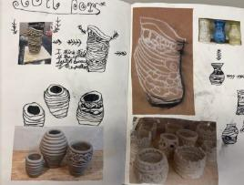
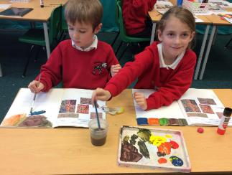
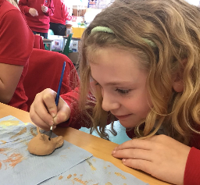
Long Term Plan Coverage – Cycle B
 | Autumn 1 | Autumn 2 | Spring 1 | Spring 2 | Summer 1 | Summer 2
Year N & R | All About Me Drawing Focus | Space Painting Focus | Julia Donaldson Collage Focus | Newbald Sculpture Focus | Minibeasts Printmaking Focus | Beside the Seaside Painting Focus
Year 1 & 2 | Transport Drawings Hot air Balloon Art Drawing, Painting & Collage Artist: Vincent Van Gogh | Polar Regions Landscapes & Animals | Great Fire of London(buildings) Printing & Drawing | Pirates and the oceans Collage / Painting -sea scape Artist: Turner /Terry Frost/Henri Matisse. Collage & Painting | An Island Home Textiles -weaving tartan Textile / Collage | Kings and Queens Sculpture -Clay tiles palaces and Castles Sculpture
Year 3 & 4 | Blitz Scenes & World War 2 Art & Propaganda Drawing & Painting | Famous American Artists, Jasper Johns, Jackson Pollock & Edward Hopper Famous Artists, Painting & Collage | The Romans Sculpture Coil pots and mosaics Sculpture & Collage |  | Forests Drawing : pastels Rainforest animals Drawing & Painting | Middle Ages Bayeux Tapestry Printing Printing
Year 5 & 6 | Propaganda Art & Paul Nash Drawing focus | Brazilian Artist Study Romero Britto Famous Artists | Ancient Greece Sculpture Masks Sculpture | Human Rights Make my voice heard Guernica –Picasso Drawing & painting | The Mayan Civilisation Printmaking : block printing & Digital Print design -string /lino printing Printing | Maps and Rivers Drawing/sketching Flora and Fauna Lilian Snelling & Drawing
Key Core Concept Areas & Coverage
Drawing
Painting
Sculpture
Printing
Textile/Collage
Within the above Concept Areas
Famous Artists
Developing Ideas

Slide 5
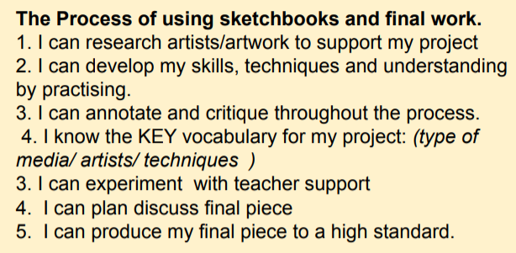

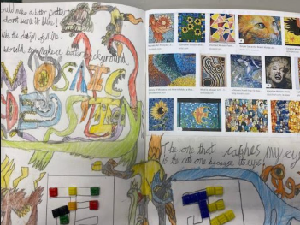
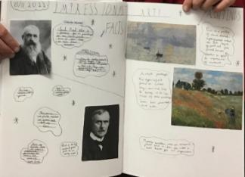
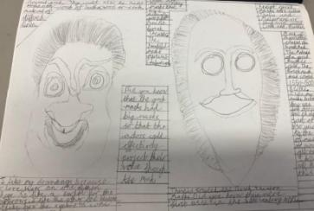
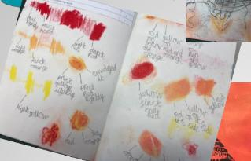
Sketchbooks
Need to show progression of the project with research /experimentation
All work needs to have short date and learning objective
Aim to have a double page allocated to a project showing aspects of the learning journey -children can take pride in this and learn how to add interesting titles/lettering and neat annotations. Of course, extra pages may be needed.

Slide 6
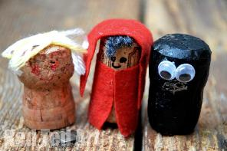
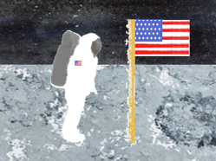
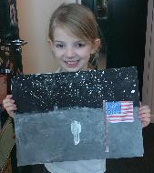
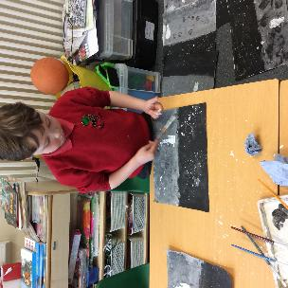
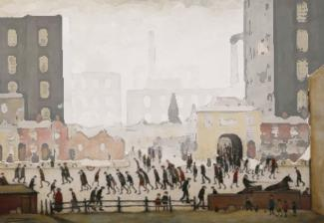
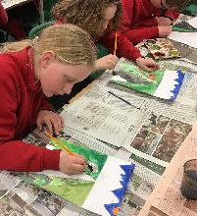
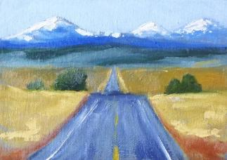
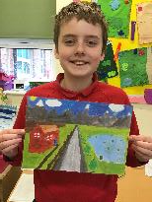
Newbald Primary School : Spring 2 Art
Newbald Primary School : Nursery & Reception Art
Term: Spring 2 – Traditional Tales
Art Focus: Sculpture
Project: Various activities linked to the development matters learning goals
Newbald Primary School : Year 1 & 2 Art
Term: Spring 2 – Explorers
Art Focus: Printmaking
Project: Drawing and resist printmaking
Newbald Primary School : Year 3 & 4 Art
Term: Spring 2 – England
Art Focus: Famous Artists & Painting
Project: English Famous Artists: LS Lowry & John Constable
Newbald Primary School : Year 5 & 6 Art
Term: Spring 2 – Mountains
Art Focus: Drawing & Painting
Project: Perspective & Mountain Landscapes

Slide 7


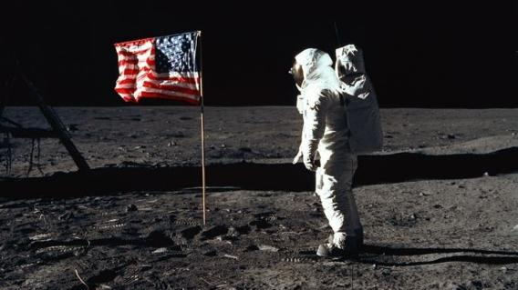
Newbald Primary School : Year 1 & 2 Art
Term: Spring 2 – Explorers
Art Focus: Printing
Project: Explorers printing
Year 1 – Printing Key Objectives
Recognise patterns in the environment & Print with a range of hard and soft materials: e.g. corks, sponge, fruit, vegetables
Know how to create repeating patterns in
print
Begin to demonstrate a range of techniques, e.g. rolling, pressing, stamping and rubbing.
Year 2 – Printing Key Objectives
Create simple printing blocks for press print Experiment with overprinting motifs and colour
Know how to create a simple printing block and use it to create a print
demonstrate a range of techniques, e.g. rolling, pressing, stamping and rubbing

Slide 8
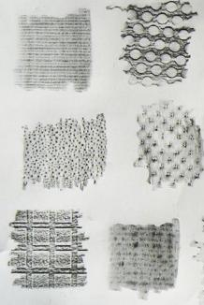
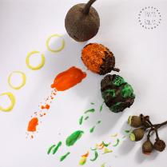
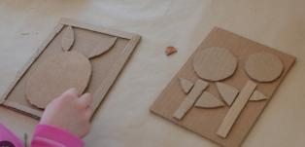
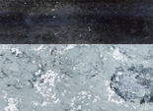
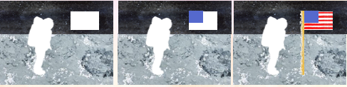
Explorers printing
I can create rubbing prints
I can print with a range of hard and soft materials
I can use printing techniques to create a texture
I can create printing blocks for press print
I can experiment with overprinting motifs and colour
I can apply finishing touches to my artwork & evaluate it.

Slide 9
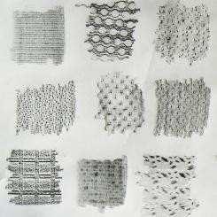
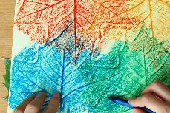
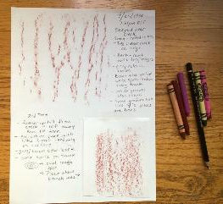
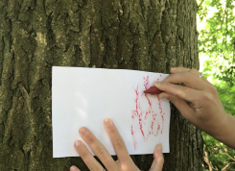
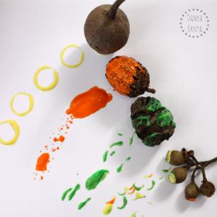
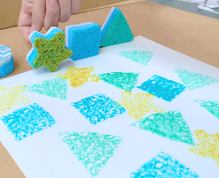


Explorers Printing
1. I can create rubbing prints
(This session could easily be joined to session 2) Explain that in this unit the children will be exploring a variety of printing techniques. One technique they will as part of this unit will be using rubbings. Use wax crayons and paper to take a rubbing of a textured item such as the bark from a tree-trunk. Discuss how the process works. The raised parts touch the paper and rub the wax onto the paper, whilst the recess areas do not create friction with the wax. Allow the children to explore and experiment with taking rubbings of natural and man made items. Results could be cut and added to sketch books.
2. I can print with a range of hard and soft materials
Explain that as part of this unit the children are going to explore a variety of printing techniques to create a piece of art work depicting a famous explorer. This unit uses Neil Armstrong & the first moon landings, but the principles could be applied to any explorer of choice. The image used as inspiration is the one to the right of Neil Armstrong with the American Flag on the Moon.
Identify that Neil Armstrong was the first explorer to land on the surface of the moon. Look at pictures and a short video of the landing / first step. Ask the children to describe the surface of the moon. How can we recreate this for the background of our artwork? Create the idea of blocking one colour and using items to print a repeated pattern of texture. Ask the children to paint a background with simple horizon black sky and mid grey foreground and let this dry. Discuss what could be used to create the interesting texture on the surface of the moon? Some ideas might be corks, sponges, vegetables (e.g. potatoes), scrunched paper or foil or some other natural materials such as pieces of bark sticks etc. Collect some items including going on a hunt for natural materials and experiment with using these to print textures and patterns. When dry these can be recorded in the sketch book.

Slide 10


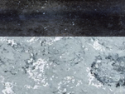
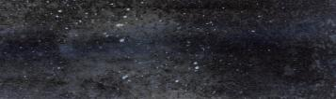
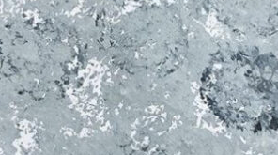
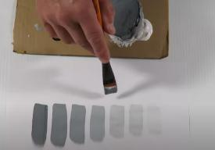
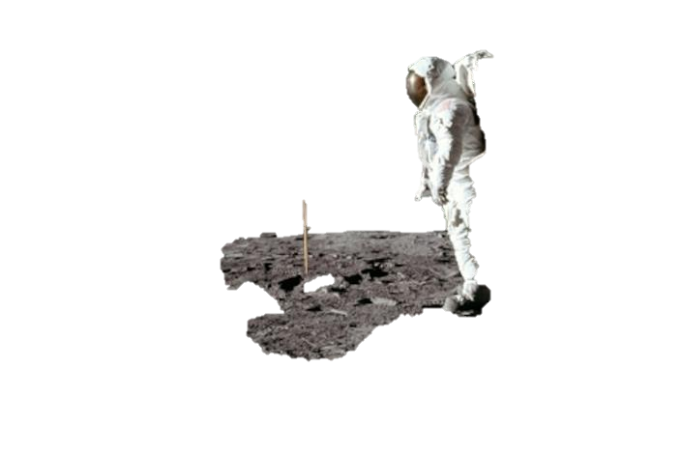
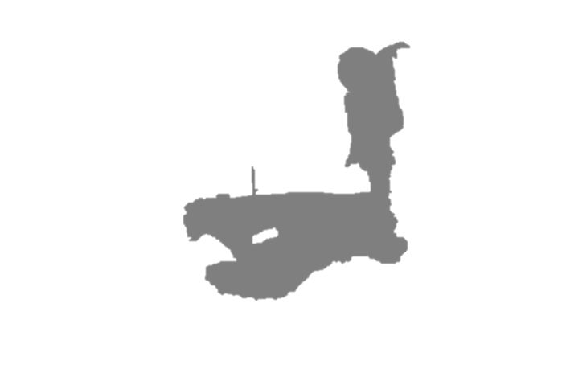


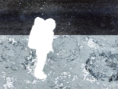
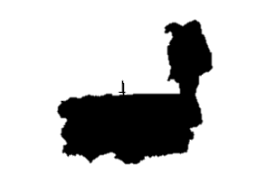

3. I can use printing techniques to create a texture
Following on from the previous lesson explain that the children are going to use items to print a texture to the now dry background they created in the previous session. Identify that the children will be using many tones or shades of grey. Encourage the children to mix different shades from white to a dark tone (darker than the mid tone grey used to create the foreground). Encourage the children to make a record of this in their sketch books from white to black (light to dark). Let the children choose from the tones of grey they have created & items used in the previous sessions to print a texture re creating the surface of the moon. If the children wish to they can think about textures for the black sky. A delicate flick of white paint from an old toothbrush creates an illusion of far away stars.
4. I can create printing blocks for press print
Remind the children about their project to create a printed piece of art. What would be the next step? Identify the astronaut: Neil Armstrong. Look at the shape of the astronaut in his space suit. This is a complex shape and tricky to get right. Explain a simple process of ensuring that we get the right shape. Cut out a copy. (Both the photograph and cot out images are included on the next pages – they may need to be resized to suit the piece of art) Stick it on some corrugated cardboard and then cut this out. This can be stuck on another piece of thick card to create a printing block. (This process can be done in groups as the block can be used to create a repeated pattern.) Use a roller to paint the raised part of the created printed block with white and print onto the background created in the previous lesson.
If time allows (and after they have printed on their main piece of art) the children could create a fun repeated pattern piece on different coloured card as in the example. This could be included in their sketch books once dried.
Example of a card printing block

Slide 11

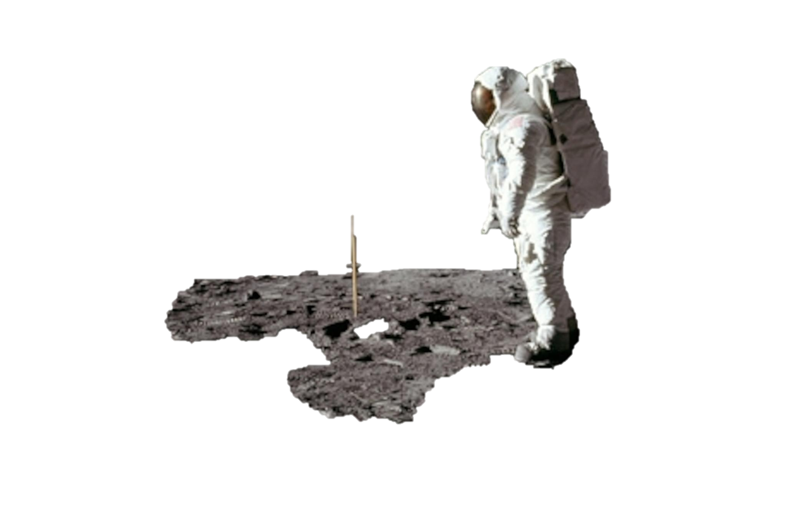

Slide 12
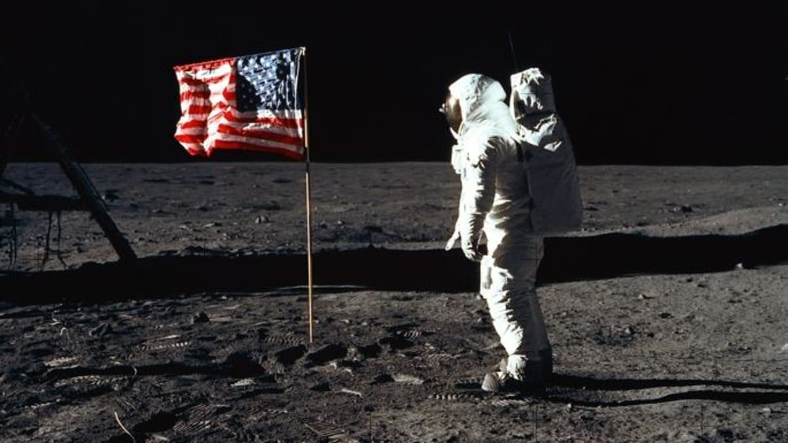

Slide 13

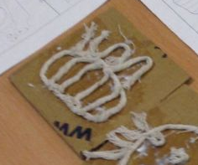
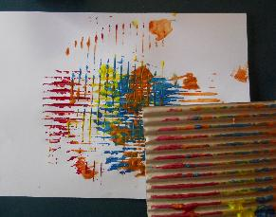
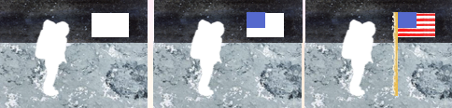
5. I can experiment with overprinting motifs and colour
Look at the American flag. How can we create a print of this? Firstly identify that we have 3 colours to print. Identify possible problems with more colours next to each other. They might mix. We don’t want purples here. Ask the children to explain the process of how they could print this. Hopefully the children will draw upon various skills learnt in their previous sessions. One possible process could be to print a white rectangular shape. This could be using a created card printing block or using a rectangular sponge or shaped / cut potato. Once the white rectangle is dried, print a blue smaller rectangle using a similar process. Then the red stripes need to be printed. This could be done by creating a printing block and gluing string to create raised stripes. A roller can be used to apply red paint and it can be carefully over printed. Another way to create stripes is to remove the outer layer of corrugated card to reveal the wavy card beneath. A roller can be used to apply red paint and it can be carefully over printed.
Another way of applying the red stripes can be similar to creating a print of the flag pole.
To print the flag pole simply use the edge of a piece of card. Paint the edge with brown paint and press print in place.
Example of a card printing block with string used for raised areas.
Example of corrugated card printing block with top removed to create striped effect

Slide 14

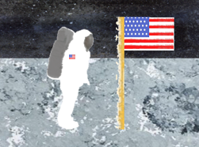
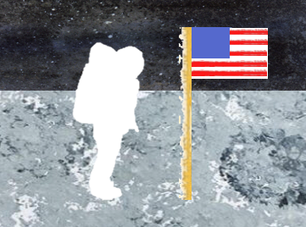
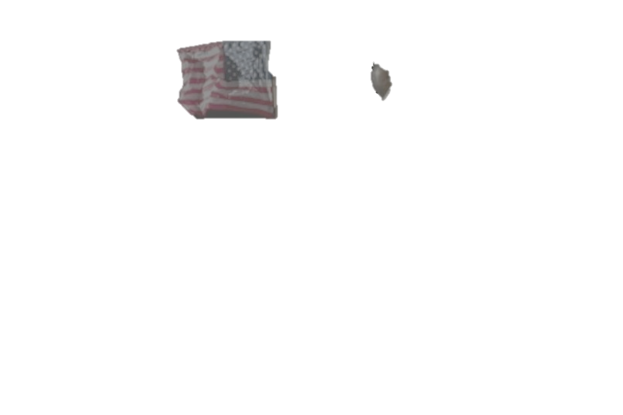


6. I can apply finishing touches to my art work & evaluate it.
Ensure that any of the printed processes are dry and then ask the children what needs to be done to complete the artwork? Some starts need to be added to the flag and detail needs to be added to the astronauts space suit. Explain that it is up to the children how to do this. One way to add white stars would be to print dots with a cocktail stick. The oxygen tank / back pack & visor could be sponge or potato printed or simply painted. If the children wish to they could add fine detail such as a small American flag on the space suit with any media e.g. pencil crayons etc but it is not necessary to add every piece of detail to the piece. Once completed a gallery could be created. Children should be encouraged to say what went well and what could be improved upon and why evaluating their art work.

Slide 15





Newbald Primary School : Year 3 & 4 Art
Term: Spring 2 – England
Art Focus: Famous Artists & Painting
Project: England & The UK – English Famous Artists:
LS Lowry & John Constable
Year 3 - Painting Key Objectives
Know to use a range of brushes to create different effects in painting.
Create different effects and textures with paint
Understand how to create a background or fill large spaces using a wash
To know how to create tints, tones and shades
Year 3 – Famous Artists Key Objectives
Begin to use inspiration from famous artists to replicate a piece of work;
Begin to reflect upon their work inspired by a famous notable artist and the development of their art skills;
Begin to express an opinion on the work of famous, notable artists and refer to techniques and effect;
Year 3 – Drawing Key Objectives
Begin to show an awareness of space when drawing
Begin to understand how proportion can be related foreground, and background
Year 4 - Painting Key Objectives
To use language of and mix primary and secondary colours and use (and mix) tints and shades
Confidently control the types of marks
made and experiment with different effects and textures including blocking in colour, washes, thickened paint creating textural effects.
Year 4 – Famous Artists Key Objectives
Use inspiration from famous artists to replicate a piece of work;
Reflect upon their work inspired by a famous notable artist and the development of their art skills;
Express an opinion on the work of famous, notable artists and refer to techniques and effect;
Year 4 – Drawing Key Objectives
Draw for a sustained period of time at an appropriate level.
To show an awareness of space when drawing
Begin to understand, perspective and proportion including foreground, middle-ground and background

Slide 16







English Famous Artists: LS Lowry & John Constable
I know who John Constable was and I can talk about his artwork
I can give an opinion about the Hay Wain by John Constable
I Know who Lowry was, I can talk about his artwork & the colours he used.
I Know who Lowry was, I can talk about his artwork & the colours he used.
I can begin to use perspective by creating a middle-ground.
I can begin to use perspective by creating a foreground.

Slide 17


English Famous Artists:
LS Lowry & John Constable
1. I know who John Constable was and I can talk about his artwork
Explain that through this art topic the children will learn about two famous English artists. Their styles are contrasting and although their artwork was very different they have created some very popular artwork and their most famous paintings have become ‘the most hung paintings in the UK’ (Meaning framed replicas of the artwork appear in many people’s homes and public places across the country etc). Look at John Constable and some examples of his paintings including his most famous painting: The Hay Wain. Link to the recent Victorians topic an explain that Constable lived in England in the period just before when Victoria became queen (Late Georgian period). Identify this style of art as Romanticism (or romantic). Ask the children what they think this means.
Romanticism was a cultural movement that started in Europe. It was somewhat of a reaction to the Industrial Revolution which occurred during the same time period. Romantic art focused on emotions, feelings, and moods of all kinds including spirituality, imagination, mystery, and passion. The subject matter varied widely including landscapes, religion, revolution, and peaceful beauty. The brushwork for romantic art became looser and less precise. The great Romantic artist Caspar David Friedrich summed up Romanticism saying "the artist's feeling is his law".
Share the presentation: https://www.twinkl.co.uk/resource/ks2-all-about-the-artist-john-constable-powerpoint-t-tp-7046
with the children and ask them to create an artist study in their sketch book on the artist Constable. This could include fact file about the artist. Print John Constable’s most famous painting: The Hay Wain and display it in the classroom for the children to see and explain that this will be the focus of the next art session.

Slide 18


Slide 19






2. I can give an opinion about the Hay Wain by John Constable
Look again at the Hay Wain by John Constable. Identify again that Constable paintings were in the Romanticism style and again reinforce what this means (information from lesson1)
Read through the National Gallery information about the painting the Hay wain (Included on the following slides). Discuss the information and spot the items mentioned in the painting.
Ask the children to give their opinions about the painting. Ask the children if they think everything in the painting would have been exactly as it is in the painting or has the artist changed things so the painting looks nice?
Ask the children to make a study of the painting in their sketch books. The children could annotate a copy of the painting making note of the many items that appear such as, the fisherman & boat, woman collecting water, the mill house, the dog, the horse & rider, the smoke rising from the chimney, the yellow & green fields (suggesting summer / harvest time), the clouds (suggesting rain is coming), the 2 farm workers in the wagon, the horses with red collars.
The children should identify background, middle-ground and foreground in the painting. They could evaluate the painting writing what they like about it and why and what they would suggest to make it even better.
The children could sketch a section of the Hay Wain in detail to appreciate the painting style and detail.

Slide 20





The buildings give the scene its specific location. In The Hay Wain we can see, on the left-hand side, a mill-house, rented by a farmer called Willy Lott from Constable’s father, who owned both the house and surrounding land. The house is often referred to as ‘Will Lott’s cottage’ to reinforce the quaintness and rusticity of the scene, but it was in fact a much more sizeable property. To the extreme right, beside the fisherman’s boat on the far side of the river, we can see the beginning of a red brick wall belonging to a water-mill, just out of sight in this view.
Before Constable was born his parents lived in the mill-house and afterwards the family continued to live in the Suffolk countryside – the setting for this painting. Constable drew much of his initial inspiration for scenes such as this one from memories of the childhood he had spent in the area.
John Constable, who completed this picture in 1821, was famous for his landscapes. His sketches, both in pencil and oil paint, were done in the open air as he observed the natural world and the effects of the weather and changing seasons on the countryside. However, he would ‘compose’ his final paintings back in his studio, using the sketches as component parts. The resulting landscapes have a very spontaneous appeal, despite the fact that they have been so carefully arranged.
The dog and the fisherman and boat in The Hay Wain exist as separate sketches, often reappearing in other works by Constable, and the artist made several changes to the composition of this painting before deciding on this version. In the Victoria and Albert Museum in London, a full-size, swiftly painted oil sketch shows another figure group – a horse and a rider – to the right of the dog, but Constable has painted them out in the National Gallery’s finished painting.

Slide 21





The wisps of smoke curling from the chimney of the house, and the woman beside it, drawing water from the river, give the scene a harmonious, domesticated atmosphere. In the background, in the yellow and green fields, dappled with sunlight, we can see workers, one sharpening his scythe, others pitchforking hay onto an already laden wagon, and one man stacking the load from the top. The time of year must be between June and early August – haymaking season. The cloudy, wind-swept sky would seem to indicate the possibility of rain and certainly evokes English summertime weather. Constable actually made many of the cloud studies for this painting on Hampstead Heath in London. The hay wain itself (‘wain’ is an old word for ‘wagon’) is crossing the river at a ford to continue into the fields. The driver has stopped for a moment, perhaps to let the horses drink. The usually steep wooden sides of this type of vehicle have been cropped and we can see the two workers riding on the wagon. Constable has also introduced a note of colour in the red fringes of the ‘housen’ or leather collars which the horses are wearing. Usually housen on working horses are dark in colour, but Constable has used red, a colour generally confined to ceremonial or festive occasions, to add a bright touch to the centrepiece of his composition, making it stand out against the green vegetation, and thereby attracting our attention and drawing us into the painting and the rural scene.
Constable’s innovative technique, with looser brushwork and the use of white paint to suggest reflections of light upon the water, was not very popular with contemporary English critics, who preferred a more traditional style of painting and more ‘serious’ subject matter. He did, however, achieve considerable success in France, winning a Gold Medal at the Paris Salon of 1824 with this painting. Just as Constable had admired Rubens’s skill at depicting natural phenomena in his landscapes such as An Autumn Landscape with a View of Het Steen, the French Impressionists were to be very much influenced by Constable’s ideas about sketching outdoors and observing the effects of nature.

Slide 22
Green Trees (suggesting summer / Late summer)
the clouds (suggesting rain is coming)
the smoke rising from the chimney
the yellow & green fields (suggesting harvest time),
the mill house
the fisherman & boat,
the 2 farm workers in the wagon
woman collecting water
A ford (a place to cross a shallow river)
The horse rider / Cart driver
the dog
the horses with red collars.

Slide 23






3. I Know who Lowry was, I can talk about his artwork & the colours he used.
Explain to the children that they will now learn about another famous English artist called LS Lowry. His style differs from Constable. Link to the recent Victorian topic and explain that Lowry lived in the end of the Victorian period and then in the Edwardian period that followed.
As a class share the information about Lowry. (Included on the following slides. Then similar to lesson 1, Look at JS Lowry and some examples of his paintings including his most famous paintings: Coming from the mill & Going to the match.
Ask the children to compare styles with Constable. Explain that Lowry painted in a Naive style, meaning some of his detail may appear primitive or simplified.
Ask the children how they feel when looking at Lowry paintings. Do the paintings express how it might have felt to live in the north of England at this time?
Ask the children to complete a page in their sketch book including a fact file about Lowry. Explain that some people say that Lowry painted matchstick people and matchstick cats and dogs. Identify that his figures definitely are not just stick men, yet this is a prime example of the naïve style. Children could complete a study of how Lowry painted people or figures such as the example to the right.

Slide 24




LS Lowry is one of Britain’s most famous artists from the 20th Century. LS Lowry is well known for painting industrial scenes and matchstick characters.
Lawrence Stephen Lowry was born in Stretford (Near Manchester), Lancashire, in 1887. His family were quite well off but not very happy. Lowry was a lonely child.
When Lowry was twenty-one his family had money worries and they moved to Pendlebury where there were lots of factories and cotton mills. Lowry couldn’t get a place in art school. Instead, he got a job as a clerk and took private art lessons, practising in his spare time.

Slide 25


Later, he worked collecting rents from houses all around Salford and Manchester in the North West of England. Even though he became quite a famous painter, he did this job for 42 years until he retired.
He liked to paint and draw things that he saw around the city as he did his job each day
The artist LS Lowry drew many pictures with pencil, pastel, charcoal and pens, but he is best known for his paintings.
Lowry painted lots of industrial landscapes, as this was what he saw around him as he went about his daily life.
An industrial landscape painting is a painting of a place with lots of factories where people work to make things.

Slide 26



Although Lowry painted say he painted matchstick people. His characters were more detailed than simply stick men. His naïve style simplified the human form and when painting crowds of people this gives an interesting effect.
How do Lowry’s Paintings make you feel? Do you think the people in the paintings are happy? Why do you think this? Do you like the paintings? Why?

Slide 27


Slide 28


Slide 29




4. I Know who Lowry was, I can talk about his artwork & the colours he used.
Explain that Lowry said he only ever bought and used 5 colours of paint. Can the children guess which colours? He used blue, red, yellow, white and black. With these 5 colours he could mix any other colours with these. Encourage the children to do the same as they create a reproduction of one of Lowry’s most famous paintings over the next 3 sessions. Explain that artists use something called perspective to create depth in their paintings. This gives the impression that somethings are further away (usually appear smaller) and some things appear closer (and appear larger)
Look again at the painting ‘Coming from the Mill’ Can the children notice sections that appear further away. How has the artist created this feeling? Notice that the factories are pale and muted in colour. This is the background far away. The middle ground is the other buildings. Here the colours are more bold, yet still pale . The foreground includes the people and the fence at the front. The colours are bold and dark.
Explain that the children are going to create a replica of this painting over the next 3 sessions concentrating on the background, middle ground and the foreground.
In this session ask the children to look at the background Use tracing paper to draw the outline of the faint buildings. Then ask the children to mix appropriate colours and paint the whole page – blocking in the appropriate colour. This will be the background. The children will then paint a middle ground on tracing paper in the next session and finally the foreground in the last session. They will then over lay the tracing paper to get a final effect.

Slide 30


Slide 31

5. I can begin to use perspective by creating a middle-ground.
Following on from the previous session, ask the children to use their tracing paper to draw the shapes of the middle ground buildings. Then again mixing the appropriate colours using only the primary colours, white and black the children can paint the middle ground onto the tracing paper. The children should paint the road colour here to the bottom of the page.
6. I can begin to use perspective by creating a foreground.
Following on from the previous sessions, ask the children to use their tracing paper to draw the figures and the fence of the foreground. The children should choose a finer brush to paint the detail of these. The children should paint carefully being careful to leave spaces so that when they are overlapped the middle-ground and background can be seen.
When all 3 pieces are dry carefully overlap the pieces to create a piece showing perspective. The tracing paper with mute the colours of the background, just like in Lowry’s painting. The children should evaluate their artwork saying what they like about what they have created and also what could be improved.

Slide 32



Newbald Primary School : Year 5 & 6 Art
Term: Spring 2 – Mountains
Art Focus: Drawing & Painting
Project: Perspective & Mountain Landscapes
Year 5 – Drawing Key Objectives
Work in a sustained and independent way to create a detailed drawing.
Begin to use simple perspective in their work i.e. by using single focal point on the horizon
Begin to develop an awareness of composition, scale and proportion i.e.: foreground, middle ground and background
Begin to use a variety of techniques to add effects, e.g. shadows, reflection, hatching and cross-hatching;
Begin to depict movement, perspective and proportion in drawings
Year 5 – Painting Key Objectives
Experiment with different media and materials for painting.
Develop a painting from a drawing.
Mix and match colours to create atmosphere and light effects.
Identify, mix and use primary, secondary, complimentary and contrasting colours
Year 6 – Drawing Key Objectives
Draw for a sustained period of time over a number of sessions working on one piece.
Use one point and two-point perspective in drawings
Use different techniques for different purposes
e.g. shading, hatching, blending
Use tonal contrast and mixed media
Develop their own style of drawing Show an awareness of composition, scale and proportion i.e. foreground, middle ground and background
Be able to depict movement, perspective and proportion in drawings
Year 6 – Painting Key Objectives
Work in a sustained and independent way to develop their own style of painting.
Create atmosphere including a sense of place.
Create imaginative work from a variety of sources e.g. observational drawing, music, poetry
create and show knowledge of colour palettes, demonstrating mixing techniques.
use a range of paint and (acrylic, oil paints, water colours) to create visually interesting pieces;

Slide 33






Perspective & Mountain Landscapes
I can identify the use of depth including background, middle-ground & foreground in works of art.
I can begin to use one point perspective
I can begin to use 2 point perspective
I can draw a landscape using perspective
I can paint a mountainous landscape
I can complete my painting of a mountainous landscape.

Slide 34




Perspective & Mountain Landscapes
1. I can identify the use of depth including background, middle-ground & foreground in works of art.
Look at the artwork of the artist Albert Bierstadt. He is an American artist who uses mountains frequently in his paintings. How does the artist create the effect of depth? Discuss this as a class. Identify the use of the background, middle ground and foreground. Identify the muted colours of the background compared with bolder colours in the foreground. Discuss the size of objects. How did the artist know how big to draw each item? Introduce the idea of perspective and explain that this unit will look further at drawing using perspective. In this session ask the children to add to their sketchbooks making a study of the works of Albert Bierstadt annotating background, middle ground and foreground. Children can note the use of muted and bold colours.

Slide 35



2. I can begin to use one point perspective
Remind the children about how artists can create the illusion of depth and 3 dimensional items by using perspective. Explain that we are going to use one point perspective in this session. Explain that perspective is a way of showing three-dimensions on a flat, two-dimensional surface.
  Show the PowerPoint slides (included) : Introducing perspective and discuss the slides. This shows examples of both 1 and 2 point perspective. Explain that the children will experiment with 1 point perspective in this session.
Explain that their ruler will be their friend with these ‘technical’ drawings. Demonstrate an example for the children to follow and complete in their sketchbooks.
Draw a horizon through the centre of a page and label this (a whiteboard can also be used to demonstrate) Then in the centre create a dot. Label this as a vanishing point. Draw a 2D shape such as a square or rectangle above the horizon and to the right of the dot. Take each vertex of the shape and draw with a ruler lines to the vanishing point. This will give an illusion of a 3d shape being created.
Ask the children to replicate this drawing shapes around the vanishing point. The children could keep it simple drawing squares, but they can experiment with a variety of 2D shapes to see what effect will be created.
Watch this video to explain the task further: https://www.youtube.com/watch?v=D4Mg6HWfdKM This video goes on to create backgrounds – No need to do this part, but children can add colour to add to the effect of depth & perspective.

Slide 36

Introduction to Perspective
Creating the Illusion of Space

Slide 37


What is perspective?
In art, perspective is a technique used to create an illusion of a three-dimensional space on a two-dimensional surface.
There are two types of perspective, linear and non-linear.

Slide 38




Non-linear Perspective
Non-linear perspective shows depth through overlapping, size variation, color, and value.
Overlapping
Size Variation
Color
Value

Slide 39

Non-linear Perspective
Using a background, middle ground and foreground appearing to overlap, with the artist considering size and proportion, whilst using muted and bold colours can be an example of non-linear perspective. Some of these techniques can be used alongside linear perspective.

Slide 40




Linear Perspective
Linear perspective: Using lines to create an illusion of depth.
One point perspective: When all lines meet at one point.
Two point perspective: When lines appear to meet at two different points.
Multiple point perspective: When lines go to more than two points.

Slide 41

One Point Perspective
Only one vanishing point is on the horizon line.
A vanishing point is the point in which receding parallel lines appear to converge.
The horizon line is the line that delineates where the sky meets the ground. Is used as a guide for where the viewer’s eye level falls.

Slide 42

Two Point Perspective
When two vanishing points exist on the horizon line.
Two-point perspective is useful in creating corners and multiple street views in a cityscape.

Slide 43


Slide 44

Multiple Point Perspective
Many vanishing points can be used to create complicated perspective images. These can be very complex. Don’t worry, we are going to master one point and two point perspective in this unit!

Slide 45

Are the following images…
One point perspective
Two point perspective
Multiple point perspective

Slide 46


Slide 47


Slide 48


Slide 49


Slide 50


Slide 51


Slide 52


Slide 53


Slide 54



3. I can begin to use 2 point perspective
Two Point Perspective
Recap through the PowerPoint slides from the previous session and especially the quiz part identifying if the image has 1 or 2 point perspective.
Explain that the children will be learning to draw using 2 point perspective in this session. Reassure the children that this is no more complicated than the one point perspective and it can give some great 3 dimensional effects.
Show the following PowerPoint slides that gives a step by step guide to drawing a cuboid above the horizon, below the horizon and on the horizon.
Also play this step by step video guide: https://www.youtube.com/watch?v=29-bPAhvzFI
Ask the children to draw 3 cuboids in their sketchbook by following the step by step guide. Ask them to label the horizon/ eyelevel & vanishing points. Explain that one cuboid should be above the horizon, one on the horizon and one below.
If time allows discuss where a light source would be and how this would affect the shading. Ask the children to use hard and soft drawing pencils and use a variety of techniques such as shading, hatching and blending to shade the cuboids as in the example to the right.

Slide 55
Two Point Perspective
When drawing in perspective we can also use two vanishing points as opposed to just using one vanishing point.
This is called ‘Two Point Perspective’.
Here are some examples of two point perspective drawings.

Slide 56

Two Point Perspective
Eye
Level
Vanishing
point 2
Vanishing
point 1

Slide 57

Two Point Perspective
Vanishing Point 2
Vanishing Point 1
Eye
Level

Slide 58

Two Point Perspective
Vanishing Point 1
Vanishing Point 2
Eye
Level

Slide 59
Instead of drawing shapes straight on as in One Point Perspective, we can also draw shapes at an angle using Two Point Perspective.
Eye Level
Vanishing Point Left
Vanishing Point Right

Slide 60
Above the Eye level we can see the bottom of the shape
Eye Level
Vanishing Point Left
Vanishing Point Right
Below the Eye level we can see the top of the shape

Slide 61
When we have shapes that are drawn on the Eye Level we can neither see the top or the bottom of the shape.
Eye Level
Vanishing Point Left
Vanishing Point Right

Slide 62

An example of a building situated on the
Eye Level.
VP 1
VP 2

Slide 63

Here are some examples of
Two point perspective drawings.
Eye Level
Eye Level
Eye Level
Eye Level

Slide 64
Drawing a cube using
Two point perspective
VP 1
VP 2
Eye Level
Draw the Eye Level and mark the two vanishing points.
Then, draw a vertical line below the eye Level and join the top & bottom with
VP 1 and VP 2.

Slide 65
Drawing a cube using
Two point perspective
VP 1
VP 2
Eye Level
Estimate the length of the sides of your cube by drawing two vertical lines.

Slide 66
Drawing a cube using
Two point perspective
VP 1
VP 2
Eye Level
Darken or thicken the lines which form the cube.

Slide 67





4. I can draw a landscape using perspective
Remind the children about both one point and two point perspective and Watch the video above. Explain that their task will be to create a mountainous landscape that includes perspective.
Suggest one point perspective leading to a singular vanishing point. Explain that they can use photographs of mountainous scenes to inspire their artwork as well as paintings by artists such as Albert Bierstadt. (Some examples are included on the following slides) They must sketch their piece carefully over a sustained period and then paint it for display. Explain the paintings must be of quality to make it to the display.
Remind the children how to use 1 point perspective. Watch this tutorial video to help the children to construct their own composition for their artwork. https://www.youtube.com/watch?v=nJiWIYmLatw
The composition, design and content of the of the piece will be up to the child, but encourage them to use a road, train track, path, canal or river as the central focus leading the eye into the picture. Of course there must be mountains in the background. Encourage the children to use repeated items such as fence posts or trees to show that they understand that these must be smaller as they appear further away. This will help with the depth of the painting. Explain that the work of art must be painted, so the children must consider this in their design.

Slide 68


Slide 69


Slide 70


Slide 71


Slide 72


Slide 73


Slide 74

5. I can paint a mountainous landscape
  Following on from the previous session remind the children that they will be creating a piece of art using one point perspective. Ask the children to use a variety of paints to create the painting. Explain that they will need to Work in a sustained and independent way to develop their own style of painting. Ask the children how they intend to Create atmosphere including a sense of place? Will they consider the weather? Will there be an solitary figure in the distance? Ill there be a solitary farmhouse? Remind them that although they must create a mountainous landscape their work can be imaginative and should draw from inspiration from artists they have studied whilst they have been at school. Explain that they will need to create visually interesting pieces and show knowledge of colour palettes, demonstrating mixing techniques. The children may choose watercolour paints to pain the background wash for the sky and mountains giving a muted colour, but they must also use poster paint, gouache or acrylic paint for their work of art to ensure that foreground colours are clear (These paints could also be used for the background if required)
  use a range of paint and (acrylic, oil paints, water colours) to create visually interesting pieces;
6. I can complete my painting of a mountainous landscape.
Remind the children of the criteria for their painting (as stated in the previous session) Ensure that the children choose appropriate size brushes for completing the finer detail of their paintings. Ask the children to complete their works of art. Create a gallery / display of the artwork and invite the children to discuss how they created their pieces. Invite the children to then say 2 things that they are pleased about and 1 thing they could improve.

