Slide 1


Newbald Primary School
ART
Autumn 1 - Framework

Slide 2




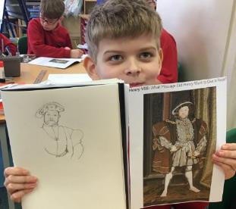



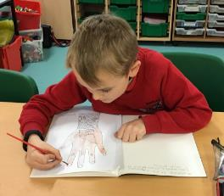

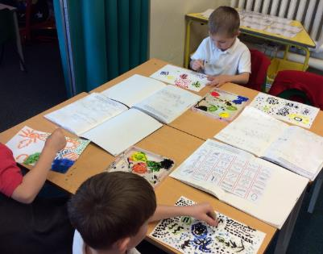


Core Concepts
Key Core Concept Areas
Drawing
Painting
Sculpture
Printing
Textile/Collage
Plus:
Famous Artists
Developing Ideas

Slide 3

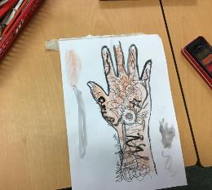
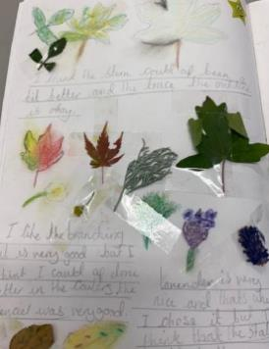
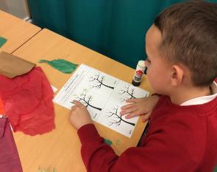
Long Term Plan Coverage – Cycle A
 | Autumn 1 | Autumn 2 | Spring 1 | Spring 2 | Summer 1 | Summer 2
Year N & R | People who help us Drawing Focus | The World Painting Focus | Dinosaurs Collage Focus | Traditional Tales Sculpture Focus | Growing & Lifecycles Printmaking Focus | Houses & Homes Painting Focus
Year 1 & 2 | Painting Aboriginal Art Emily Kame Kngwarreye | Painting Aboriginal Art | Weather and Climate Collage | Explorers printing | Local Artist: Yorkshire Sculpture Artists Henry Moore & Barbra Hepworth etc | Sketching Light & Shade Real Life Drawings Drawing: still life inventions
Year 3 & 4 | Victorian Britain: Victorian Artist focus: Beatrix Potter Drawing & painting - Watercolour |  | India & Asia printing Carbon Paper Print Art | English Artist Greats: Painting Landscapes L. S. Lowry, John Constable | Coasts Drawing: Light, shade & sea birds | Vikings Viking Long-ship Collage
Year 5 & 6 | Ancient Egyptian Art Watercolour silhouette landscapes (Painting) Canopic Jars (sculpture & clay work) | European Artists Study Monet Vincent Van Gogh Seurat Painting | Hans Holbein Tudor Portraits Drawing & Painting Tudor Roses collage | Mountain Landscapes Albert Bierstadt (artist) Use of depth / perspective Drawing & painting | Pop Art Study Andy Warhol (Printing) Roy Lichtenstein (Ben Day Dots) Richard Hamilton (Collage)
Key Core Concept Areas & Coverage
Drawing
Painting
Sculpture
Printing
Textile/Collage
Within the above Concept Areas
Famous Artists
Developing Ideas

Slide 4
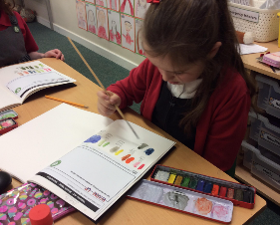
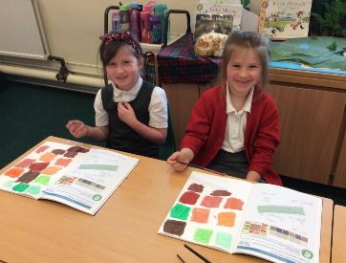
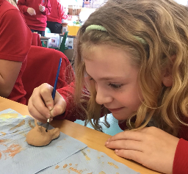
Long Term Plan Coverage – Cycle B
 | Autumn 1 | Autumn 2 | Spring 1 | Spring 2 | Summer 1 | Summer 2
Year N & R | All About Me Drawing Focus | Space Painting Focus | Julia Donaldson Collage Focus | Newbald Sculpture Focus | Minibeasts Printmaking Focus | Beside the Seaside Painting Focus
Year 1 & 2 | Transport Drawings Hot air Balloon Art Drawing, Painting & Collage Artist: Vincent Van Gogh | Polar Regions Landscapes & Animals | Great Fire of London(buildings) Printing & Drawing | Pirates and the oceans Collage / Painting -sea scape Artist: Turner /Terry Frost/Henri Matisse. Collage & Painting | An Island Home Textiles -weaving tartan Textile / Collage | Kings and Queens Sculpture -Clay tiles palaces and Castles Sculpture
Year 3 & 4 | Blitz Scenes & World War 2 Art & Propaganda Drawing & Painting | Famous American Artists, Jasper Johns, Jackson Pollock & Edward Hopper Famous Artists, Painting & Collage | The Romans Sculpture Coil pots and mosaics Sculpture & Collage |  | Forests Drawing : pastels Rainforest animals Drawing & Painting | Middle Ages Bayeux Tapestry Printing Printing
Year 5 & 6 | Propaganda Art & Paul Nash Drawing focus | Brazilian Artist Study Romero Britto Famous Artists | Ancient Greece Sculpture Masks Sculpture | Human Rights Make my voice heard Guernica –Picasso Drawing & painting | The Mayan Civilisation Printmaking : block printing & Digital Print design -string /lino printing Printing | Maps and Rivers Drawing/sketching Flora and Fauna Lilian Snelling & Drawing
Key Core Concept Areas & Coverage
Drawing
Painting
Sculpture
Printing
Textile/Collage
Within the above Concept Areas
Famous Artists
Developing Ideas

Slide 5
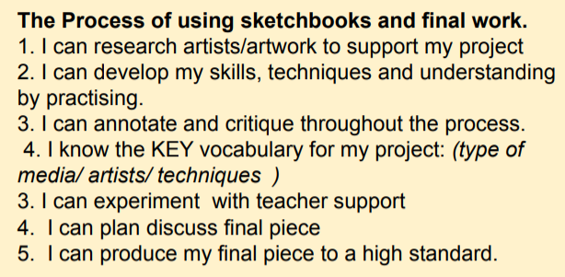

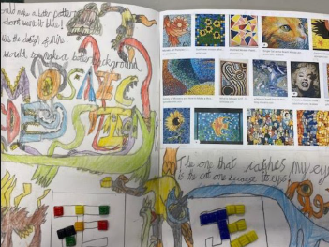
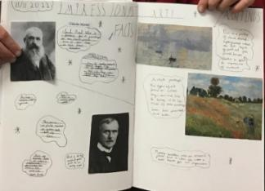
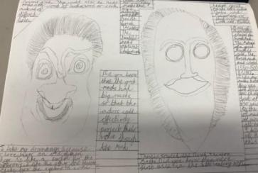
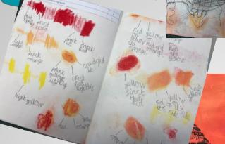
Sketchbooks
Need to show progression of the project with research /experimentation
All work needs to have short date and learning objective
Aim to have a double page allocated to a project showing aspects of the learning journey -children can take pride in this and learn how to add interesting titles/lettering and neat annotations. Of course, extra pages may be needed.

Slide 6
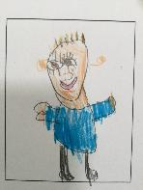
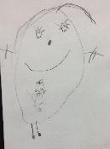
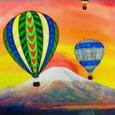
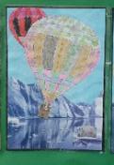
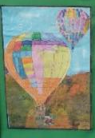
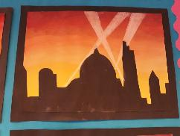
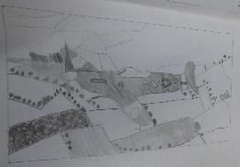
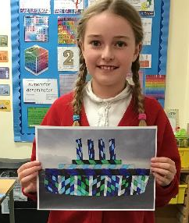
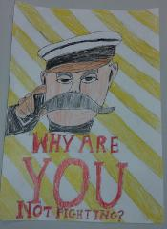
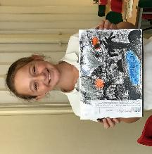
Newbald Primary School : Autumn 1 - Art
Newbald Primary School : Nursery & Reception Art
Term: Summer 2 – All About Me
Art Focus: Drawing Focus
Project: Various activities linked to the development matters learning goals
Newbald Primary School : Year 1 & 2 Art
Term: Autumn 1– Transport
Art Focus: Drawing, Painting & Collage
Project: Vincent Van Gogh & Transport Art
Newbald Primary School : Year 3 & 4 Art
Term: Autumn 1 – World War Two
Art Focus: Drawing & Painting
Project: World War 2 Art, Propaganda & Blitz Art
Newbald Primary School : Year 5 & 6 Art
Term: Autumn 1 – World War 1
Art Focus: Drawing
Project: Propaganda Art & Paul Nash

Slide 7


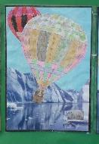
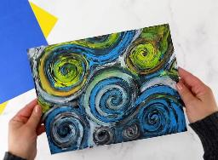
Newbald Primary School : Year 1 & 2 Art
Term: Summer 2 – Transport
Art Focus: Drawing, Painting & Collage
Project: Vincent Van Gogh & Transport Art
Year 2 – Drawing Key Objectives
Experiment and control marks made with pencils, pastel, charcoal, and chalks Begin to use different grades of pencil when drawing Begin to add detail to line drawings
To know how to use charcoal and chalk in drawings
Control pencil to be able to vary thickness, lightness/ darkness, and use dots patterns and lines to demonstrate pattern and texture;
Year 2 Painting Key Objectives
Use a variety of brush sizes and types appropriately
Know how to mix
paint to create the three secondary colours
Experiment with different brushes (including brushstrokes) and other painting tools;
To be able to add white and black to alter tints and shades
Year 2 Collage Key Objectives
Accurately and artistically fold, tear, crumple and overlap papers for effect, creating images from a variety of media e.g. photocopies, fabric, crepe paper, magazines etc.
Collect, sort, group and use materials (including textiles) to create pieces of art including Cutting and shaping fabric using scissors, applying shapes using glue or stitching, applying decoration using beads, buttons, feathers etc.
To know how to make a piece of art using collage techniques
To create effective patterns by weaving
Year 2 – Famous Artists Key Objectives
Describe the work of famous, notable artists and designers
Express an opinion on the work of famous, notable artists;
Use inspiration from famous, notable artists to create their own work and compare;
Year 1 – Drawing Key Objectives
Experiment with marks made with pencils, crayons, pastels, felt tips
Investigate tone by drawing light/dark lines, patterns and shapes using a pencil.
To know how to make light marks by pressing lightly and darker marks by pressing harder
Begin to control lines, e.g. to draw lines of varying thickness, to create simple drawings from observations
use dots and lines to demonstrate pattern and/ or texture;
Year 1 Painting Key Objectives
Make marks using paint with a variety of tools
Know the names of the primary and secondary colours: Red, blue, yellow, green, orange, purple.
Begin to add white and black to alter tints and shades;
Year 1 Collage Key Objectives
Fold, tear, crumple and overlap papers Create images from a variety of media e.g. photocopies, fabric, crepe paper, magazines etc.
Collect, sort, group and use materials (including textiles) to create pieces of art
To begin to know how to make a piece of art using collage techniques
To begin to create pattern by weaving
Year 1 – Famous Artists Key Objectives
Begin to describe the work of famous, notable artists and designers
Begin to express an opinion on the work of famous, notable artists;
Begin to use inspiration from famous, notable artists to create their own work and compare

Slide 8
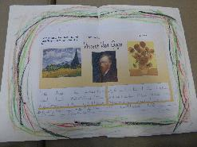


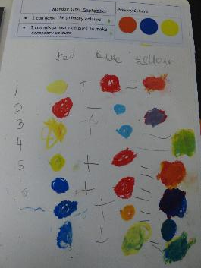
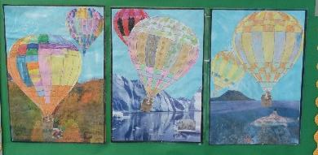
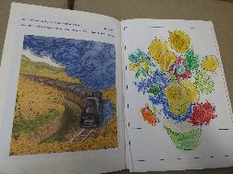
Vincent Van Gogh & Transport Art
I know who Vincent Van Gogh was and I can give an opinion about his work
I can name the primary colours & experiment in mixing primary colours to make secondary colours
I can make marks like Van Gogh using oil pastels & I can create art inspired by Van Gogh’s Sunflowers
I can create a background for my hot air balloon artwork
I can create a hot air balloon for my artwork
I can complete my hot air balloon artwork and evaluate it

Slide 9
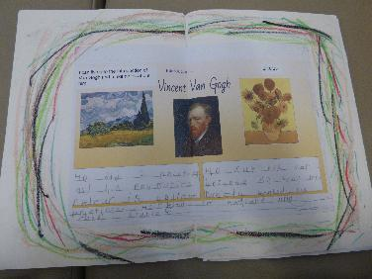
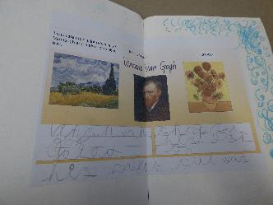
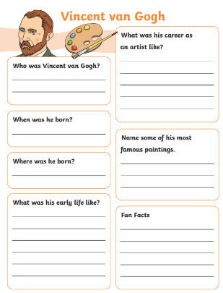
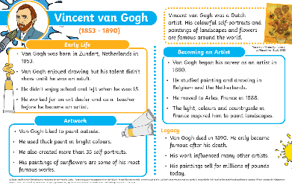
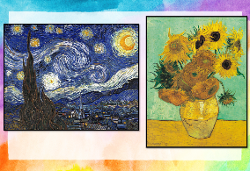
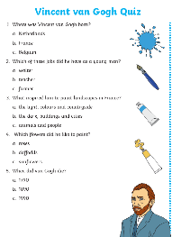
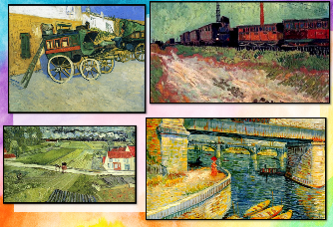
Vincent Van Gogh & Transport Art
1. I know who Vincent Van Gogh was and I can give an opinion about his work
Explain that in this unit the children are going to learn about a famous artist called Vincent Van Gogh. Explain they will be looking at his artwork and giving their opinions about it.
Introduce Vincent Van Gogh by showing this short video:
https://www.bbc.co.uk/teach/class-clips-video/articles/zw677yc
Discuss the video as a class.
Some more information about Van Gogh can be shared using this PowerPoint:
https://www.twinkl.co.uk/resource/t-t-2547004-van-gogh-information-powerpoint
The pupils can create a fact file about Van Gogh. A possible template is below:
https://www.twinkl.co.uk/resource/vincent-van-gogh-fact-file-template-t-ad-1666088714
An example fact file and quiz is below:
https://www.twinkl.co.uk/resource/ks1-vincent-van-gogh-fact-file-and-quiz-t-ad-1719562401
Explain that Van Gogh was famous for painting ‘The sunflowers’ and ‘A Starry Night’, but he was also known for including transport in his paintings. Look at some examples of Van Gogh’s paintings on the next two slides. Children should give an opinion about the paintings. Which do they like the most and why? Which do they like the least and why? Can they spot Vincent's favourite colour being used? (Yellow) Can they see his impressionist style? Copies can be given to the children and they could annotate the pictures and write an opinion.

Slide 10
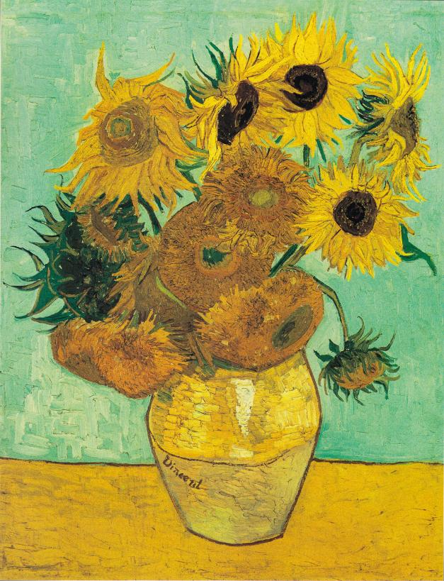
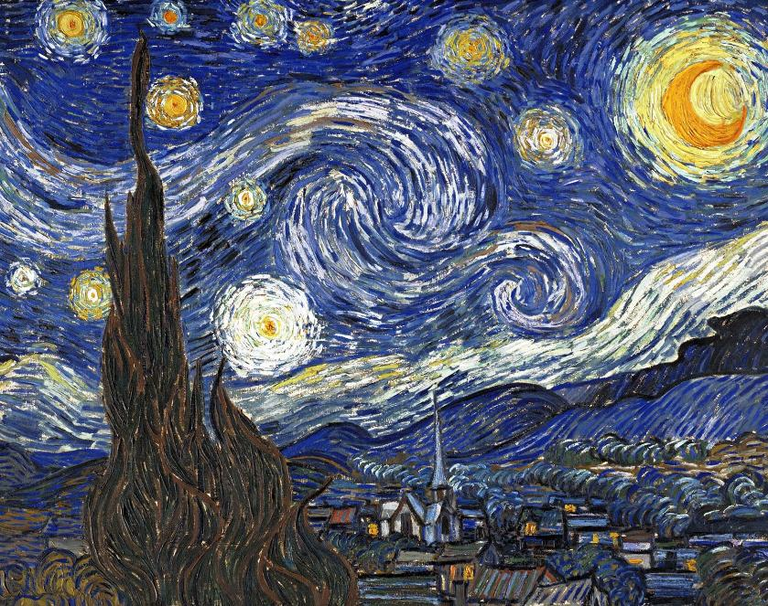

Slide 11
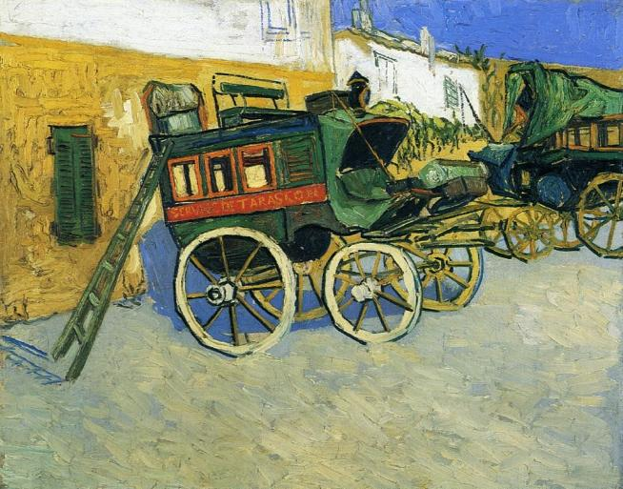
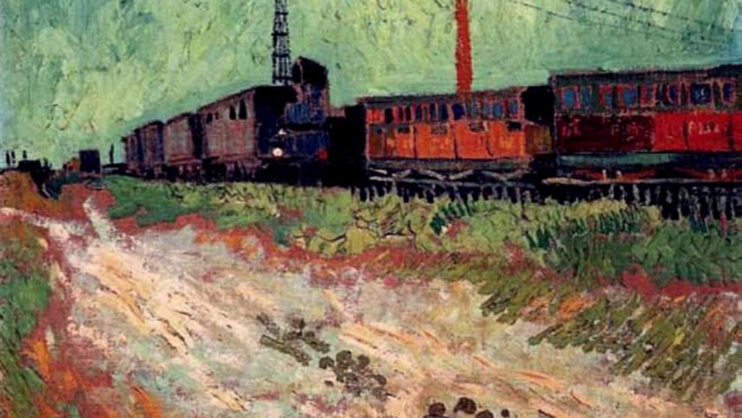
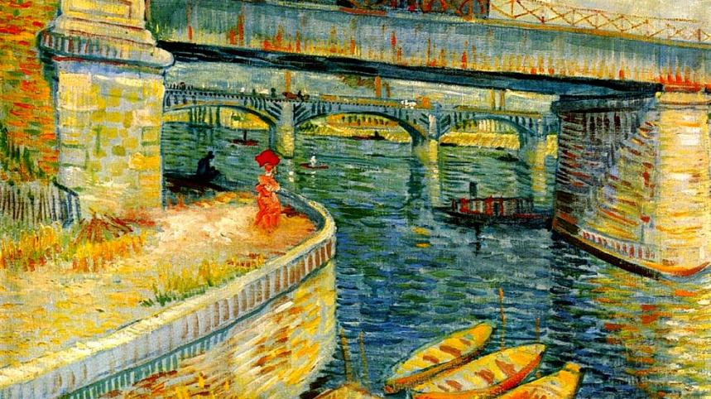
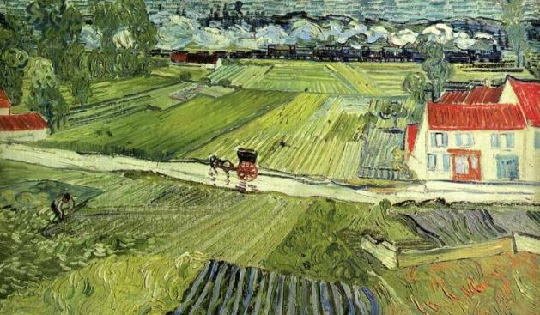

Slide 12
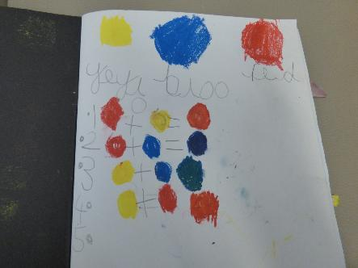
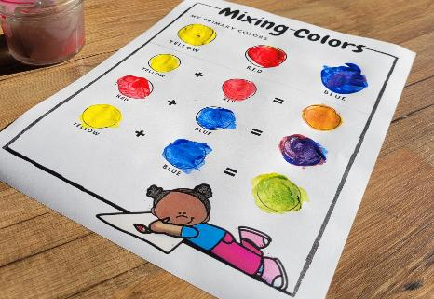
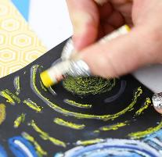

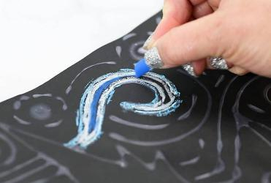
2. I can name the primary colours & experiment in mixing primary colours to make secondary colours
Remind the children of the artist that they have studied: Van Gogh. Remind the children of his favourite colour (Yellow) and that he liked to use bright bold colours. Discuss colour and the primary colours. Can the pupils identify red, yellow and blue as the primary colours? Why are these special? The pupils might be able to suggest that when two of the primary colours are mixed a new colour is made. Explain we call these colours secondary colours.
Explain that in the next session the pupils will be exploring oil pastels and although paint can be mixed, in this session the pupils will experiment with oil pastels.
Set the children a challenge to make a chart to record all of the colours that can be made using the primary colours e.g.:
Red + Yellow = Orange
Blue + Red = Purple
Yellow + Blue = Green
The children should write the colour name and also give a circle example of the colour. The pupils will need to experiment with mixing the oil pastel to create the secondary colour.
If time allows the pupils could look at the swirls used by Van Gogh in paintings such as a Starry Night and use oil pastels to recreate marks like these in their sketch books.

Slide 13

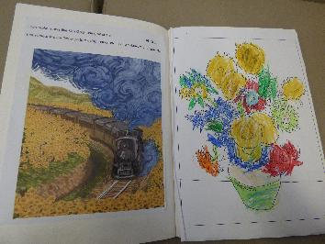
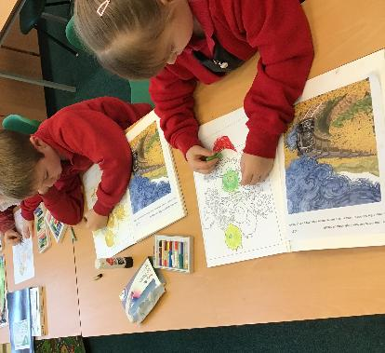
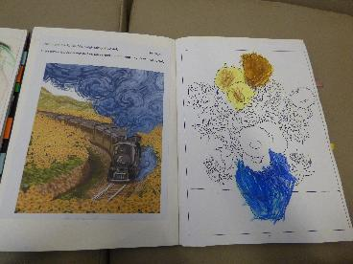




3. I can make marks like Van Gogh using oil pastels & I can create art inspired by Van Gogh’s Sunflowers
Recap the unit so far and remind the pupils about what they have learnt about Vincent Van Gogh and his style of art. Also remind the pupils about their experiments with oil pastels and mixing primary colours. Can the pupils name all the primary colours? Can the pupils name all the secondary colours?
Look at the sunflowers by Van Gogh (Or A Starry Night) and ask the pupils to look at Van Gogh’s style and make a recreation of this artwork in their sketchbooks. For pupils that need it they could be given a template so that they can concentrate purely on using oil pastels and mark making

Slide 14





4. I can create a background for my hot air balloon artwork
Give the children A3 or A4 size paper and ask them to paint a sky scene. Encourage the pupils to think about the colour of the sky. This could be simply a blue sky, but also thinking creatively about cloudy skies or a sunset or sunrise. Use paint to create a vibrant coloured page. If pupils are creating blue sky encourage different blues, whites and texture creation. Ask pupils to splat paint or use sponges to fill the page. The children should explore paint and have fun.
5. I can create a hot air balloon for my artwork
Using a template, such as the one on the next page ask the pupils to create a ‘patchwork’ hot air balloon. Here pupils can experiment with marks made with pencils, crayons, pastels, felt tips. They can create a different pattern in each section of the hot air balloon. Here the children can experiment with using a variety of media to make light marks by pressing lightly and darker marks by pressing harder. They can draw lines of varying thickness. They can use dots and lines to demonstrate pattern and/ or texture. When complete the ballon will need to be cut out. Where possible pupils can do this, but some pupils may need assistance with this.
6. I can complete my hot air balloon artwork and evaluate it
Explain what a collage is and explain that to complete the piece of art the pupils will need to create a landscape and then add the hot air balloon to complete the piece. Have some examples of different scenes for the children to choose from and cut landscape at the horizon. This can then be stuck to the children’s sky paintings. Lastly the balloons should be added. A picture of the final piece can be photographed, and this can be added to the children’s sketchbooks. The pupils could add an evaluation by saying two things they liked about their painting and one thing they would like to improve.
Some examples of completed hot air balloon artwork can be seen on this slide and the next three slides.

Slide 15


Slide 16


Slide 17



Slide 18







Newbald Primary School : Year 3 & 4 Art
Term: Autumn 1 – World War Two
Art Focus: Drawing & Painting
Project: World War 2 Art, Propaganda & Blitz Art
Year 4 - Painting Key Objectives
To use language of and mix primary and secondary colours and use (and mix) tints and shades
Confidently control the types of marks
made and experiment with different effects and textures including blocking in colour, washes, thickened paint creating textural effects.
Year 4 - Drawing Key Objectives
Draw for a sustained period of time at an appropriate level.
Demonstrate experience in different grades of pencil and other implements to draw different forms and shapes.
To use a range of implements to draw different forms and shapes.
To understand how to use a variety of hard and soft drawing pencils to create different effects
To use shading to show light and shadow effects.
To show an awareness of space when drawing
Begin to understand, perspective and proportion including foreground, middle-ground and background
Year 3 - Painting Key Objectives
Know how to use a range of brushes to create different effects in painting.
Create different effects and textures with paint
Understand how to create a background or fill large spaces using a wash
To know how to create tints, tones and shades
Year 3 - Drawing Key Objectives
Develop intricate patterns/ marks with a variety of media.
Experiment with marks and lines with a wide range of implements e.g. artist pencils
To begin to understand how to use a variety of hard and soft drawing pencils to create different effects
Begin to use shading to show light and shadow effects.
Begin to show an awareness of space when drawing
Begin to understand how proportion can be related foreground, and background

Slide 19











Slide 20





World War 2 Art, Propaganda & Blitz Art
I can experiment with watercolour paint, blend and create different tones
I can create a watercolour wash
I can create a silhouette for a blitz landscape
I can use a grid guide to sketch
I can use artist pencils to sketch a spitfire WW2 landscape
I can complete my WW2 spitfire landscape and evaluate my artwork

Slide 21








1. I can experiment with watercolour paint, blend and create different tones
Explain to the children that in this World War 2 art unit they will be working towards creating 2 pieces of art. One with a painting focus and one with a drawing focus. Explain that the first involves using water colour paint. Discuss what the pupils know about using watercolour pains and where they have used them before.
Explain that in this session the pupils have a task to explore watercolour paints and they should make a sketch book study exploring using the paints. Some key things that the pupils must include will be:
Use and explore the effects of a range of brushes including thick and thin brushes (including flat and pointed brushes). Ask the children to think of examples where the different brushes would be useful eg filling in large spaces eg sky or painting detail on a face etc. Children should annotate and label their experiments with what they used etc.
Experiment with colour and paint and label primary colours and mix secondary colours. With Watercolours the pupils may notice that yellow, cyan (light blue) and magenta are given as standard primary colours in watercolour sets.
Show a short video explaining: Tints, colour and shade. https://www.youtube.com/watch?v=a0nzbUF_w3I Experiment with tints and shades ensuring that they are labelled. Here children can appreciate the use of water rather than white to make a lighter tint, whilst a white creates a milky shade of colour.
Children should also experiment with blending colours. This is a key skill that thy will need to create a sunset in their next lesson. Use 2 clours and let the wet paint ‘bleed’ together experiment and notice how the colours mix on the page.
With all the experimenting the children should annotate their creations once dry.

Slide 22



2. I can create a watercolour wash
Remind the children about what they have learnt about watercolour paint and explain that they will be painting a sunset for a World War 2 Blitz scene.
Explain what a silhouette is and share some examples of what a complete landscape may look like (some examples are shared in this pack). explain the process that the children will need to create a watercolour paint wash. This will then need to dry before the silhouette can be added.
Look at some colourful sunsets / sunrises and the children should notice how the colours blend from one to another. Use this as inspiration for their landscape sky wash.
Children should have an A3 piece of art paper, such as watercolour paper. When using watercolours, often the paper warps and buckles, creating an uneven surface which will gather water. Once that dries, it can leave distinct outlines. It is impossible to avoid this, as the warping happens when the paper fibres soak up the water and grow in size, but using a thicker watercolour paper might help. To prevent the sheet of paper from moving and to reduce the amount of warping, it helps to tape down the edges to the table with masking tape. The pupils will need to ensure that they fill the paper with colour. To do this they will need to create a wash. To do this, the pupils will need plenty of water. If they don’t use enough water, the final artwork will be streaky with obvious borders between the colours. Make sure that, during painting, they regularly change the water. While painting the sky, the children should keep adding water to the paper and the parts they have already painted to ensure it doesn’t dry out.
The pupils should aim to start with yellow at the bottom of their landscape. The pupils could aim for 50% of their page yellow as most of this will be covered by the silhouette, which will be completed in the next session. The pupils should blend this through to orange then to magenta and finally sky blue. The pupils should try and avoid creating a rainbow, but keep the blend of colours subtle and horizontal.

Slide 23





Slide 24







Slide 25


Slide 26






3 I can create a silhouette for a blitz landscape
Remind the pupils about what they have done so far and look at the sunset watercolour wash they have created. Note: This must be dry before continuing with the next step.
Explain that in this session the pupils will need to complete the landscape concentrating on the silhouette. Look at some examples of silhouettes at sunset / sunrise and explain to the pupils how an object can appear completely black and flat (2D). This is the effect that they will look to create.
There are many ways the pupils could create the silhouette effect. They could paint with opaque thick paint, cut black paper / card and stick this on top of their wash or use a black wax crayon.
The children should ensure that they create a silhouette of the land at the base of the landscape. This is vital as without this buildings will appear to be flying in the sky without a black silhouette base at the bottom of the landscape. Children should think about key buildings that were bombed during WW2 such as St Paul’s Cathedral or London Bridge that create an iconic silhouette. Other general city buildings could also be added. Although a bomber plane can be added, do not encourage silhouettes of birds or bombs in the sky.
Once a silhouette is complete the pupils could use chalk to add a search light effect. Search lights must start from the land and widen. They do not stop and must continue to the edge of the page. To do this pupils could use a straight edge of a piece if scrap paper and use a white or yellow piece of chalk / chalk pastel to push off the scrap paper. This leaves a straight crisp edge.
The final landscapes can be displayed. A copy of / photograph of the final landscape should be included in the pupil’s art sketch books along with accompanying sentences saying what they likes about their art and what could be improved if they did it again.

Slide 27


4. I can use a grid guide to sketch
Explain that in the next few sessions the pupils will work on improving their drawing technique. Start by introducing a warmup drawing exercise and ask the pupils to draw a WW2 plane such as a spitfire in their sketchbooks. Set a small-time limit for a quick sketch (eg 5 minutes speed sketch). Ask the pupils was this easy? Does it look accurate? How can we improve our drawing?
Explain that artists see shapes within the object they are drawing, and they cannot draw the whole thing in one go. More time will be needed and a drawing is created by piecing together shapes. Use a grid guide and model how each part of the object can be drawn by sketching in proportion to the grid to make a reproduction.
Some examples are on the next pages and can also be found here: https://www.twinkl.ca/resource/drawing-second-world-war-aircraft-t-ad-345?sign_in=1
If time allows the pupils can make a second attempt at drawing a spitfire. Did they take more notice of the shapes each part created?

Slide 28


Slide 29


Slide 30



5. I can use artist pencils to sketch a spitfire WW2 landscape
6. I can complete my WW2 spitfire landscape and evaluate my artwork
Remind the children of what they have do so far and remind them of their grid drawings of a spitfire. Ask the pupils to use what they have learnt to create a sketch of a World War 2 landscape. This could include a spit fire too building on what the pupils have learnt in their previous session. Here the pupils can experiment with artists sketching pencils. At this point limit the pupils to one H pencil (any grade) for detail and light marks, their trusty HB mid range pencil and a B pencil (any grade) for dark shadows etc.
https://youtu.be/CIoiQ7V_C1g?si=Ugs7R3U1mQ-GGi4d
The link above shows a simple introduction to H HB and B pencils.
Give the pupils a black and white photo image. Ask the pupils to notice highlights and shades. Ask the pupils to see shapes and draw a grid over the photo lightly. A light grid could be created using a H pencil lightly for the completed art. Explain that these construction lines should not be seen when the drawing is complete. The children may take more than one session to complete their drawings and draw for a sustained period of time. The drawings should show light and shadow and the children should try and replicate the different greys seen in the photograph.
When complete the children should evaluate their art work. This should be done for both pieces, the watercolour landscape and the pencil sketch landscape. Which do the pupils prefer and why? What was hard to do and why? What worked well and why? What have they learnt?

Slide 31





Newbald Primary School : Year 5 & 6 Art
Term: Autumn 1 – World War 1
Art Focus: Drawing
Project: Propaganda Art & Paul Nash
Year 5 – Drawing Key Objectives
Work in a sustained and independent way to create a detailed drawing.
Begin to use simple perspective in their work i.e. by using single focal point on the horizon
Begin to develop an awareness of composition, scale and proportion i.e.
foreground, middle ground and background
Begin to use a variety of techniques to add effects, e.g. shadows, reflection, hatching and cross-hatching;
Begin to depict movement, perspective and proportion in drawings
Year 6 – Drawing Key Objectives
Draw for a sustained period of time over a number of sessions working on one piece.
Use one point and two-point perspective in drawings
Use different techniques for different purposes
e.g. shading, hatching, blending
Use tonal contrast and mixed media
Develop their own style of drawing Show an awareness of composition, scale and proportion i.e. foreground, middle ground and background
Be able to depict movement, perspective and proportion in drawings

Slide 32






Propaganda Art & Paul Nash
I can explore and discuss the work of World War 1 artists
I can recreate artwork in the style of Paul Nash
I can understand the power and use of propaganda art
I can understand how dazzle camouflage was used in World War 1
I create artwork inspired by the poem ‘In Flanders Fields’
I can complete, reflect and evaluate my artwork

Slide 33








Propaganda Art & Paul Nash
1. I can explore and discuss the work of World War 1 artists
For this unit plans are taken from the PlanBee Resources. All plans and resources are available in the teacher area of the school website

Slide 34





2. I can recreate artwork in the style of Paul Nash
For this unit plans are taken from the PlanBee Resources. All plans and resources are available in the teacher area of the school website

Slide 35







Slide 36






3. I can understand the power and use of propaganda art
For this unit plans are taken from the PlanBee Resources. All plans and resources are available in the teacher area of the school website

Slide 37









4. I can understand how dazzle camouflage was used in World War 1
For this unit plans are taken from the PlanBee Resources. All plans and resources are available in the teacher area of the school website

Slide 38











Slide 39







5. I create artwork inspired by the poem ‘In Flanders Fields’
For this unit plans are taken from the PlanBee Resources. All plans and resources are available in the teacher area of the school website
6. I can complete, reflect and evaluate my artwork
Use any time available to complete any unfinished artwork across the unit. If time allows, reflect on the artwork created throughout the unit and ask the pupils to evaluate them. Pupils’ evaluations should be included in sketch books. Ensure that pictures are taken of any artwork not in sketch books and ensure that these pictures are added to the pupils’ sketch books.

