Slide 1


Newbald Primary School
ART
Spring 2- Framework

Slide 2



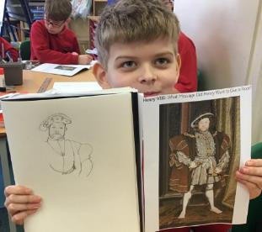



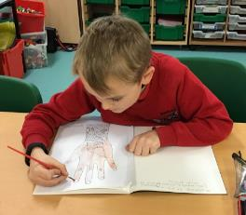

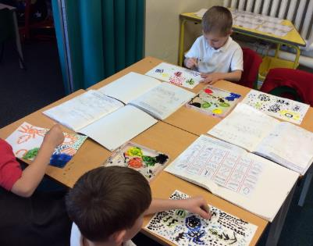


Core Concepts
Key Core Concept Areas
Drawing
Painting
Sculpture
Printing
Textile/Collage
Plus:
Famous Artists
Developing Ideas

Slide 3

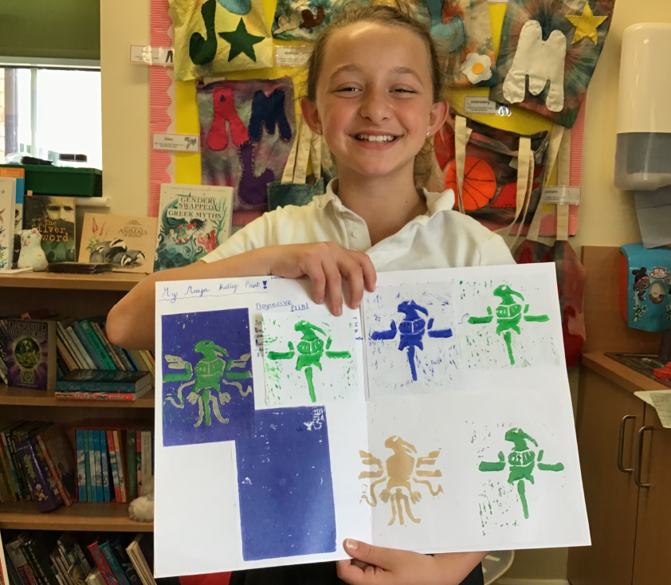
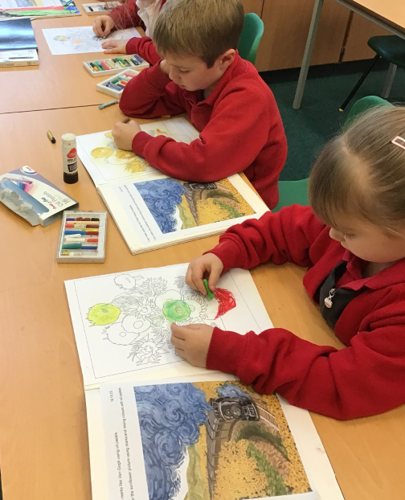
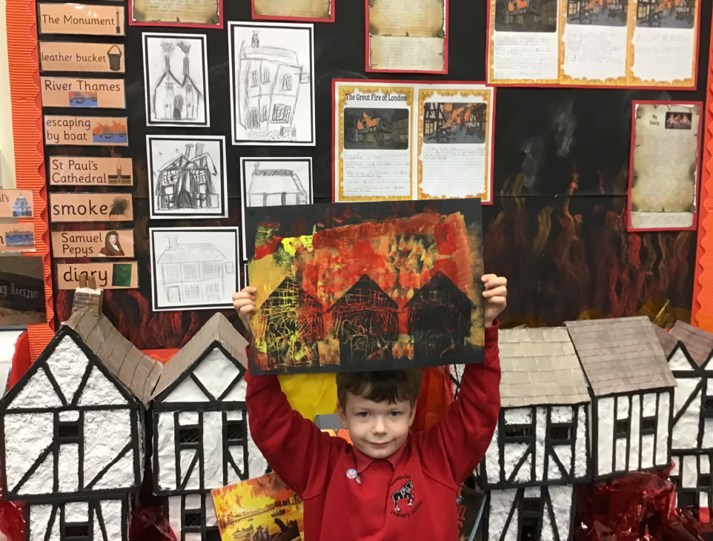
Long Term Plan Coverage – Cycle A
 | Autumn 1 | Autumn 2 | Spring 1 | Spring 2 | Summer 1 | Summer 2
Year N & R | People who help us Drawing Focus | The World Painting Focus | Dinosaurs Collage Focus | Traditional Tales Sculpture Focus | Growing & Lifecycles Printmaking Focus | Houses & Homes Painting Focus
Year 1 & 2 | Painting Aboriginal Art Emily Kame Kngwarreye | Painting Aboriginal Art | Weather and Climate Collage | Explorers printing | Local Artist: Yorkshire Sculpture Artists Henry Moore & Barbra Hepworth etc | Sketching Light & Shade Real Life Drawings Drawing: still life inventions
Year 3 & 4 | Victorian Britain: Victorian Artist focus: Beatrix Potter Drawing & painting - Watercolour |  | India & Asia printing Carbon Paper Print Art | English Artist Greats: Painting Landscapes L. S. Lowry, John Constable | Coasts Drawing: Light, shade & sea birds | Vikings Viking Long-ship Collage
Year 5 & 6 | Ancient Egyptian Art Watercolour silhouette landscapes (Painting) Canopic Jars (sculpture & clay work) | European Artists Study Monet Vincent Van Gogh Seurat Painting | Hans Holbein Tudor Portraits Drawing & Painting Tudor Roses collage | Mountain Landscapes Albert Bierstadt (artist) Use of depth / perspective Drawing & painting | Pop Art Study Andy Warhol (Printing) Roy Lichtenstein (Ben Day Dots) Richard Hamilton (Collage)
Key Core Concept Areas & Coverage
Drawing
Painting
Sculpture
Printing
Textile/Collage
Within the above Concept Areas
Famous Artists
Developing Ideas

Slide 4
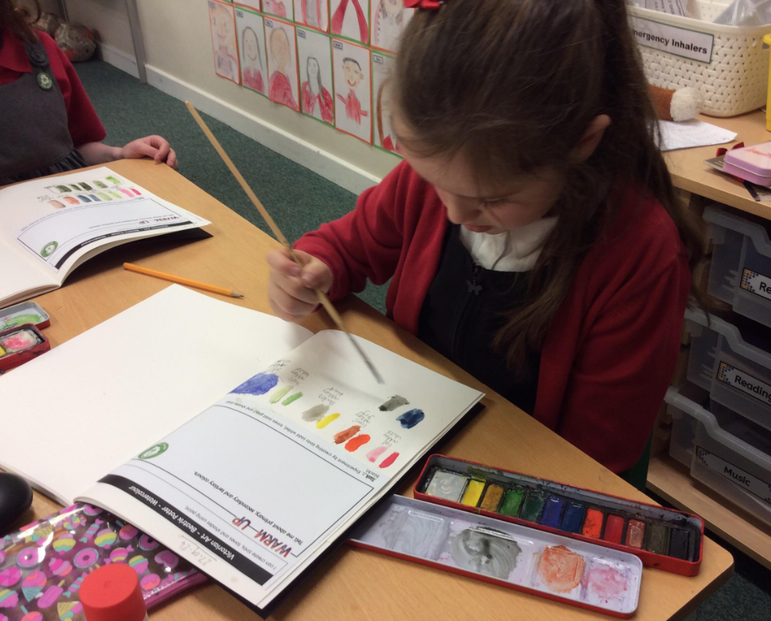
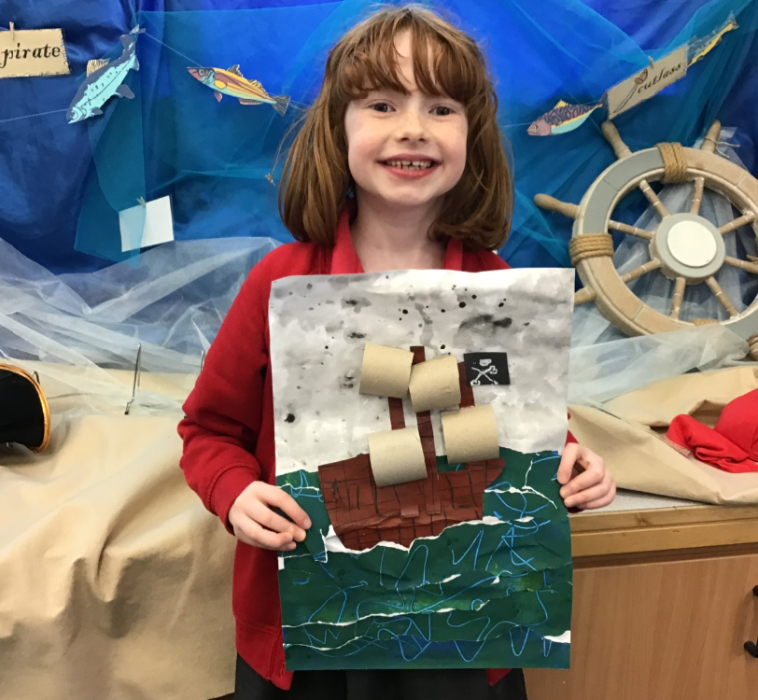
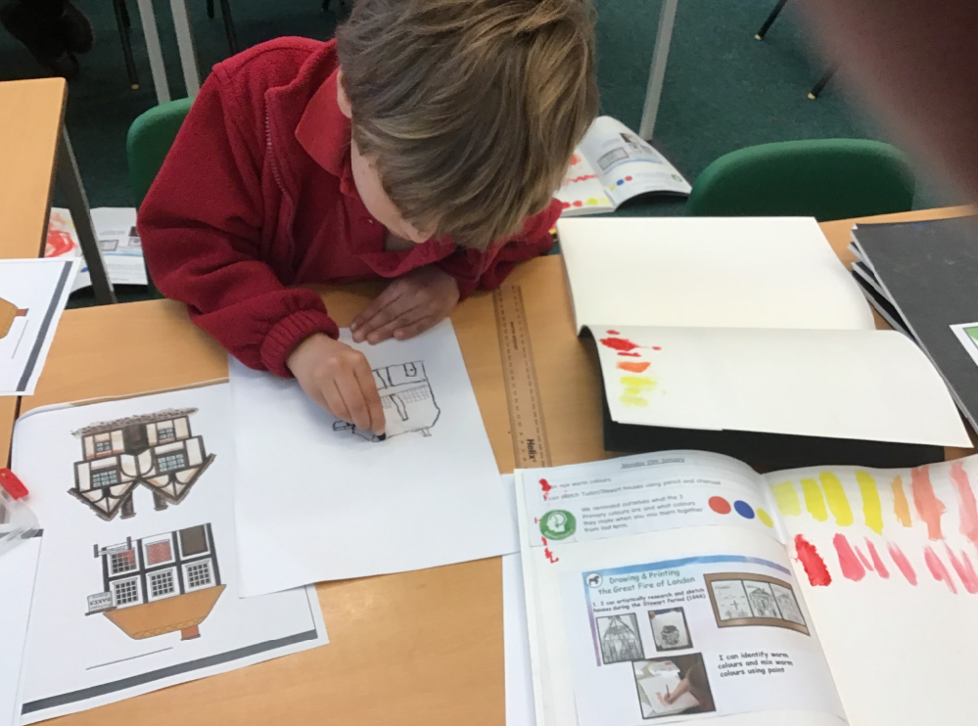
Long Term Plan Coverage – Cycle B
 | Autumn 1 | Autumn 2 | Spring 1 | Spring 2 | Summer 1 | Summer 2
Year N & R | All About Me Drawing Focus | Space Painting Focus | Julia Donaldson Collage Focus | Newbald Sculpture Focus | Minibeasts Printmaking Focus | Beside the Seaside Painting Focus
Year 1 & 2 | Transport Drawings Hot air Balloon Art Drawing, Painting & Collage Artist: Vincent Van Gogh | Polar Regions Landscapes & Animals | Great Fire of London(buildings) Printing & Drawing | Pirates and the oceans Collage / Painting -sea scape Artist: Turner /Terry Frost/Henri Matisse. Collage & Painting | An Island Home Textiles -weaving tartan Textile / Collage | Kings and Queens Sculpture -Clay tiles palaces and Castles Sculpture
Year 3 & 4 | Blitz Scenes & World War 2 Art & Propaganda Drawing & Painting | Famous American Artists, Jasper Johns, Jackson Pollock & Edward Hopper Famous Artists, Painting & Collage | The Romans Sculpture Coil pots and mosaics Sculpture & Collage |  | Forests Drawing : pastels Rainforest animals Drawing & Painting | Middle Ages Bayeux Tapestry Printing Printing
Year 5 & 6 | Propaganda Art & Paul Nash Drawing focus | Brazilian Artist Study Romero Britto Famous Artists | Ancient Greece Sculpture Masks Sculpture | Human Rights Make my voice heard Guernica –Picasso Drawing & painting | The Mayan Civilisation Printmaking : block printing & Digital Print design -string /lino printing Printing | Maps and Rivers Drawing/sketching Flora and Fauna Lilian Snelling & Drawing
Key Core Concept Areas & Coverage
Drawing
Painting
Sculpture
Printing
Textile/Collage
Within the above Concept Areas
Famous Artists
Developing Ideas

Slide 5
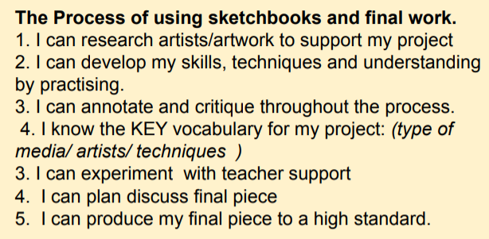

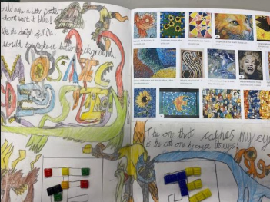
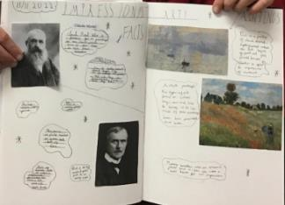
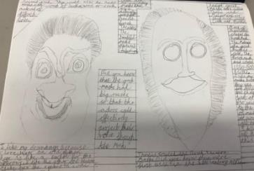
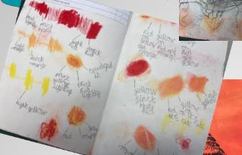
Sketchbooks
Need to show progression of the project with research /experimentation
All work needs to have short date and learning objective
Aim to have a double page allocated to a project showing aspects of the learning journey -children can take pride in this and learn how to add interesting titles/lettering and neat annotations. Of course, extra pages may be needed.

Slide 6
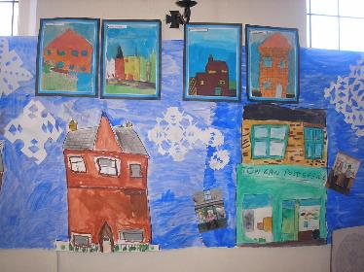
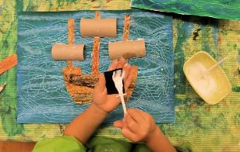
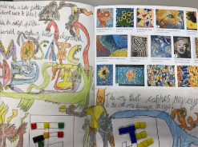
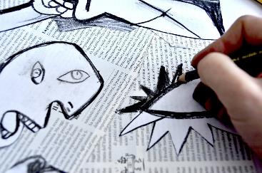
Newbald Primary School : Spring 2 - Art
Newbald Primary School : Nursery & Reception Art
Term: Spring 2 – Newbald
Project: Various activities linked to the development matters learning goals
Newbald Primary School : Year 1 & 2 Art
Term: Spring 2 – Pirates and the Oceans
Art Focus: collage /painting
Project: Stormy Seas: Painted Paper Texture Collage
Newbald Primary School : Year 3 & 4 Art
Term: Spring 2 – Romans
Art Focus: Sculpture & Collage
Project: Roman coil pots & Mosaics (Continued from Spring 1)
Newbald Primary School : Year 5 & 6 Art
Term: Spring 2 – Human Rights Activists
Art Focus: drawing / painting
Project: Making my voice heard – Picasso Artist Study

Slide 7


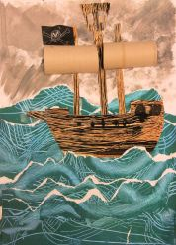
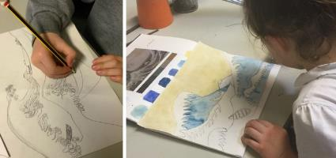
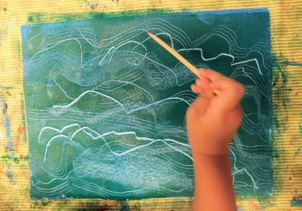
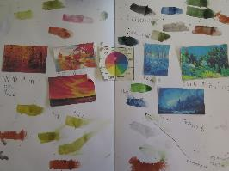
Newbald Primary School : Year 1 & 2 Art
Term: Spring 2 – Pirates and the Oceans
Art Focus: collage /painting
Project: Stormy Seas: Painted Paper Texture Collage
Year 2 – Collage Key Objectives
Accurately and artistically fold, tear, crumple and overlap papers for effect, creating images from a variety of media e.g. photocopies, fabric, crepe paper, magazines etc.
Collect, sort, group and use materials (including textiles) to create pieces of art including Cutting and shaping fabric using scissors, applying shapes using glue or stitching, applying decoration using beads, buttons, feathers etc.
To know how to make a piece of art using collage techniques
To create effective patterns by weaving
Year 2 Painting Key Objectives
Use a variety of brush sizes and types appropriately
Know how to mix paint to create the three secondary colours
Experiment with different brushes (including brushstrokes) and other painting tools;
To be able to add white and black to alter tints and shades
Year 1 - Collage Key Objectives
Fold, tear, crumple and overlap papers Create images from a variety of media e.g. photocopies, fabric, crepe paper, magazines etc.
Collect, sort, group and use materials (including textiles) to create pieces of art
To begin to know how to make a piece of art using collage techniques
To begin to create pattern by weaving
Year 1 Painting Key Objectives
Make marks using paint with a variety of tools
Know the names of the primary and secondary colours: Red, blue, yellow, green, orange, purple.
Begin to add white and black to alter tints and shades.

Slide 8
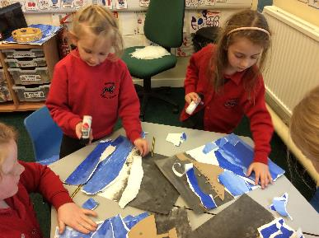
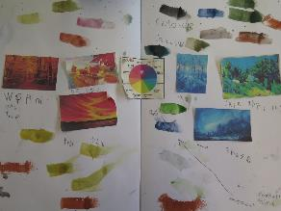

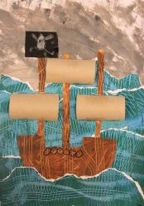
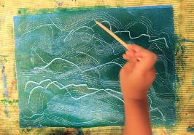
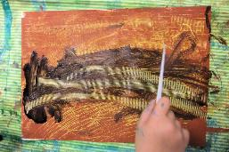
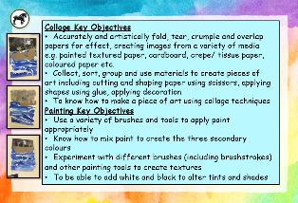
Stormy Seas:
Painted Paper Texture Collage
I can mix secondary colours and use white and black to alter tints and shades.
I can create painted textures to recreate wood water and stormy sky
I can create painted textures to recreate wood water and stormy sky
I can create a collage of a pirate ship on a stormy sea
I can create a collage of a pirate ship on a stormy sea
I can evaluate my artwork of a pirate ship on a stormy sea

Slide 9
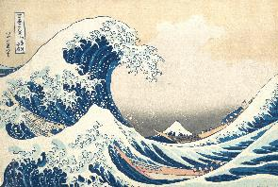
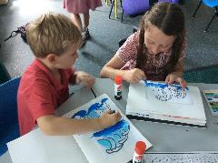
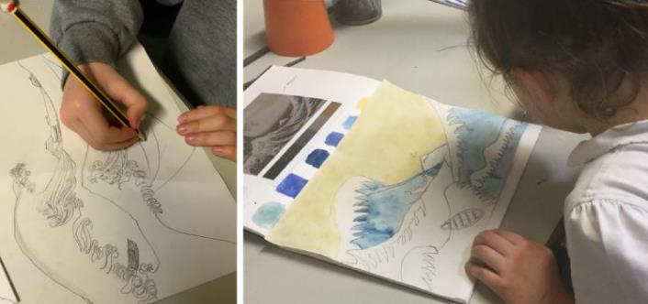
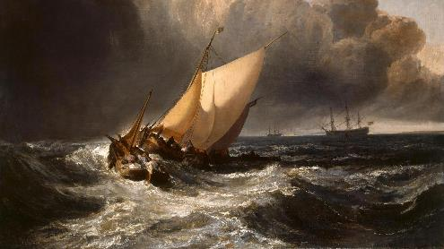
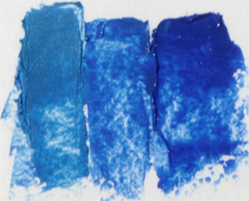
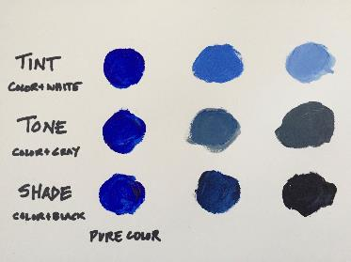
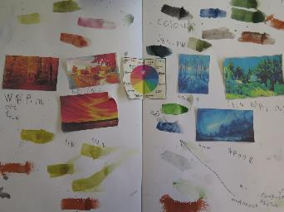
Stormy Seas:
Painted Paper Texture Collage
1. I can mix secondary colours and use white and black to alter tints and shades.
Useful Link: https://hannahsartclub.wordpress.com/2014/10/09/pirate-ships-in-stormy-seas-painted-paper-texture-collage-october-2014/
Explain that over the next few art lessons the pupils will make a collage of a pirate ship on a stormy sea. This will involve the pupils building up skills using a variety brush sizes and types as well as knowing how to mix paint to create secondary colours as well as adding white and black to these to alter the tints and shades. To begin with, look at some paintings that include scenes of seas and ships some examples could be ‘The great Wave off Kanagawa by Hokusai and or Dutch boats in a gale by J M W Turner. Children should create a sketchbook study and comment on aspects of the paintings that they like and say why they like them. Explain that these paintings may inspire their pirate ship paintings. Use this opportunity to ask the children to mix colours seen in the paintings. Explain that primary colours cannot be mixed, but by adding white or black to a colour such as blue will give different lighter or darker shades.

Slide 10

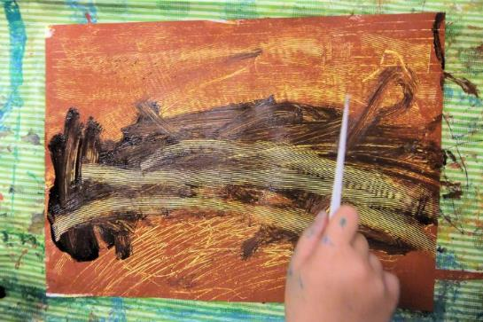
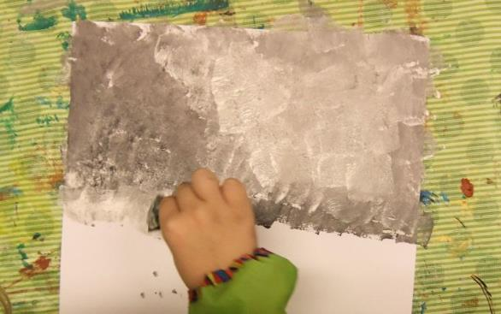
2 & 3. I can create painted textures to recreate wood water and stormy sky
Note: this session may take 2 session to complete.
Explain the project to create a pirate ship on a stormy sea scene and if necessary show the children some examples of artwork created previously (Slides 12-14)
Set the challenge for the children to create 3 A3 pieces in these sessions, that will then help them create a final piece. Explain that the pupils need a blue/green sea coloured piece, a brown wood effect piece and then a white light blue/ grey cloudy piece.
Explain that the pupils should experiment with using items to create a texture to represent the textures of water and wood, to later be transformed into ocean and ship the following sessions. The children should use a variety of brushes.
Draw on previous learning and encourage the children to think about mixing a brown and using white and black to change the tint and shade. Explain that Blue from the bottle does not reflect the true colour of sea water. Encourage the children to mix colours and experiment, like in the previous session to get the desired colours.
The children can use a variety of painting tools including using small paint-rollers to add a layer of blue-green paint, before going to work making wavy and squiggly lines with a range of “texture tools”. It may help to let a abase lighter colour dry before adding a second tone above here.
Use and experiment with everyday items such as combs, plastic knives and forks, chopsticks and lollipop sticks rather than expensive purpose-made texture tools.
For the wood a base layer of a yellow/orange works well. Once this is dry a variety of different shades of brown create a great wood effect. Children could try and use texture tools to replicate wood-grain .
Explain that both the sea and wood pieces will be cut, shopped and torn to create the desired effects, yet the cloud pice will become the background. A light blue / white first layer could be effective here with sponged white/ grey clouds on top. Scrunched paper/ foil can also give interesting effects. Only thee top third will be seen here with storm-clouds, mixing white and black paint, sponging it on in streaks and dabs.

Slide 11

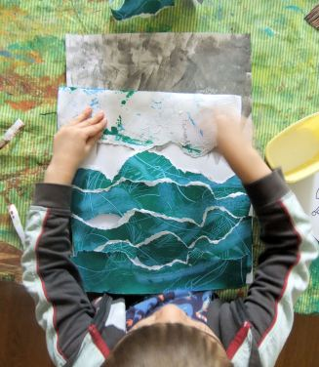
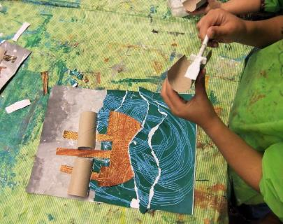
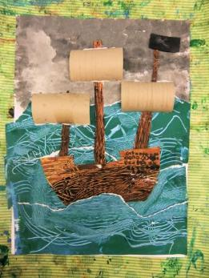
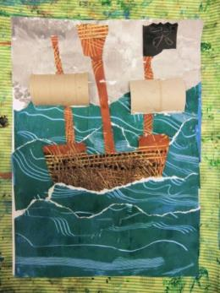
4 & 5. I can create a collage of a pirate ship on a stormy sea
Note: this session may take 2 session to complete.
Recap the last sessions and hopefully the children should have 3 painted pieces which should be dry.
These sessions are all about cutting-out, gluing and assembling. First ask the pupils to cut-out a pirate ship shape from the wood-effect paper (Younger or less able pupils could use a template to draw around) Challenge pupils to cut three strips for the ships masts and consider details such as a crow’s nest.
For the ocean children should tear the blue painted texture and then overlap these in an arrangement they are happy with that looks like a stormy sea. These can be arranged and then glued onto the cloudy piece. The torn strips should be arranged in layers beneath the stormy sky background and glued down one by one look like huge ocean waves. The ship can be tucked behind one of the waves and stuck down with three tall masts.
Adding extra detail such as sails could be a chosen colour of paper, or sails could be created from cardboard tubes that are cut in half.
Use black paper for a Jolly Rodger flag and encourage the pupils to think about extra detail such as portholes and windows that could be drawn on with fine ink pens or white / blue tissue paper could be added to the waves as a finishing touch.
Ask the children to ensure that their artwok is well fixed and each part is glued in place.

Slide 12
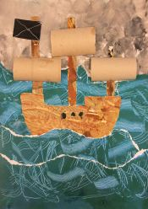
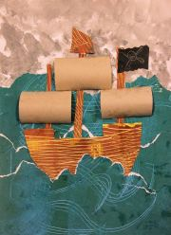
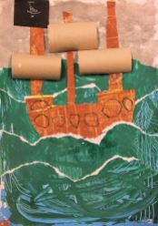
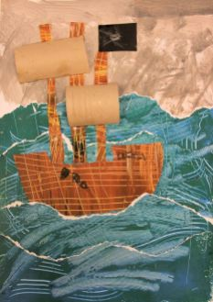
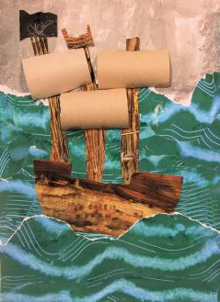
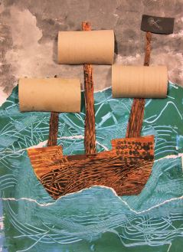
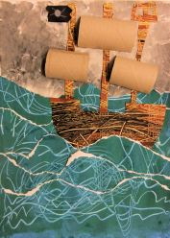

Slide 13
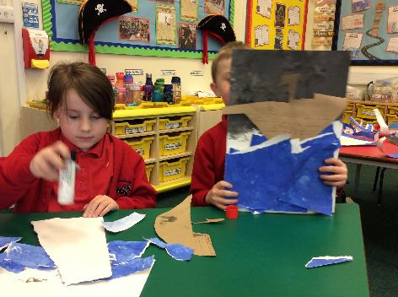
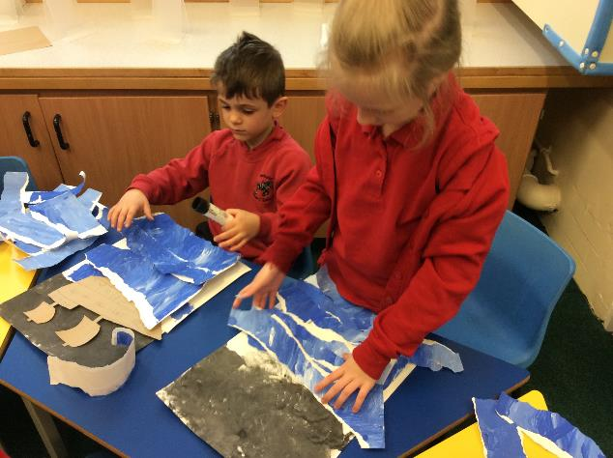







Slide 14




Slide 15


6. I can evaluate my artwork of a pirate ship on a stormy sea
Remind the children about the art unit and ask them to think about the key skills that they have learnt and used in the creation of their artwork.
Look at the adapted list of key objectives that have been covered in this unit (next slide) and share these with the children. Can the pupils say how they have met each objective?
Ensure that a picture of the final artwork is taken for each pupil. Ask the children to include this in their sketchbooks. Ask them to evaluate their artwork by annotating / writing in their sketchbook. The pupils should say what they like best about their artwork and also what could be improved. Encourage the pupils to pick 2 things they like and 1 thing that could be improved.
If time allows the pupils could walk around the class’ artwork (as a gallery) and then say something that they thought was good about each other’s work.
Collage Key Objectives
Accurately and artistically fold, tear, crumple and overlap papers for effect, creating images from a variety of media e.g. painted textured paper, cardboard, crepe/ tissue paper, coloured paper etc.
Collect, sort, group and use materials to create pieces of art including cutting and shaping paper using scissors, applying shapes using glue, applying decoration
To know how to make a piece of art using collage techniques
Painting Key Objectives
Use a variety of brushes and tools to apply paint appropriately
Know how to mix paint to create the three secondary colours
Experiment with different brushes (including brushstrokes) and other painting tools to create textures
To be able to add white and black to alter tints and shades

Slide 16



Collage Key Objectives
Accurately and artistically fold, tear, crumple and overlap papers for effect, creating images from a variety of media e.g. painted textured paper, cardboard, crepe/ tissue paper, coloured paper etc.
Collect, sort, group and use materials to create pieces of art including cutting and shaping paper using scissors, applying shapes using glue, applying decoration
To know how to make a piece of art using collage techniques
Painting Key Objectives
Use a variety of brushes and tools to apply paint appropriately
Know how to mix paint to create the three secondary colours
Experiment with different brushes (including brushstrokes) and other painting tools to create textures
To be able to add white and black to alter tints and shades

Slide 17







Newbald Primary School : Year 3 & 4 Art
Term: Spring 1 – Romans
Art Focus: Sculpture & Collage
Project: Roman coil pots & Mosaics
Year 4 - Sculpture Key Objectives
Plan, design and make models using clay/ papier-mache malleable materials from observation or imagination
Develop and refine skills in joining, extending and modelling clay
To effectively join and mould clay/other malleable material to
create a 3D object
To effectively cut, make and combine shapes to create recognisable forms;
Add materials to the sculpture to create detail effectively
Year 4 Collage Key Objectives
Know how to select appropriate materials and items, using collage effectively to reflect personality
To select colours and materials carefully to create effect, giving reasons for their choices;
Demonstrate a variety of techniques, e.g. overlapping, tessellation, mosaic and montage
Select and use techniques such as rip, tear, scrunch, fold, cut to create effective imagery
To refine work as they go to ensure precision
Year 3 - Sculpture Key Objectives
Know Begin to plan, design and make models using clay/ malleable materials from observation or imagination
Begin to develop skills in joining, extending and modelling clay
Begin to know how to join and mould clay/other malleable material to
create a 3D object
Begin to cut, make and combine shapes to create recognisable forms;
Add materials to the sculpture to create detail;
Year 3 Collage Key Objectives
Know how to select appropriate materials and items, to create a collage
To begin to select colours and materials to create effect, giving reasons for their choices;
To begin to learn and practise a variety of techniques, e.g. overlapping, tessellation, mosaic and montage;

Slide 18




Roman Coil Pots & Mosaics
I can research and make annotated sketches of Roman coil pots
I can develop my clay skills to make a Roman style coil-pot
I can create a Roman style coil-pot
I can paint and evaluate my Roman style coil-pot
I can research Roman mosaics
I can create a Roman style mosaic

Slide 19




I can research and make annotated sketches of Roman coil pots
Explain that in this unit the children are going to research and make a clay coil pot in the style to that created in ancient Rome. Firstly, ask the pupils to research Roman coil pots and record some information along with some annotated drawings of roman coil pots in their sketch books. Explain to the children that they are going to make a coil pot using clay. They will need to sketch and design what their coil pot will look like. Children should take inspiration from both observation and/ or their imagination. Encourage the pupils to annotate their work.

Slide 20





2. I can develop my clay skills to make a Roman style coil-pot
3. I can create a Roman style coil-pot
These sessions would be best suited as one to prevent clay drying out. Give the children chance to experiment with the clay and teach techniques that will be needed to create a Roman style coil pot. Demonstrate how to make a long sausage or worm that will be coiled round. Explain that slip, water and clay mix will need to be painted on to any joining surfaces and that the children will need to cross hatch using clay tools on any joining pieces of clay. This technique is also used for any pieces of clay decoration.
There are many how to make a coil pot videos on YouTube to demonstrate the process. Children can either use the coiled texture or can use their fingers to smooth the sides, which is the traditional method. Encourage the children to refer back to their drawings and designs from session 1 when making their pot. Encourage the children to develop and refine skills in joining, extending and modelling clay. The children should effectively join and mould the coiled clay to
create a 3D coil pot. Demonstrate and give the children opportunity to use clay tools where they can effectively cut, make and combine shapes to create recognisable forms that could be used as decorative features which can be added to the sculpture (pot) to create detail effectively
See the next few pages for more photograph examples.

Slide 21





Slide 22







Slide 23


Slide 24






Slide 25






Slide 26






4. I can paint and evaluate my Roman style coil-pot
When the clay Roman style coil-pots have fully dried, ask the pupils to paint their creations. Metallic gold and bronze works best here. When the paint has dried a layer of PVA glue can act like a glaze giving the pot a shiny finish. When the pot is complete include a photograph of the finished item in the pupil’s art sketch book. Invite the pupils to evaluate their work saying what worked well and what could be improved if they made another coil pot.

Slide 27




5. I can research Roman mosaics
6. I can create a Roman style mosaic
Use two sessions to research and create a mosaic. For these sessions the pupils will be learning about collage. Firstly, ask the pupils to research Roman mosaics in their Art sketchbooks. Encourage the pupils to annotate their work and collect a variety of examples to inspire their piece. Explain that they are going to research and then create a Roman style mosaic. Ask the pupils to make a sketch or create a design for a small, simple, yet effective mosaic.
Making and creating a mosaic
Ask the pupils what the Romans would have used for their mosaics. Decide if the pupils will use small tiles (available at most craft shops etc) or use coloured paper or magazines. Ask the pupils to choose and select appropriate materials to reflect personality and their designs. Ask them to think carefully about their designs and to select colours and materials carefully to create effect, giving reasons for their choices. The pupils could annotate their drawings in their sketchbooks to show this. Demonstrate a mosaic technique and explain that in this style that the Romans uysed the pieces do not overlap, yet there is not a large gap between each piece either. This is much harder for the pupils to grasp if they are using paper rather than 3D tiles. Encourage the pupils to refine their work as they go to ensure precision. Take a picture of a finished mosaic to include in the children’s sketch books (or include the final mosaic in the sketchbook). Invite the pupils to look at each other’s creations and verbally say which mosaics they liked (other than their own) and give a reason why they thought it was good.

Slide 28






Slide 29




Slide 30






Newbald Primary School : Year 5 & 6 Art
Term: Spring 2 – Human Rights Activists
Art Focus: drawing / painting
Project: Making my voice heard – Picasso Artist Study
Year 5 – Drawing Key Objectives
Work in a sustained and independent way to create a detailed drawing.
Begin to use a variety of techniques to add effects, e.g. shadows, reflection, hatching and cross-hatching;
Year 5 – Painting Key Objectives
Experiment with different media and materials for painting.
Develop a painting from a drawing.
Mix and match colours to create atmosphere and light effects.
Identify, mix and use primary, secondary, complimentary and contrasting colours
Year 5 – Collage Key Objectives
add collage to a painted or printed background;
create and arrange accurate patterns using a variety of papers and textured materials
use a range of mixed media
plan and design a collage inspired by famous collage artwork
Year 5 – Famous Artists Key Objectives
Begin to give detailed observations about notable artists’, artisans’ and designers’ work;
Begin to offer facts about notable artists’, artisans’ and designers’ lives;
Year 6 – Drawing Key Objectives
Draw for a sustained period of time over a number of sessions working on one piece.
Use different techniques for different purposes e.g. shading, hatching, blending
Use tonal contrast and mixed media
Develop their own style of drawing
Year 6 – Painting Key Objectives
Experiment with different media and materials for painting.
Develop a painting from a drawing.
Mix and match colours to create atmosphere and light effects.
Identify, mix and use primary, secondary, complimentary and contrasting colours
Year 6 – Collage Key Objectives
Effectively add collage to a painted or printed background;
Create and arrange accurate patterns using an increased variety of papers and textured materials
Effectively plan and design a collage inspired by famous collage artwork
Year 6 – Famous Artists Key Objectives
Give detailed observations about notable artists’, artisans’ and designers’ work;
Offer facts about notable artists’, artisans’ and designers’ lives;

Slide 31





Making my voice heard – Picasso Artist Study
I can identify facts about the artist Pablo Picasso and his life
I can make detailed observations about a notable artist’s work (Pablo Picasso: Guernica)
I can create a collage based upon Guernica
I can create a drawing for my Human Rights painting
I can create a painting inspired by Guernica
I can complete and evaluate my Human Rights painting

Slide 32





1. I can identify facts about the artist Pablo Picasso and his life
Explain to the children that they are going to research a notable artist: Pablo Picasso.
Set the pupils a challenge to create a double page art-sketchbook study about Pablo Picasso.
Within this activity the children should:
Offer facts about Pablo Picasso’s life
Explain what Cubism is and how Picasso is classified as a cubist painter
Make sketches of his most famous work and give detailed observations about his work
Give opinions about his work explaining why they like or dislike chosen paintings
Use some of the links below to share information with the pupils:
https://www.twinkl.co.uk/teaching-wiki/pablo-picasso#:~:text=He%20was%20born%20on%20October,Sant%C3%ADsima%20Trinidad%20Ruiz%20y%20Picasso.
https://www.twinkl.co.uk/resource/t2-a-216-all-about-picasso-powerpoint
Show the children this video, which is a dramatization of Picasso’s biography
https://www.bbc.co.uk/teach/class-clips-video/ks1-art-and-design-pablo-picasso/zr8ccmn

Slide 33



2. I can make detailed observations about a notable artist’s work (Pablo Picasso: Guernica)
Remind the pupils about their art unit and their study of the notable artist: Pablo Picasso. Recap key learning about who he was, which country he came from and which art style he was famous for using: Cubism.
Explain in this session the pupils will need to look at one of Picasso’s most famous pieces of art. Explain that this links nicely with the class topic of Human Rights Activists. With the painting Guernica, Picasso is highlighting injustice and suffering. Show the painting to the children (A copy is on the next slide and details of the paintings on the following two slides). First explain the scale. This painting is huge measuring: 11.5 feet tall by 25.5 feet long (349.3 x 776.6 cm). (slide 37) How do the children feel when they see the artwork? Is it a pleasant scene? What do they think it shows? Do they think the painting has a hidden message? If so, what do they think this is?
Watch this video clip that explains the artwork further:
https://www.youtube.com/watch?v=l_VSixma864
Ask the children to create a double page art-sketch-book study of the work of art. The pupils could use this art appreciation worksheet: https://www.twinkl.co.uk/resource/cfe2-a-010-guernica-by-picasso-art-appreciation-activity-sheet
The children should re-watch the video and stick a copy of the painting in their sketch book and label each part and write about the significance and symbolism that Picasso wanted to achieve.
Discuss the effect that he created. How does this artwork stand up for human rights? Does this painting help efforts to spread propaganda that this was a ‘great war’? How would the politicians and generals react to seeing this painting. What did Picasso want to achieve by painting Guernica. Do the children think it made a difference?

Slide 34


Slide 37


Slide 38


Slide 39



3. I can create a collage based upon Guernica
Remind the pupils about what they have done so far in this unit. Recap and challenge the children to say what they know about Pablo Picasso, Cubism and his human rights painting: Guernica.
Explain that in this session the pupils will make a collage inspired by the painting Guernica. This can be a class piece, with everyone contributing. Think about scale and think big. Explain that if each child creates an A4 (or even A3) piece in a similar cubist style then these can be brought together to make a large piece together.
Use newspaper, carefully trimmed to create a background. Prints of Spanish newspaper or articles relating to multiple human rights events the children have learnt about e.g.: Rosa Parks, MLK, Malala Yousafzai, the Suffragettes etc could work well here.
Ask the pupils to choose different details from Guernica. They should replicate the style of Picasso and draw using pencil and charcoal. This should be on a large scale. (Please see the next slide for more examples)
Bring all the artwork together. A picture of each individual piece and the overall piece can be printed, so each child has a record in their art sketchbook.

Slide 40








Slide 41








Slide 42







Slide 43


Slide 44



4. I can create a drawing for my Human Rights painting
5. I can create a painting inspired by Guernica
6. I can complete and evaluate my Human Rights painting
Recap over what the children have learnt about so far: Picasso, Cubism, Guernica etc
Explain that over the next 3 sessions the pupils will be challenged to create their own cubist human rights piece of art. The pupils should be influenced by the style of Picasso, and it should be a cubist piece. The artwork could highlight injustice from any of the human rights activists they have studied. Some of the examples have chosen the theme of global warming and litter in the oceans.
Over the sessions the pupils will need to work in their sketchbooks to think about ideas and composition. A broken glass effect can help structure the pieces (see examples). Set the pupils a challenge to include at least 1 detail from Guernica in their pieces of art.
Create a painting ensuring colour choices (monochrome) fit with the desired effect.
After the painting is complete the children will need to take a picture of their finished piece and include this in their sketchbook along with an evaluation. The pupils should consider two things that they were pleased with and one thing that they could improve upon if they were to do the piece again. Look at the following slides for examples.

Slide 45


Slide 46


Slide 47


Slide 53


